Slide 1
Global Progress of ISO non-sewered sanitation standards & online resources
ISO 30500 & ISO 24521
Presenter name
Organization
Date
Location

Slide 2
Sanitation Standards Explained in 2 Minutes
English
Français
Português
中文
Notes:
Watch a 2 minute video on Sanitation Standards in your preferred language:
Sanitation Standards Explained in 2 Minutes (English Subtitles) https://www.youtube.com/watch?v=DhNaJqEZvoM&feature=youtu.be
Normes d'assainissement en 2 minutes (sous-titres Français) https://www.youtube.com/watch?v=Gxl_DB-peqc
Normas de saneamento em 2 minutos (legendas em Português) https://www.youtube.com/watch?v=9TJPg1AkoJ0&
Sanitation Standards Explained in 2 Minutes (Chinese subtitles)/ 两分钟了解卫生标准 （中文字幕）https://www.youtube.com/watch?v=ASPT3YMJdNo or https://v.youku.com/v_show/id_XNDc4MzA0OTkyOA==.html?spm=a2hbt.13141534.app.5~5!2~5!2~5~5~5!2~5~5!2~5!2~5!2~5~5~A
Please see all videos here: https://www.youtube.com/user/ansidotorg/playlists?view=50&sort=dd&shelf_id=5

Slide 3
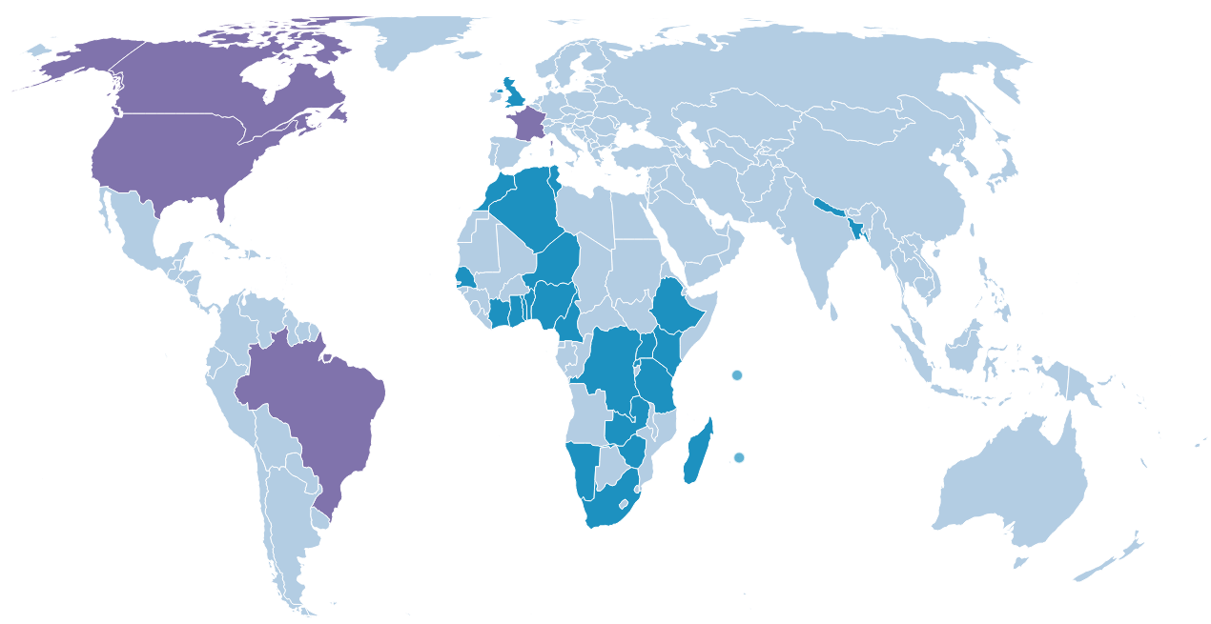
National Adoption of ISO 30500 & ISO 24521
National Adoption Map current as of February 26, 2024
Notes:
Please visit https://sanitation.ansi.org/Standard/StandardAdoptionMap for the latest map

Slide 4
ISO 30500 National Adoption Detail
Algeria, November 2019
Bangladesh, August 2019
Benin, August 2019
Brazil, November 2021
Cameroon, November 2019
Canada, November 2019
Cote d’Ivoire, June 2019
Democratic Republic of Congo, June 2019
Ethiopia, January 2021
France, November 2018
Ghana, December 2019
Kenya, April 2020
Madagascar, June 2020
Mauritius, September 2020
Morocco, April 2021
Namibia, September 2020
Nepal, January 2024
Niger, November 2020
Nigeria, October 2019
Rwanda, September 2019
Senegal, November 2018
Seychelles, August 2019
South Africa, April 2019
Tanzania, June 2020
Togo, April 2019
Tunisia, September 2020
Uganda, October 2019
United Kingdom, November 2018
United States of America, November 2019
Zambia, October 2020
Zimbabwe, March 2020
National Adoption list current as of February 26, 2024
Notes:
29 countries have adopted ISO 30500

Slide 5
Benefits of National Adoption of ISO 30500
Policy makers– can rely on global expert opinion to ensure safety of the product for its citizens without spending its own time and money
Manufacturers– have a blueprint to use to create a product that meets international guidelines, making market entry easier
Increase user confidence in the product, since it reflects a consensus of regulators, manufactures, and users from across the world
Increase the ability to widely manufacture, market, and deploy the technology where it is needed most
Facilitate free and fair global trade due to an internationally recognized system and faith in the ISO (International Organization for Standardization) name
Enable regulators and government to tap into a constantly updated source of information and experiences
Allow users of these toilets to have a dignified, reliable, safe, hygienic, odor-free experience that may even produce by-products that can be re-used by the community

Slide 6
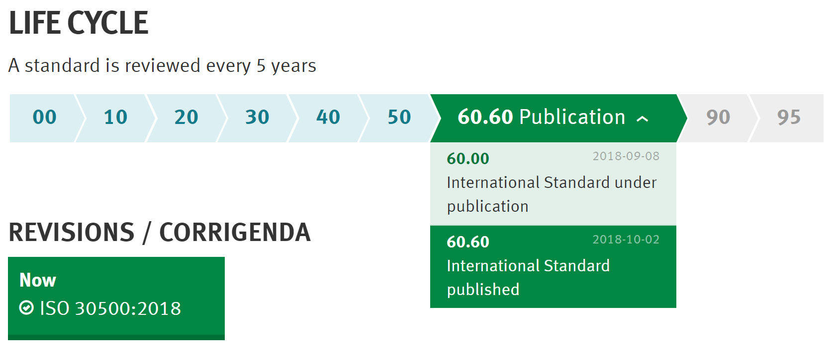
Benefits of Identical Adoption of ISO 30500
Engage directly in markets that have identically adopted ISO 30500
Abide by agreed-upon human and environmental safety standards recommended by global experts
Rely on ISO review of ISO 30500 every 5 years
Save time and money
Contribute to UN SDGs

Slide 7
ISO 24521 National Adoption Detail
Algeria, November 2019
Bangladesh, August 2019
Benin, August 2019
Cameroon, November 2019
Cote d'Ivoire, June 2019
Democratic Republic of Congo, October 2020
Ghana, December 2019
Kenya, January 2018
Madagascar, June 2020
Mauritius, September 2020
Morocco, April 2021
Namibia, September 2020
Niger, November 2020
Nepal, January 2020
Nigeria, October 2019
Rwanda, September 2019
Senegal, September 2020
Seychelles, August 2019
South Africa, May 2020
Tanzania, June 2020
Togo, July 2019
Tunisia, February 2018
Uganda, June 2017
United Kingdom, September 2016
Zambia, December 2016
Zimbabwe, May 2016
National Adoption list current as of February 26, 2024
Notes:
27 countries have adopted ISO 24521

Slide 8
ANSI’s Global Engagement– Africa ARSO
African Organisation for Standardisation (ARSO) is the continental standards organization in Africa.
ARSO created a new technical harmonization sub-committee for sanitation in early 2019.
ARSO simultaneously reviewed 4 ISO non-sewered sanitation standards in 2019: ISO 30500, ISO 24521, ISO 24510, ISO 24511.
Member bodies voted to approve all four standards identically.
ARSO Council approved all four standards as ARSO harmonized standards in November 2019.
ISO 30500, ISO 24521, ISO 24510, ISO 24511 adopted as ARSO harmonized standards.
Notes:
In Africa, regional and continental standards bodies have simultaneously reviewed ISO non-sewered sanitation standards (NSSS)
In late 2018, ANSI approached ARSO about simultaneously reviewing ISO 30500, along with ISO 24521, ISO 24510, ISO 24511.
In early 2019, ARSO established a new sanitation subcommittee to review these standards at the ARSO level.
1st sanitation committee created
In mid-2019, ARSO conducted meetings to review 4 ISO NSSS with 32 member countries participating on the Technical committee, the largest in ARSO history.

Slide 9
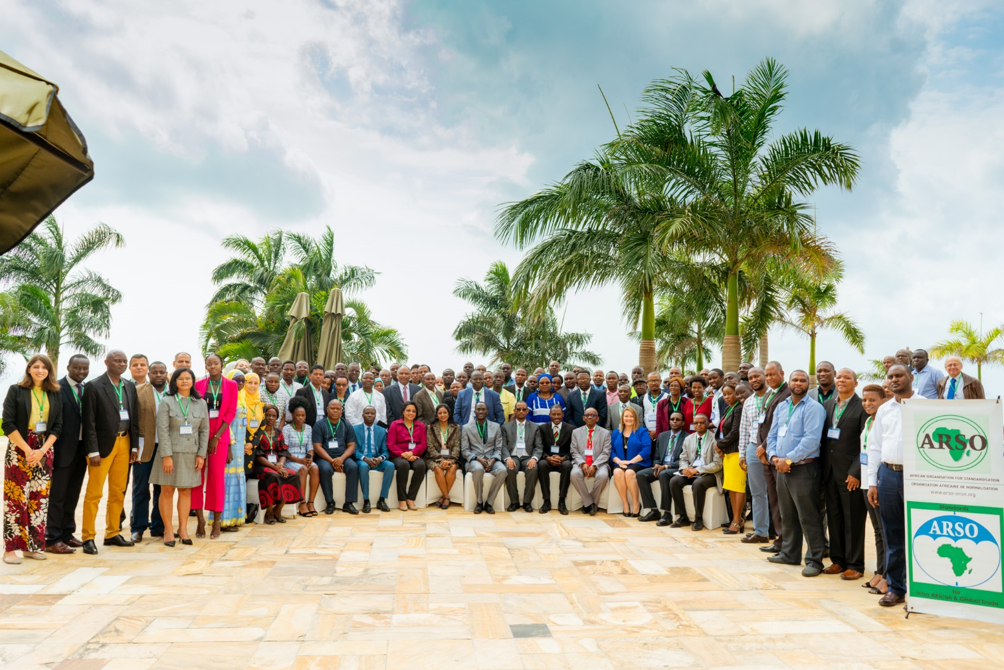
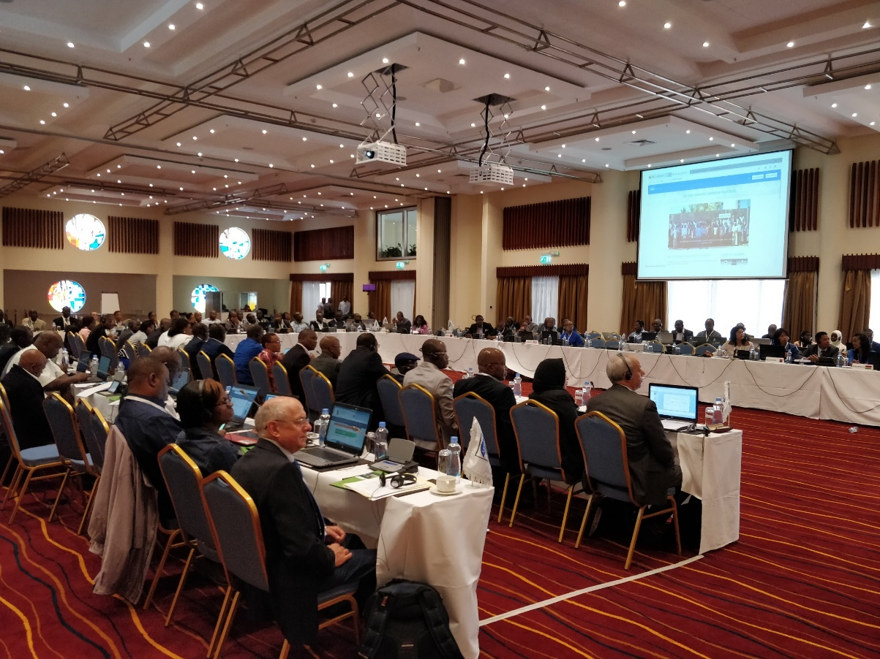
ARSO Meetings
Notes:
ARSO THC 08-3 Meetings
May 2019, Nairobi, Kenya (left)
July 2019, Dar es Salaam, Tanzania (right)

Slide 10
ANSI’s Global Engagement—West Africa ECOWAS
Economic Community of West African States (ECOWAS) is the regional standards organization for West Africa with 15 member countries.
ECOWAS created a new technical harmonization sub-committee for sanitation in mid-2019.
ECOWAS simultaneously reviewed 2 ISO non-sewered sanitation standards in 2019: ISO 30500, ISO 24521.
ECOWAS member bodies voted to approve ISO 30500 and ISO 24521 as ECOWAS harmonized standards in January 2020.
ECOWAS Technical Management Committee approved the standards as ECOWAS harmonized standards in June 2021.
Notes:
In early 2019, ANSI approached ECOWAS about simultaneously reviewing ISO 30500 and ISO 24521.
In mid-2019, ECOWAS established a new sanitation subcommittee to review these standards at the ECOWAS level.
1st sanitation sub-committee committee created
In mid-2019, ECOWAS conducted meetings to review 2 ISO non-sewered sanitation standards (ISO 30500, ISO 24521)
After approval from member bodies, the standards go to the ECOWAS TMC for review. If approved by the TMC, the ISO standards will then become ECOWAS harmonized standards. All 15 ECOWAS member countries are required to nationally adopt standards harmonized by ECOWAS through their ECOSHAM mechanism.
ECOWAS Technical Management Committee approved the standards as ECOWAS harmonized standards in June 2021

Slide 11
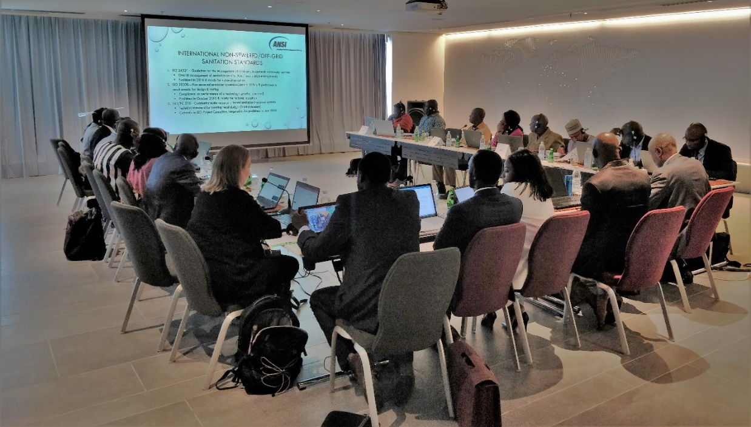
ECOWAS Meeting
Notes:
ECOWAS THC meeting
Abidjan, Côte d'Ivoire August 2019

Slide 12
ANSI’s Global Engagement—South Asia
Bangladesh
In January 2019, ANSI hosted meetings with the Bangladesh Standards & Testing Institution (BSTI) and national stakeholders.
BSTI reviewed and nationally adopted ISO 30500, ISO 24521, ISO 24510, ISO 24511, and IWA 28 (identically) in August 2019.
Bhutan
In January 2020, ANSI met with leadership at the Bhutan Standards Bureau (BSB), the Ministry of Works & Human Settlement (MWHS), and the Bhutan Toilet Organization (BTO) to discuss ISO non-sewered sanitation standards and their relevance in Bhutan.
Notes:
In addition to work in South Asia and Africa, the US and Canada worked together to nationally adopt ISO 30500 in November 2019. It is believed that products that meet ISO 30500 could also be very beneficial in the US/Canada in national parks, rural areas, and eco-friendly buildings.
Please let ANSI know if there is any way that we can ease the process for you or answer questions! We are happy to share more information about country processes/findings.

Slide 13
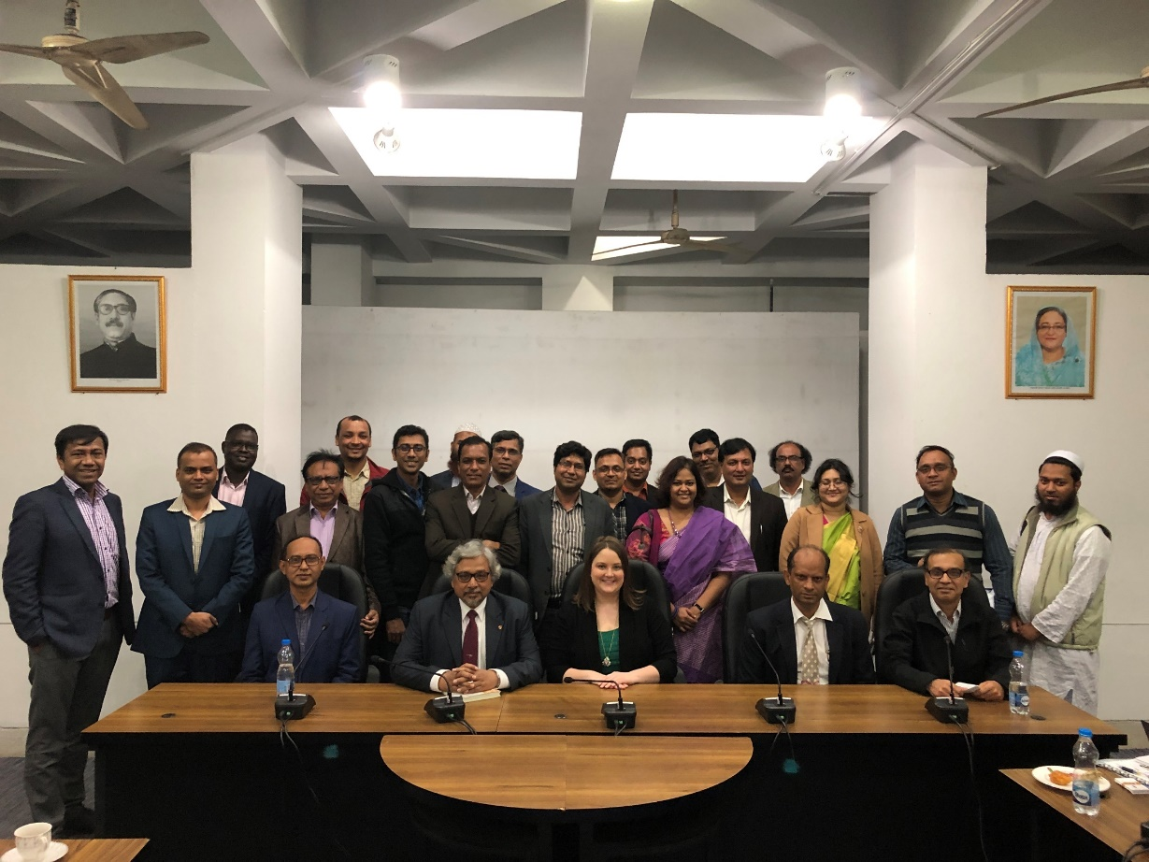
Bangladesh
Notes:
January 2019 meetings in Dhaka, Bangladesh

Slide 14
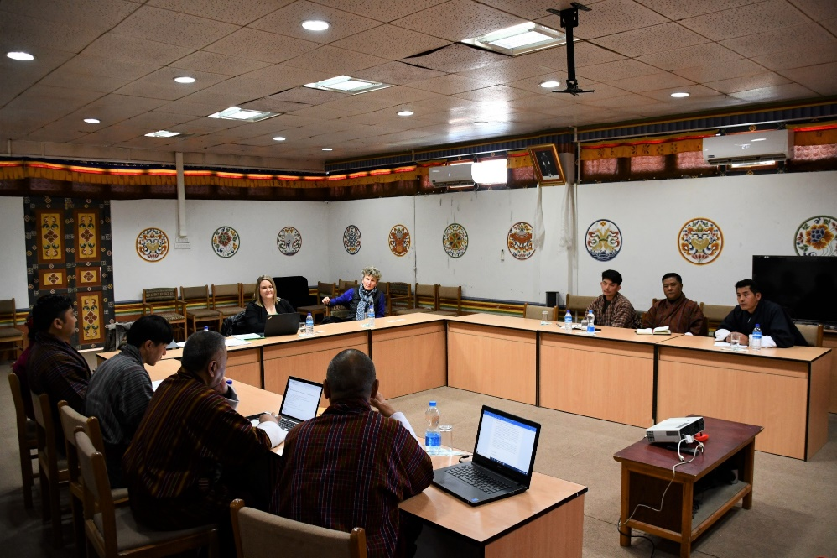
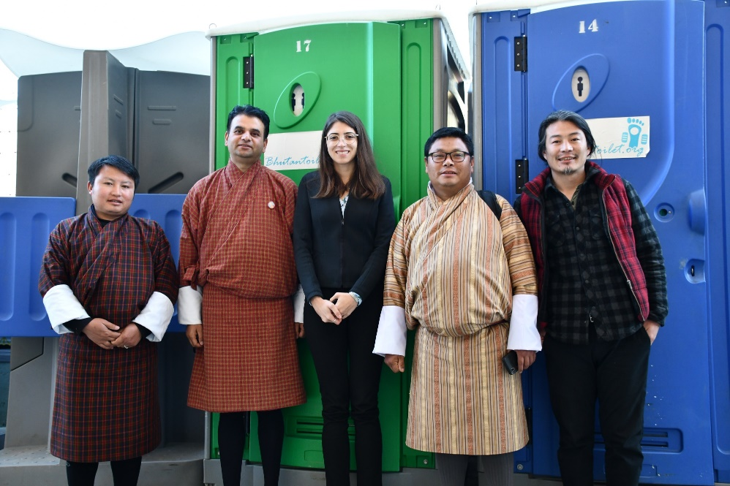
Bhutan
Notes:
January 2020 meetings in Thimphu, Bhutan

Slide 15
ANSI’s Global Engagement—South Asia
Sri Lanka
In December 2019, ANSI met with leadership at the Sri Lanka Standards Institution (SLSI) to discuss hosting an awareness-building workshop with key national stakeholders.
SLSI hosted an awareness building workshop on ISO non-sewered sanitation standards with national water, sanitation and hygiene (WASH) stakeholders in Colombo in January 2020.

Slide 16
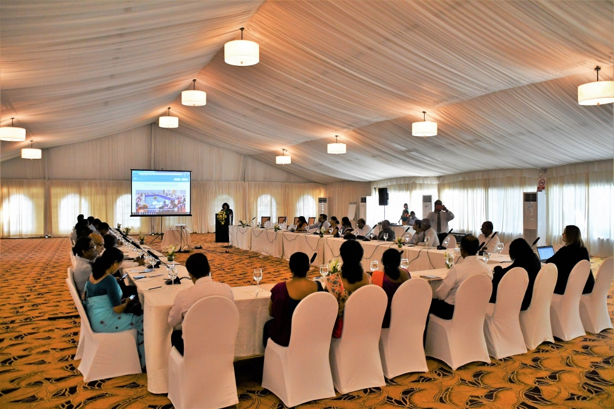
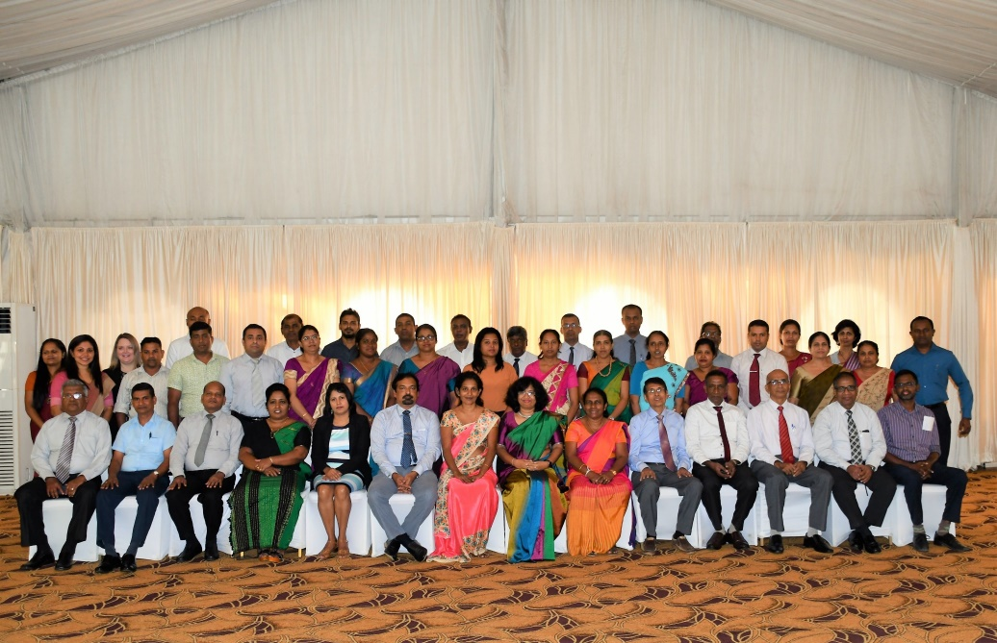
Sri Lanka
Notes:
January 2020 Non-sewered sanitation standards workshop hosted by Sri Lanka Standards Institution (SLSI)
Colombo, Sri Lanka

Slide 17
ANSI’s Global Engagement—South Asia
Nepal
In May 2018, ANSI held meetings with key government and private sector stakeholders at the national level to discuss ISO non-sewered sanitation standards.
Nepal Bureau of Standards & Metrology (NBSM) reviewed and nationally adopted ISO 24521 in January 2020.
NBSM is currently reviewing ISO 24510 and ISO 24511, and national adoption is expected in 2020.
NBSM expects to begin review of ISO 30500 in 2020.
Pakistan and Afghanistan
Afghanistan National Standards Authority (ANSA) and Pakistan Standards Quality Control Authority (PSQCA) have expressed interest in participating in awareness-building workshops on ISO 30500 and ISO 24521.
Cap-Net UNDP facilitated virtual trainings in 2020.

Slide 18
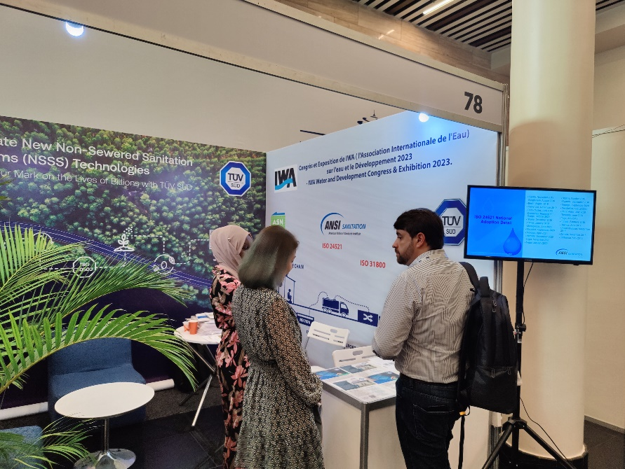
Find ANSI at International WASH Conferences
View all out past event photos!
International Water Association Development Conference
Rwanda, 2023
World Water Forum
Senegal 2022

Slide 19
https://sanitation.ansi.org/
sanitation@ansi.org

