Slide 1
agenda: a new household toilet
the need
the technology
why it matters
your role

Slide 2
the challenge
2 billion people without access to safe, clean toilets
1 million preventable deaths each year
Notes:
Effective sanitation is linked to better health, safety, and livelihood, however more than 2 billion people in the world currently have no access to safe, clean toilets, a situation which contributes to over one million preventable deaths every year.

Slide 3
a solution
ISO 30500 is a technical document containing specifications for a new, technology-neutral household toilet product
not connected to a networked sewer or drainage system
treats waste all by itself
Notes:
A non-sewered sanitation system is a toilet system with a prefabricated integration treatment unit. It may sound complicated – but it’s as simple for the user, and maybe even easier, than the systems they’re currently using.
The front-end component of the toilet remains the same – whether it’s a squat toilet, western toilet, or any other kind.
The back-end component of a non-sewered sanitation system collects, conveys, and fully treats the specific input within the system to allow for safe reuse or disposal of the generated solid, liquid, and gaseous output.
It’s not connected to a networked sewer or networked drainage system – so there’s no water required to flush, and no septic or pit latrine to empty.

Slide 4
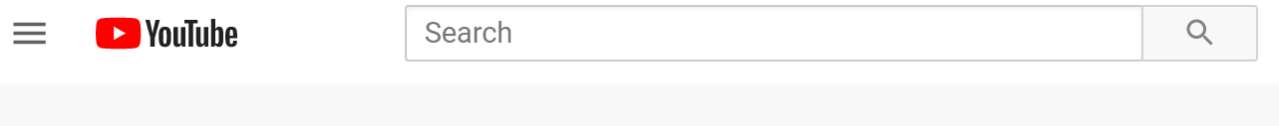

Sanitation Standards Explained in 2 Minutes
English
Français
Português
中文
Notes:
Watch a 2 minute video explaining Sanitation Standards in your preferred language:
Sanitation Standards Explained in 2 Minutes (English Subtitles) https://www.youtube.com/watch?v=DhNaJqEZvoM&feature=youtu.be
Normes d'assainissement en 2 minutes (sous-titres Français) https://www.youtube.com/watch?v=Gxl_DB-peqc
Normas de saneamento em 2 minutos (legendas em Português): https://www.youtube.com/watch?v=zxv-7lPT1xQ
Sanitation Standards Explained in 2 Minutes (Chinese subtitles)/ 两分钟了解卫生标准 （中文字幕）https://www.youtube.com/watch?v=ASPT3YMJdNo or https://v.youku.com/v_show/id_XNDc4MzA0OTkyOA==.html?spm=a2hbt.13141534.app.5~5!2~5!2~5~5~5!2~5~5!2~5!2~5!2~5~5~A
Please see all videos here: https://www.youtube.com/user/ansidotorg/playlists?view=50&sort=dd&shelf_id=5

Slide 5
how it works
front-end typically looks much like a traditional toilet system
back-end treats the input using a range of sophisticated biological, chemical, or physical processes
Notes:
In most cases, the front-end looks much like a traditional toilet system (Urinal, squatting pan, sitting pan); and the user will be unaware that the back-end is anything out of what they’re used to.
The back-end, however, is quite sophisticated. It treats the input (feces, urine, menstrual blood, toilet paper, anal cleansing water) using a range of biological or chemical to physical unit processes (e.g. anaerobic & aerobic digestion, combustion, electrochemical disinfection, membranes).
Some systems use one of these technologies/processes while other systems apply various unit processes in combination.

Slide 6
Notes:
Concept of a non-sewered sanitation system, as shown in the ISO 30500 standard.

Slide 7
an option for everyone
non-sewered sanitation systems offer a sustainable, practical option wherever conventional sewer systems or other onsite solutions aren’t feasible
public toilets
national parks
green buildings
rural communities
urban settings
informal settlements
Notes:
Non-sewered sanitation systems (NSSS) and ISO 30500 can benefit all of our communities
In higher income communities, a NSSS is a sustainable solution to wasteful systems commonly used today, which overuse water and electricity
In lower income communities, these systems can provide a safer, hygienic option without the need for consistent electric or sewer connection

Slide 8
global consensus
48 countries came together to review the standard
  Industry
  Government
  Academia
  NGOs
Notes:
ANSI approached ISO about starting this process of creating an international standard for sustainable, non-sewered sanitation systems (which eventually became ISO 30500) back in 2016.
After a committee of experts (PC 305) – including representatives from industry, government, academia, and NGOs – from across the globe developed the standard, the testing of prototypes began in South Africa with the University of KwaZulu-Natal in 2017. Prototypes attempting to meet ISO 30500 performance and testing criteria have also been tested in India and China.
Since 2018, ANSI has been advocating to promote national recognition of this standard. ANSI recognizes the incredible potential of non-sewered sanitation standards to transform communities around the world. Please contact ANSI or your national standards body if you have questions about non-sewered sanitation standards.

Slide 9
Project Committee 305 members, representing 48 countries

Slide 10

What’s a Standard, and How Does it Benefit Global Water and Sanitation?
English
Français
Português
中文
Notes:
Watch a short video on how standards can improve water, sanitation and hygiene in your preferred language:
What’s a Standard, and How Does it Benefit Global Water and Sanitation? (English Subtitles) https://www.youtube.com/watch?v=tH-UzBsslSc
Qu’est-ce qu’une norme et quels sont ses avantages pour le secteur de l’eau et l’assainissement (sous-titres Français) https://www.youtube.com/watch?v=UEJhNzE-p-I
Que é uma Norma e como beneficia a água e o saneamento global? (legendas) https://youtu.be/zxv-7lPT1xQ
What’s a Standard, and How Does it Benefit Global Water and Sanitation? // 什么是标准， 它对于全球水和卫生有何益处？（中文字幕）https://www.youtube.com/watch?v=5W4FvUuEjoE or https://v.youku.com/v_show/id_XNDc4MzAyMjEzMg==.html?spm=a2hbt.13141534.app.5~5!2~5!2~5~5~5!2~5~5!2~5!2~5!2~5~5!2~A
Please see all videos here: https://www.youtube.com/user/ansidotorg/playlists?view=50&sort=dd&shelf_id=5

Slide 11
ISO specifications
quality metrics
solid and liquid discharges
air, odor and noise emissions
criteria for production
safety
functionality
usability
reliability
maintainability
compatibility with environmental protection goals
Notes:
In order to meet the standard, prototypes and products will have to uphold a quality standard for solid discharges; liquid discharges; odor; air emissions; and noise emissions, and meet certain criteria for safety; functionality; usability; reliability; maintainability; and compatibility with environmental protection goals

Slide 12
why a standard?
a tool for policymakers working toward more sustainable sanitation systems
  facilitate innovation
  break down trade barriers to international markets
  conserve precious water
  achieve the SDGs
  spur economic empowerment
Notes:
Adopting ISO 30500 has many benefits for [insert your country name].
It can save time and money: policymakers won’t have to spend resources to ensure the safety of products, and manufacturers will be given a guideline to create products which will meet international standards, making market entry easier.
Regulators and the government will be able to tap into a constantly updated source of information and experiences, ensuring the most efficient system.

Slide 13
why a standard?
a guideline to widely manufacture, market, and deploy the technology where it’s needed most
  provide a benchmark to ensure quality and safety
  increase productivity and efficiency
  minimize waste and errors
  reduce costs
Notes:
A standard will increase the ability of businesses to widely manufacture, market, and deploy technology, and help facilitate international trade by using a universally recognized system and capitalizing on the faith in the ISO name.

Slide 14
why a standard?
a safe, reliable, hygienic toilet for families and communities
Notes:
End users of these toilets will be guaranteed a reliable, safe, hygienic, and odorless experience which may even produce by-products that can be re-used by the community.

Slide 15
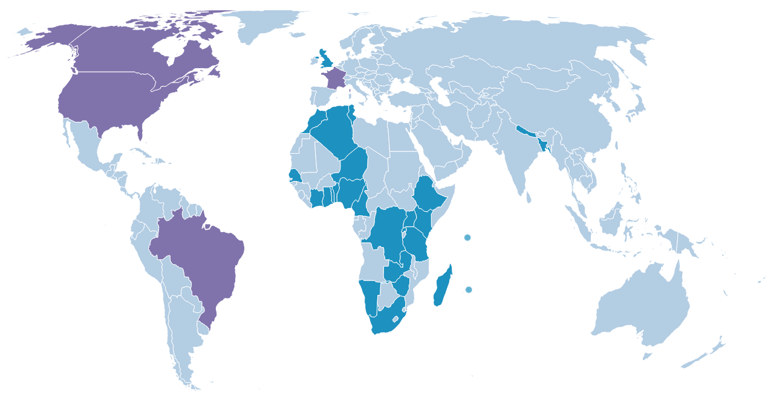

National Adoptions of ISO 30500 & ISO 24521
National Adoption Map current as of February 26, 2024
Notes:
Please visit https://sanitation.ansi.org/Standard/StandardAdoptionMap for the latest map

Slide 16
your role & next steps
how can you work toward adoption and use of the standards?
identify key sanitation standards, regulations, or laws already in place
understand the process for nationally adopting a new international standard
host a national workshop to educate stakeholders in your country or community
gather ideas from key stakeholders and earn their buy-in
conduct trainings for WASH sector employees

Slide 17
ANSI is here to help
partnerships and networking
one-on-one technical assistance in working toward adoption
ongoing and follow-up assistance to support implementation and use
additional education and training materials

Slide 18
ISO 30500
dignity
progress
prosperity
https://sanitation.ansi.org/
sanitation@ansi.org

