Slide 1
ISO 30500:
A Global Consensus Process
Presenter name
Organization
Date
Location

Slide 2
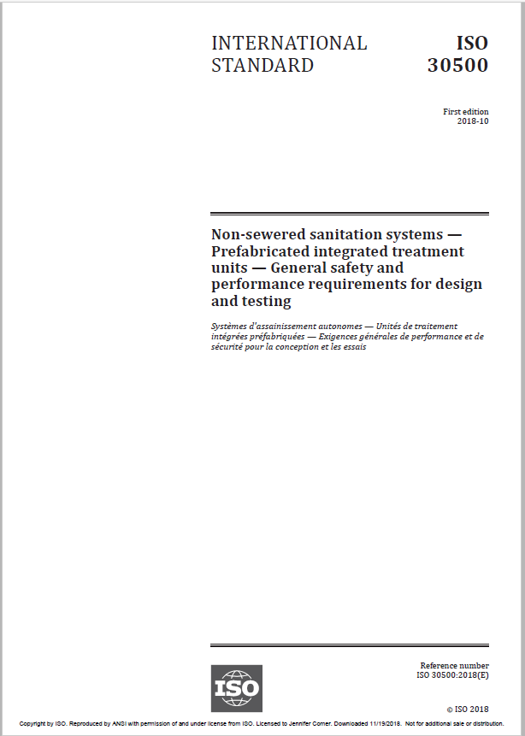
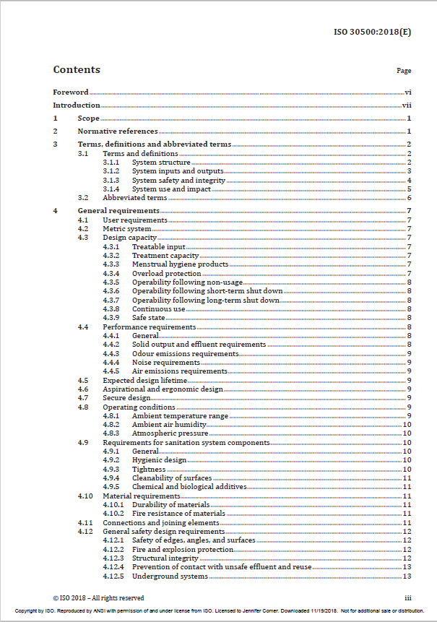
Introducing ISO 30500
Notes:
ISO 30500 is an international standard developed in the International Organization for Standardization, by a committee of experts – Project Committee 305. This section contains more information about how the ISO process works and why it results in a robust, technically sound document.

Slide 3

A Network of National Standards Bodies
Industry
Government
Stakeholder engagement and due process
ISO Policies
National standards body (ISO member)
Academia
ISO Standards
Consumers
Notes:
The International Organization for Standardization (ISO) is an independent, non-governmental international organization with a membership of 163 national standards bodies. Experts from all over the world work collaboratively in technical committees to develop voluntary, consensus-based, market-relevant international standards that support innovation and provide solutions to global challenges.
The American National Standards Institute (ANSI) is the U.S. member of ISO, and works to initiate standards-based solutions for national and global priorities. The Association Sénégalaise de Normalisation (ASN), Senegal’s national standards body and ISO member, develops national standards and oversees conformity assessment activities that promote safety and quality.
ANSI and ASN were the twinned secretariat for ISO PC 305.
Developed by groups of engineers and other experts, voluntary standards are consensus based, and are the result of cooperation between technical professionals, companies, industry groups, and government and consumer representatives. Standards represent the combined expertise of those with a stake in the technology, working to agree upon requirements and best practices.
One member per country – cannot be an individual or company
Members are responsible for organizing consultations with stakeholders in the country in order to develop a national position
Members represent their countries in the development of ISO policies and ISO standards (via project and technical committees)

Slide 4
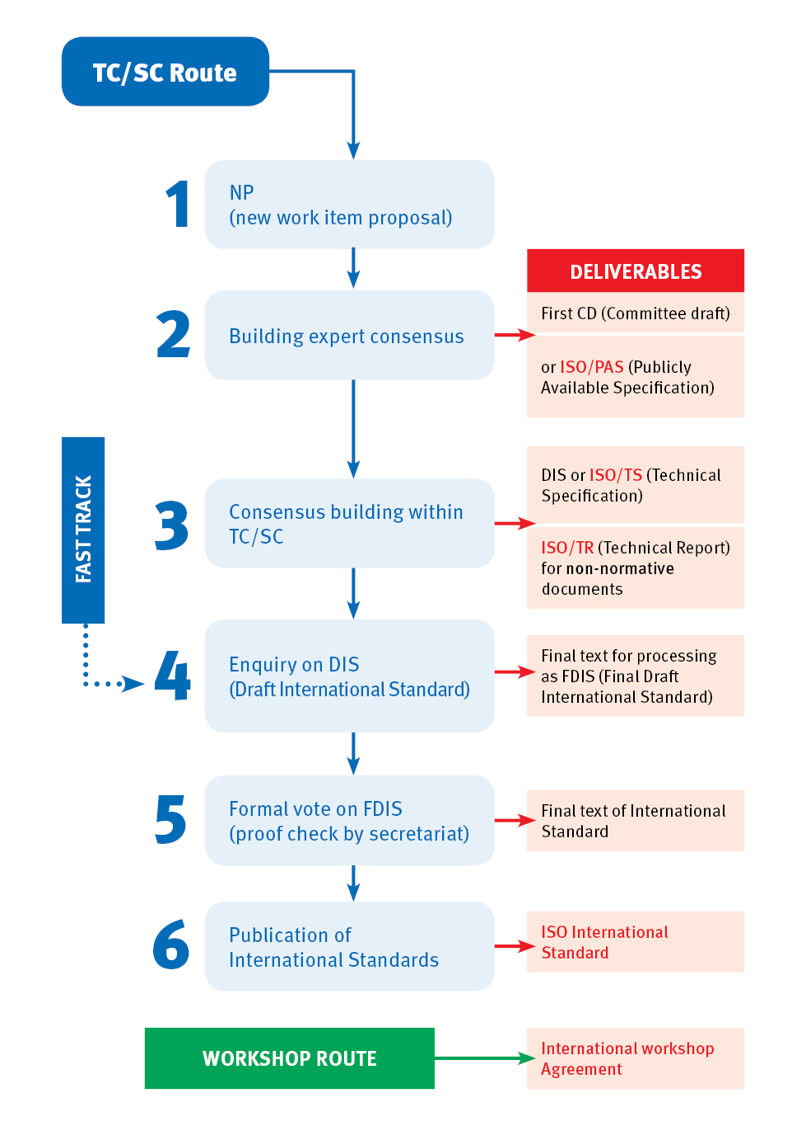
ISO Standard Development Process
Notes:
Like a symphony, it takes a lot of people working together to develop a standard. ISO’s role is similar to that of a conductor, while the orchestra is made up of independent technical experts nominated by our members.
The experts form a technical committee that is responsible for a specific subject area. They begin the process with the development of a draft that meets a specific market need. This is then shared for commenting and further discussion.
The voting process is the key to consensus. If that’s achieved then the draft is on its way to becoming an ISO standard. If agreement isn’t reached then the draft will be modified further, and voted on again.
From first proposal to final publication, developing a standard usually takes about 3 years.
This flow-chart details the main stages in the process.
Key principles in standard development
1. ISO standards respond to a need in the market
ISO does not decide when to develop a new standard, but responds to a request from industry or other stakeholders such as consumer groups. Typically, an industry sector or group communicates the need for a standard to its national member who then contacts ISO.
2. ISO standards are based on global expert opinion
ISO standards are developed by groups of experts from all over the world, that are part of larger groups called technical committees. These experts negotiate all aspects of the standard, including its scope, key definitions and content. Details can be found in the list of technical committees.
3. ISO standards are developed through a multi-stakeholder process
The technical committees are made up of experts from the relevant industry, but also from consumer associations, academia, NGOs and government. standards.
4. ISO standards are based on a consensus
Developing ISO standards is a consensus-based approach and comments from all stakeholders are taken into account.

Slide 5
ISO Project Committee (PC) 305 ISO PC 305 developed what would become ISO 30500
January 25, 2016
New Work Item Proposal (NWIP) circulated to ISO member bodies for three-month vote
2016
May 30, 2016
2016
PC 305 created
October 24, 2016
1st PC 305 meeting, Washington, DC, USA
2016
January 31, 2017
2017
First Working Group (WG) 1 meeting, Dakar, Senegal
Notes:
As noted earlier, ISO standard development normally takes 3 years. Given the rapid pace of technology development and the importance of this sector, an accelerated approach was taken and PC 305 completed its work in approximately 2 years.

Slide 6
ISO Project Committee (PC) 305 ISO PC 305 developed what would become ISO 30500
June 19, 2017
2017
2nd PC 305 and WG 1 meetings, Durban, South Africa
Sept 25-27, 2017
3rd WG 1 meeting, Berlin, Germany
2017
November 14, 2017
2017
Draft International Standard (DIS) 30500 submitted to ISO for member body comment and vote
May 21-25, 2018
3rd PC 305 and 4th WG 1 meeting, Nepal
2018
July 12, 2018
2018
Final Draft International Standard (FDIS) 30500 circulated to ISO member bodies for final vote before publication
October 1, 2018
2018
ISO 30500 published

Slide 7
ISO Project Committee (PC) 305 ISO 30500 Revision
June 22, 2023
2023
New project to revise ISO 30500:2018 approved
November 3, 2023
Working Draft approved
2023
May 16, 2024
2024
Committee Draft approved for registration and DIS registered
August 2, 2024
DIS ballot initiated with 12 week comment period
2024
January 10, 2025
2025
DIS approved for registration as FDIS and 8 weeks ballot initiated in April 2025.
July 25, 2025
2025
ISO 30500:2025 published

Slide 8
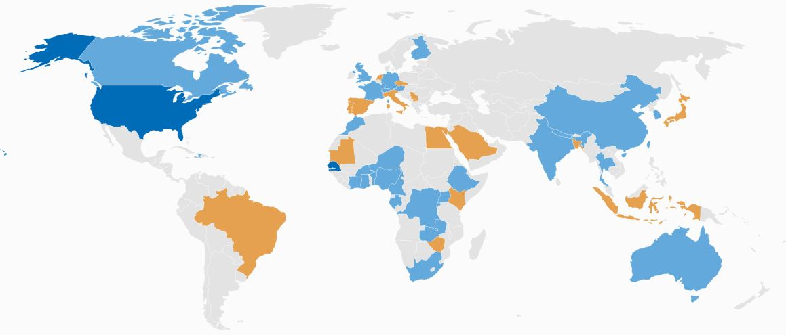
PC 305: Representing a Global Community
ISO 30500 was developed with experts from 48 countries, representing industry, government, academia and non-governmental organizations.
Notes:
Experts from 46 countries, representing government, industry, academia, and other stakeholder categories developed ISO 30500.

Slide 9
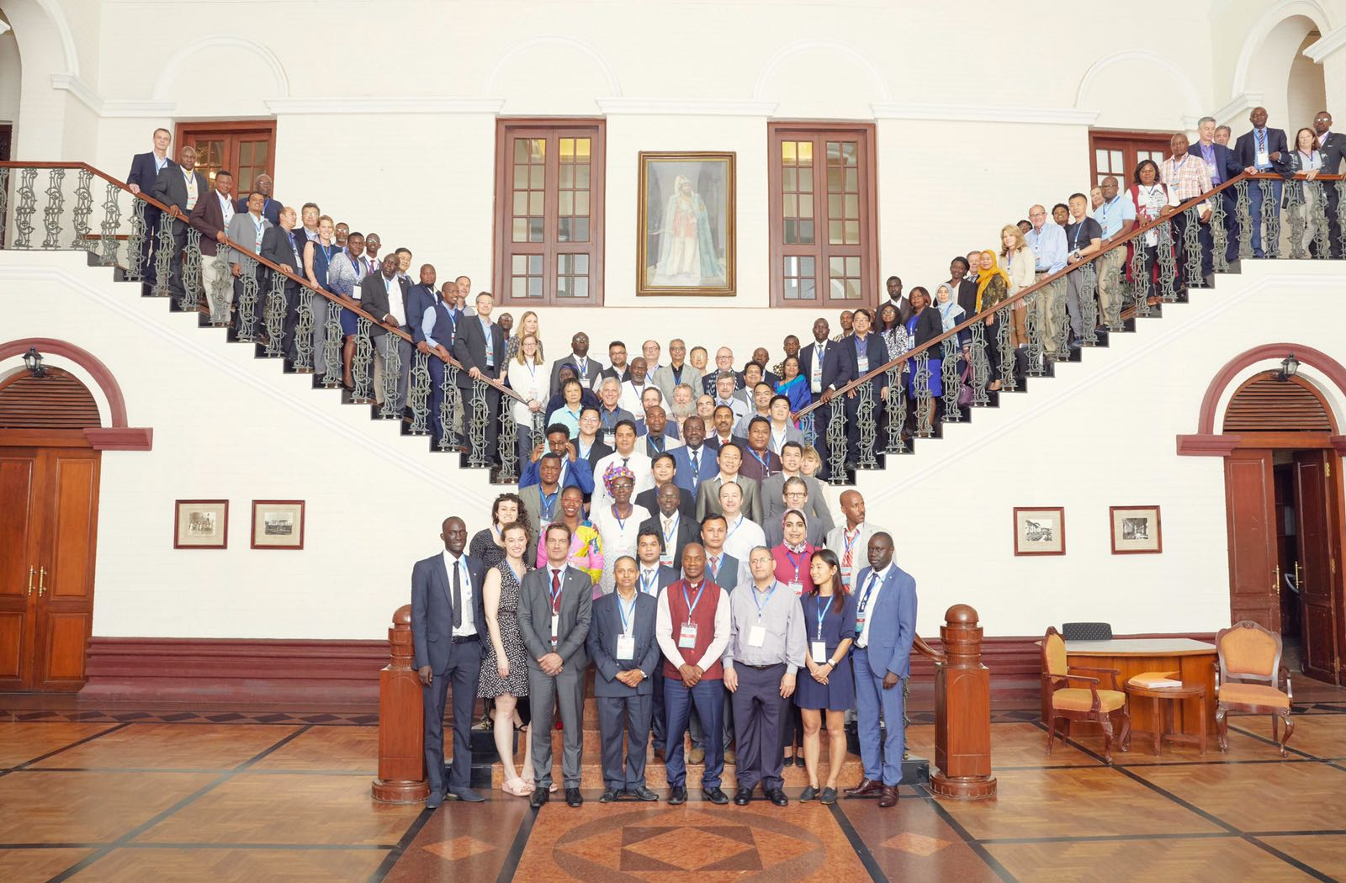
PC 305: Representing a Global Community
PC 305 consisted of experts from 48 countries, representing industry, government, academia and non-governmental organizations.
Notes:
Extra effort was undertaken to ensure that PC 305 included global representation, including from materially affected stakeholders.
After a committee of experts – including representatives from industry, government, academia, and NGOs – from across the globe developed the standard, the testing of prototypes began in South Africa with the University of KwaZulu-Natal in 2017. Prototypes attempting to meet ISO 30500 performance and testing criteria have also been tested in India and China.
Since 2018, ANSI has been advocating to promote national recognition of this standard. ANSI recognizes the incredible potential of non-sewered sanitation standards to transform communities around the world. Please contact ANSI or your national standards body if you have questions about non-sewered sanitation standards.

Slide 10
https://sanitation.ansi.org/
sanitation@ansi.org

