Slide 1

Introduction to
ISO 30500
Non-sewered sanitation systems – Prefabricated integrated treatment units – General safety and performance requirements for design and testing.
Notes:
This presentation was prepared by TÜV SÜD.
Introduction

Slide 2

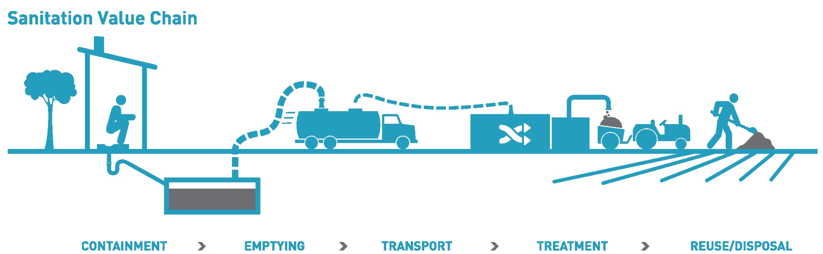
ISO 30500 and ISO 31800 – Forward Looking Standards
ISO 30500 - Non-sewered sanitation systems — Prefabricated integrated treatment units — General safety and performance requirements for design and testing
ISO 31800 - Faecal sludge treatment units — Energy independent, prefabricated, community-scale, resource recovery units — Safety and performance requirements
  “International Standards are key to the progression of new sanitation technology and developing an industry that saves lives”
- ISO Secretary-General Sergio Mujica
+ Treatment
Credits: Bill & Melinda Gates Foundation

Slide 3











Overview of ISO 30500
Frontend and backend
Backend only
Frontend only
ISO 30500 Requirements
Human Health
Environmental
Air Emissions
Odour
Noise
Electrical & EMC
Mechanical & HAZOP

Slide 4





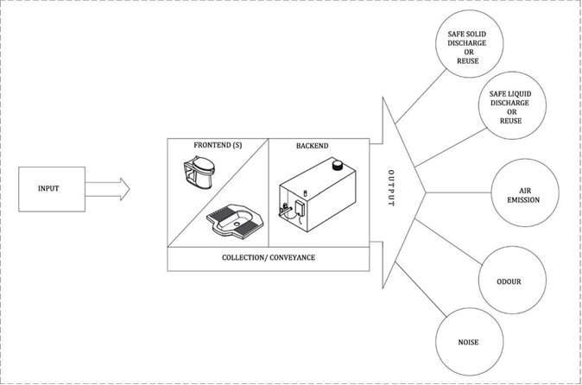
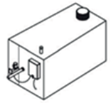






Scope of ISO 30500
SAFE SOLID DISCHARGE OR
REUSE
Certification bodies – ISO 17076 accreditated
All laboratories – ISO 17025 accreditated
MECHANICAL
SAFE LIQUID DISCHARGE OR
REUSE
FRONTEND(S)
BACKEND
OUTPUT
INPUT
AIR
EMISSION
COLLECTION/CONVEYANCE
ODOUR
EMC
ELECTRICAL
NOISE
Notes:
The systems are generally separated by a frontend for the users. And a backend where the entire processing takes place.
Some of the main process output measurements are:
Solid and effluent discharge or reuse
Air emissions measurements
Odour
And Noise measurements

Slide 5
ISO 30500 Certification Classes & Test Duration
Class
Class 1: Non-biological treatment processes one frontend – backend
Class 2: Biological treatment processes one frontend – multiple backends
Class 3: NSSSs – Biological treatment process multiple frontend – multiple backends
Class 4: Non-biological treatment processes multiple frontend – backend
Class 1 & 4 System
  Document Checks
  Controlled Laboratory Testing ≥ 22 days
  Field Testing for ≥ 30 days
Class 2 & 3 System
  Document Checks
  Controlled Laboratory Testing ≥ 22 days
  Field Testing for ≥ 5 months
No. of frontend | Class 1 & 2 | Class 3 & 4
 | 1 frontend | 2-5 frontend | > 5 frontend
Superstructure requirement / Frontend testing | 1 | 2 | 3
Notes:
The Non-sewered sanitation systems can be classified into 4 different classes.

Slide 6
ISO 30500 Overview
General Technical Information
General Safety
Documentation Checks
Process Design Safety
Material Safety
Mech. & Elec. Safety
User Interface Experience
Maintenance Design
ISO 30500
Sustainability
Loading Patterns
Loading Patterns
Controlled Laboratory Testing
Mechanical Requirements
Environmental Parameters
Human Health Parameters
Air Emissions Parameters
Acoustics Parameters
Odour Requirements
Electrical Requirements
Field Verification of Performance
Field Testing Guidelines
Environmental Parameters
Human Health Parameters
Notes:
There are generally 3 main sections to the ISO30500. Document checks, controlled laboratory testing and the field verification.
The first requirement is for document checks and required tests to supplement missing documents.

Slide 7
Loading Patterns
General Technical Information
General Safety
Documentation Checks
Process Design Safety
Schedule
Material Safety
Mech. & Elec. Safety
User Interface Experience
Maintenance Design
Normal (7.2.8.1)
ISO 30500
Sustainability
Loading Patterns
Controlled Laboratory Testing
Mechanical Requirements
Stress (7.2.8.2)
Environmental Parameters
Human Health Parameters
Diarrhoea (A.3.8.10)
Air Emissions Parameters
Acoustics Parameters
Odour Requirements
Electrical Requirements
Field Verification of Performance
Field Testing Guidelines
Environmental Parameters
Human Health Parameters
Notes:
There are generally 3 main sections to the ISO30500. Document checks, controlled laboratory testing and the field verification.
The first requirement is for document checks and required tests to supplement missing documents.

Slide 8
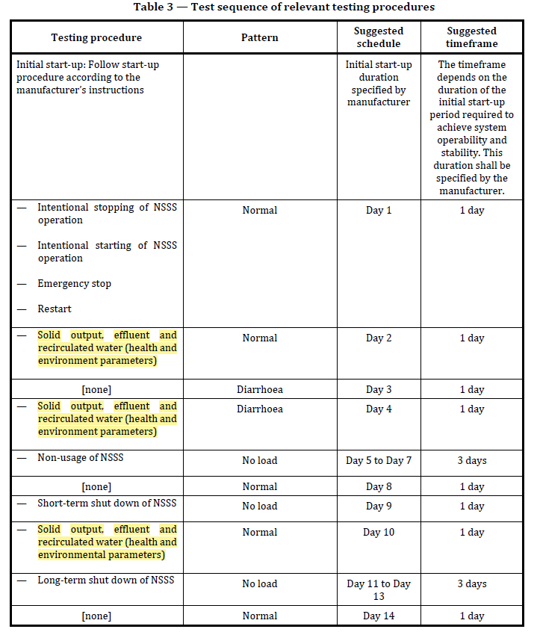
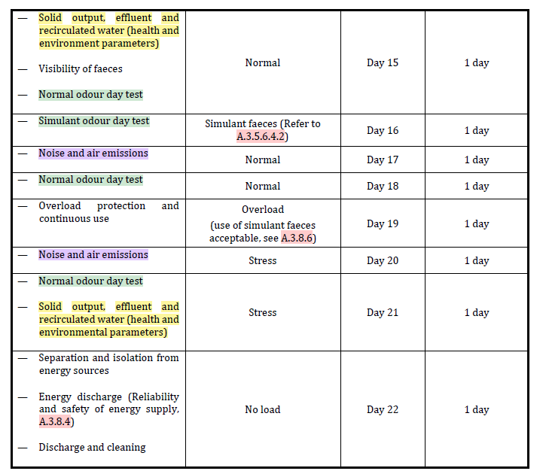
Controlled Laboratory Test Schedule
Legend
Human health and Environment Parameters
Odour Test
Noise and Air emissions
Notes:
The schedule seen here is the schedule given in the standard. The first column depicts the kind of tests being done and the 2nd column is the corresponding type of loading pattern for the day. I’ve colour coded for better visibility.
There are a total of 5 days for human health and environmental testing for solid and effluent outputs.
4 days for odour tests, in which 1 day is done using the stress test. This is to test the consistency of results under different load conditions.
2 days are used for air emissions and noise. Similarly, stress is catered for 1 of the days to check the consistency of results.

Slide 9
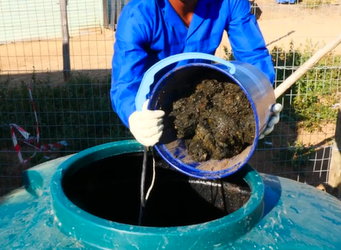
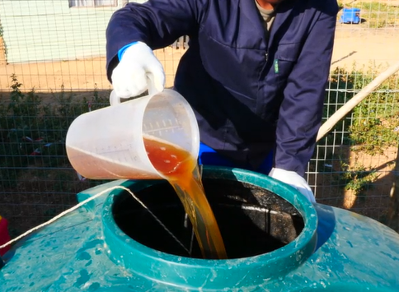
Normal Loading Pattern (7.2.8.1)
The loading of the system shall be performed as a percentage of daily load (kg/day of faeces, l/day of urine)
Capacity calculations indicated by the manufacturer
  uses per day (faecal uses/day and urine uses/day)
  the average amount of faeces (kg/use) and urine (l/use) per use
Loading shall be conducted at the corresponding timing:
  35 % from 6:00 to 9:00;
  25 % from 11:00 to 14:00;
  40 % from 17:00 to 20:00
Normal Loading Pattern | Example
(12 pax design) | ISO30500 (7.2.8) | Faeces (g) | Urine (l)
Total |  | 3000 | 15.6
6:00 – 9:00 | 35% | 1,050 | 5.46
11:00 – 14:00 | 25% | 750 | 3.90
17:00 – 20:00 | 40% | 1,200 | 6.24
Notes:
The normal loading pattern is derived from the capacity calculations indicated by the manufacturer. Provision by the manufacturer, the number of uses per day and assumption of amount per use is required. The loading timing are spread across 6 am to 8 pm to simulate closely to real case scenarios.

Slide 10
Stress (7.2.8.2)
Sanitation system is loaded with treatment capacity (TC) + “Sn”, where Sn is 80% of the difference between maximum capacity and treatment capacity. [Sn = 80% x ( Max – TC)]
Loading shall be conducted at the corresponding timing:
  35 % from 6:00 to 9:00;
  25 % from 11:00 to 14:00;
  40 % from 17:00 to 20:00
Example
Treatment capacity = 12 pax
Max capacity = 15 pax
Sn = (15 -12) x 80% = 2.4 pax
Stress loading = 12 + 2.4 = 14.4 pax
Normal Loading Pattern | Example
(14.4 pax design) | ISO30500 (7.2.8) | Faeces (g) | Urine (l)
Design |  | 3000 | 15.6
Max |  | 3750 | 19.5
Stress |  | 3600 | 18.7
6:00 – 9:00 | 35% | 1,260 | 6.6
11:00 – 14:00 | 25% | 900 | 4.7
17:00 – 20:00 | 40% | 1,440 | 7.5
Notes:
For the stress test, the maximum capacity is required from the manufacturer to calculate the stress loading. The loading times are similar to the normal loading pattern.

Slide 11
Diarrhoea (A.3.8.10)
For the diarrhoea test days, 50 % of the normal faeces loading shall be ‘diarrhoea input’ instead of solid faeces.
Half of this load is to be as normal faecal load (solid faeces), the other half diluted as diarrhoea input.
Combine fresh faeces with water at a ratio of
  2 L of water : 1 kg of fresh faeces.
Normal Loading Pattern | Example
 |  |  | Diarrhoea
(12 pax design) | ISO30500 (7.2.8) | Faeces (g) | Faeces (g) | Water (l)
Total |  | 1500 | 1500 | 3
6:00 – 9:00 | 35% | 525 | 525 | 1.1
11:00 – 14:00 | 25% | 375 | 375 | 0.7
17:00 – 20:00 | 40% | 600 | 600 | 1.2
Notes:
For the diarrhoea input, we take 50% of the faeces and convert them into diarrhoea input to simulate real case scenario. The mixture to simulate diarrhoea is 2 litres of water for every 1 kg of faeces.
The target dry matter content of the diarrhoea input should be between 3 and 10%.
For this testing, the assumption is that each diarrhoea user produces 1.2 l of diarrhoea per day
There is no intent or need to be very precise about the dry matter content of the simulated diarrhoea sample, and thus a twofold dilution by mass of fresh healthy faeces shall be used.

Slide 12
Environmental Parameters
Frontend Requirements
General Technical Information
General Safety
Visibility of Faeces (6.3)
Documentation Checks
Process Design Safety
Material Safety
Mech. & Elec. Safety
Evacuation Performance (6.4)
User Interface Experience
Maintenance Design
ISO 30500
Sustainability
Integrity against external impacts (6.5)
Loading Patterns
Controlled Laboratory Testing
Frontend Requirements
Slip, trip and falling (6.6)
Environmental Parameters
Human Health Parameters
Tightness Test (A.3.1)
Air Emissions Parameters
Acoustics Parameters
Evacuation Mechanism (A.3.3)
Odour Requirements
Electrical Requirements
Field Verification of Performance
Field Testing Guidelines
Environmental Parameters
Human Health Parameters
Notes:
Mechanical tests are mainly focused on the frontend and frontend area (except tightness test A3.1). These tests are not indicated in the schedule but is to be tested prior to commencing.
Water supply/ Pipework
Container Water test
Container Air (pressure)
Container Air (vacuum)

Slide 13
Environmental Parameters
General Technical Information
General Safety
COD
Documentation Checks
Process Design Safety
Material Safety
TSS
Frontend Requirements
Mech. & Elec. Safety
User Interface Experience
Maintenance Design
BOD
ISO 30500
Sustainability
Loading Patterns
Total Nitrogen
Controlled Laboratory Testing
Frontend Requirements
Environmental Parameters
Total Phosphorus
Human Health Parameters
Air Emissions Parameters
pH
Acoustics Parameters
Colour
Odour Requirements
Electrical Requirements
Field Verification of Performance
Field Testing Guidelines
Environmental Parameters
Human Health Parameters
Notes:
Mechanical tests are mainly focused on the frontend and frontend area (except tightness test A3.1). These tests are not indicated in the schedule but is to be tested prior to commencing.
Water supply/ Pipework
Container Water test
Container Air (pressure)
Container Air (vacuum)

Slide 14
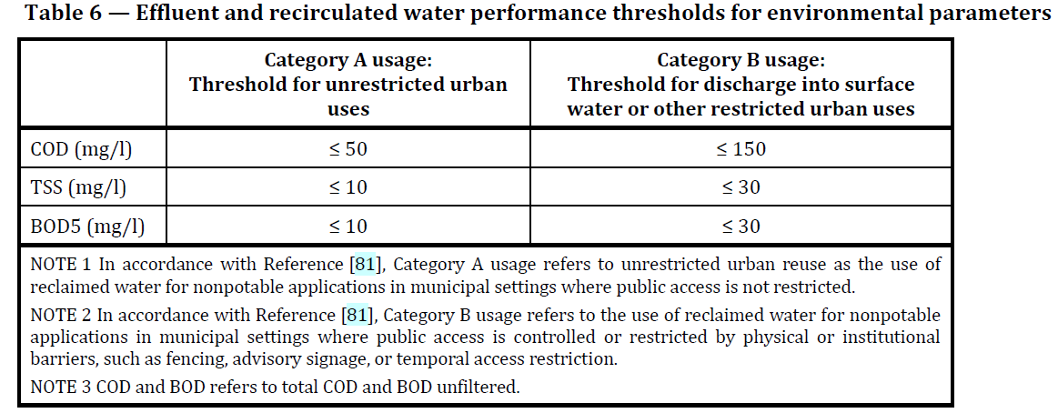

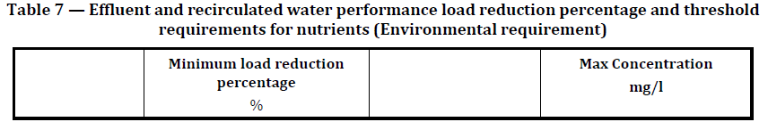
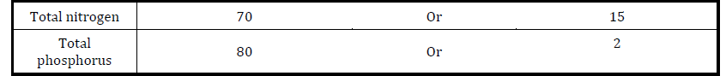
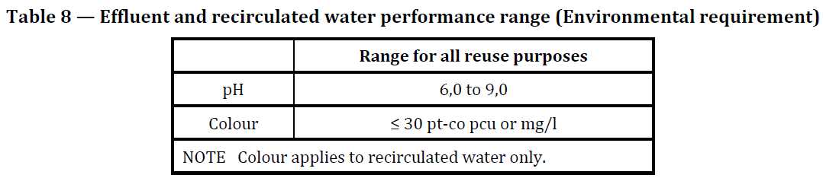
Environmental Parameters Threshold
Public Exposure
Controlled Area
Notes:
For areas with unrestricted access with public exposure, the thresholds are more stringent. Compared to urban reuse where public exposure to the reclaimed water is controlled.
For the load reduction of nutrients (total nitrogen & total phosphorus), the initial input samples have to be tested for comparison.
Unrestricted urban reuse involves the use of reclaimed water where public exposure is likely in the reuse application, thereby requiring a high degree of treatment. In general, all states that specify a treatment process require a minimum of secondary treatment and disinfection prior to unrestricted urban reuse.
Restricted urban reuse involves the use of reclaimed water where public exposure to the reclaimed water is controlled; therefore, treatment requirements may not be as strict as those for unrestricted urban reuse.

Slide 15
Environmental Parameters
General Technical Information
General Safety
COD
Documentation Checks
Process Design Safety
Material Safety
TSS
Frontend Requirements
Mech. & Elec. Safety
User Interface Experience
Maintenance Design
BOD
ISO 30500
Sustainability
Loading Patterns
Total Nitrogen
Controlled Laboratory Testing
Frontend Requirements
Environmental Parameters
Total Phosphorus
Human Health Parameters
Air Emissions Parameters
pH
Acoustics Parameters
Colour
Odour Requirements
Electrical Requirements
Field Verification of Performance
Field Testing Guidelines
Environmental Parameters
Human Health Parameters
Notes:
Mechanical tests are mainly focused on the frontend and frontend area (except tightness test A3.1). These tests are not indicated in the schedule but is to be tested prior to commencing.
Water supply/ Pipework
Container Water test
Container Air (pressure)
Container Air (vacuum)

Slide 16
Human Health Parameters
General Technical Information
General Safety
Documentation Checks
Process Design Safety
Environmental Parameters
Material Safety
Mech. & Elec. Safety
User Interface Experience
Maintenance Design
Bacteria
ISO 30500
Sustainability
Loading Patterns
Helminth
Controlled Laboratory Testing
Frontend Requirements
Environmental Parameters
Protozoa
Human Health Parameters
Virus
Air Emissions Parameters
Acoustics Parameters
Odour Requirements
Electrical Requirements
Field Verification of Performance
Field Testing Guidelines
Environmental Parameters
Human Health Parameters
Notes:
Mechanical tests are mainly focused on the frontend and frontend area (except tightness test A3.1). These tests are not indicated in the schedule but is to be tested prior to commencing.
Water supply/ Pipework
Container Water test
Container Air (pressure)
Container Air (vacuum)

Slide 17
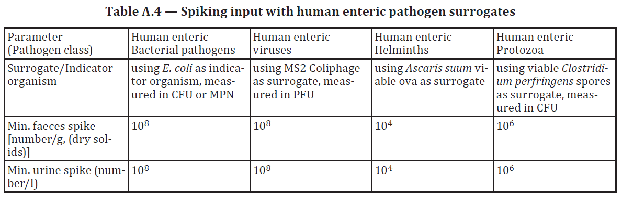
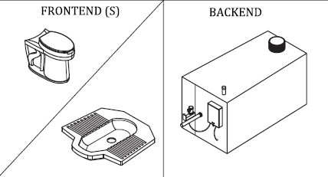
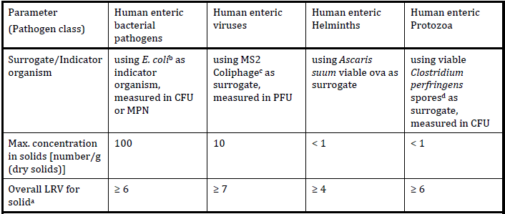

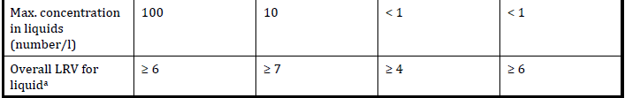

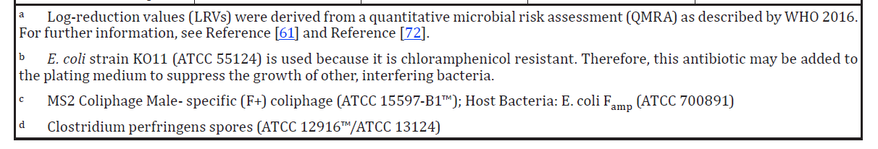
Human Health Parameters Spiking
Spiking values
1
Spike
NSSS
Input
Output
Thresholds and log reduction values requirements.
2
S1
3
S2
Requirements to fulfill human health parameters
Threshold
LRV = -
2
3
Notes:
To meet the log reduction value, the initial input have to meet the minimum required concentration shown. To meet this concentration, spiking will need to be done during the normal loading pattern. And the frequency of the spike and testing is dependent on the manufacturers process. Is it a batch process, continuous or even periodic liquid discharge system.

Slide 18

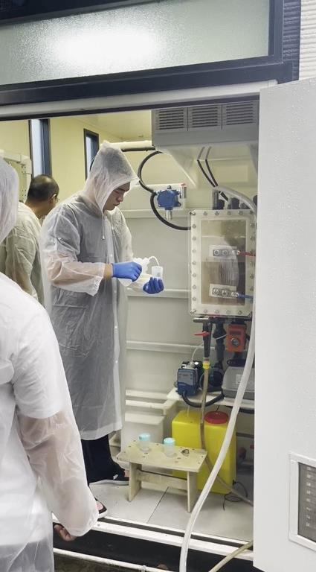
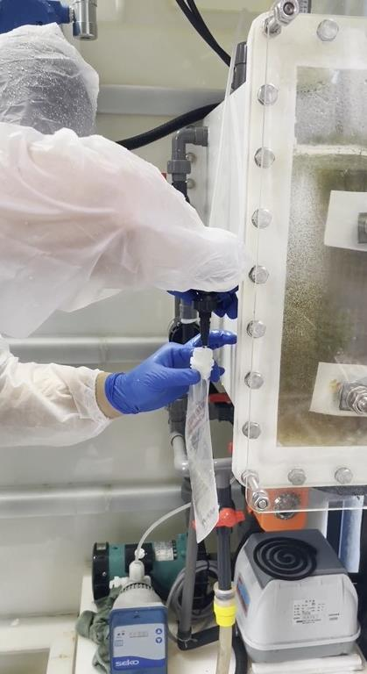
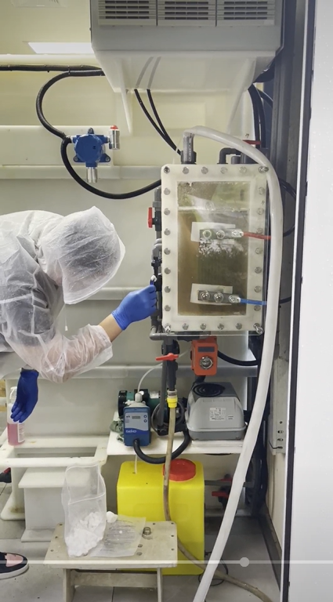
Microbial Testing
Microbe spiking
Microbe testing (Sample Taking)
TÜV SÜD Sustainable Sanitation Services| INTRODUCTION TO ISO 30500

Slide 19
Air Emissions Parameters
Human Health Parameters
General Technical Information
General Safety
Documentation Checks
Process Design Safety
Material Safety
Mech. & Elec. Safety
User Interface Experience
Maintenance Design
Bacteria
ISO 30500
Sustainability
Loading Patterns
Helminth
Controlled Laboratory Testing
Frontend Requirements
Environmental Parameters
Protozoa
Human Health Parameters
Virus
Air Emissions Parameters
Acoustics Parameters
Odour Requirements
Electrical Requirements
Field Verification of Performance
Field Testing Guidelines
Environmental Parameters
Human Health Parameters

Slide 20
Air Emissions Parameters
General Technical Information
General Safety
Documentation Checks
Process Design Safety
CO₂
Human Health Parameters
Material Safety
CO
Mech. & Elec. Safety
NO_{x}
User Interface Experience
Maintenance Design
SO₂
Sustainability
H₂S
ISO 30500
Loading Patterns
VOC
Frontend Requirements
PM2.5
Controlled Laboratory Testing
Environmental Parameters
NH₃
Human Health Parameters
Indoor
Air Emissions Parameters
Stack
Acoustics Parameters
Odour Requirements
Electrical Requirements
Field Verification of Performance
Field Testing Guidelines
Environmental Parameters
Human Health Parameters

Slide 21
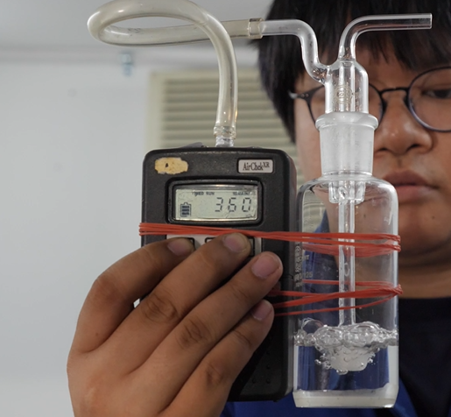
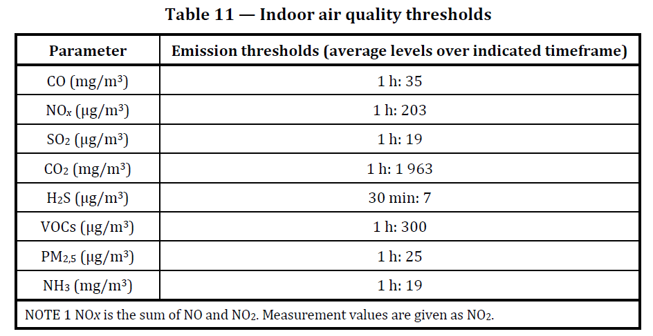
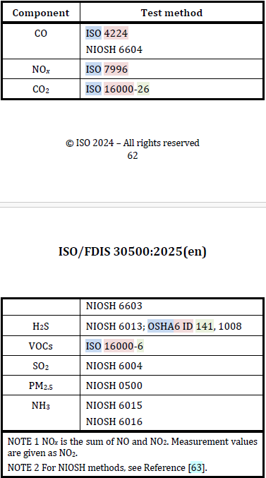
Air Emissions - Indoor
Sampling Methods and Location
About 1 to 1.5 m from the ground above the squat or seat pan
Superstructure door to remain closed during entire sampling
Atmospheric air sampling pump
Thresholds
Recommended Methods
Notes:
And the thresholds for the parameters are based on a 1 hour average sampling time. Except the H2S parameter which is measured at 30 mins average. The recommended test methods are provided in the standard as well. Please note that for air emissions testing methods, equivalent national standards are acceptable as well.

Slide 22
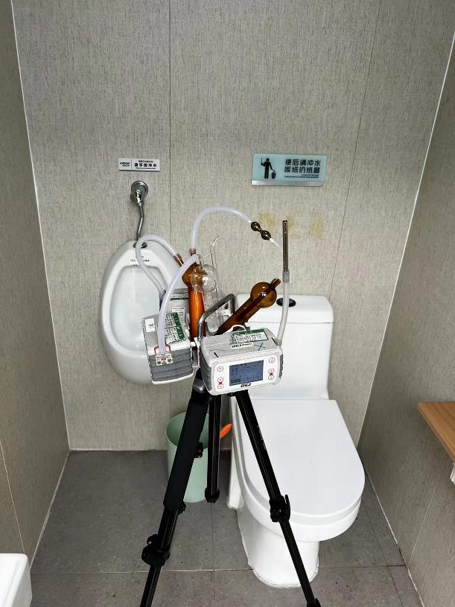
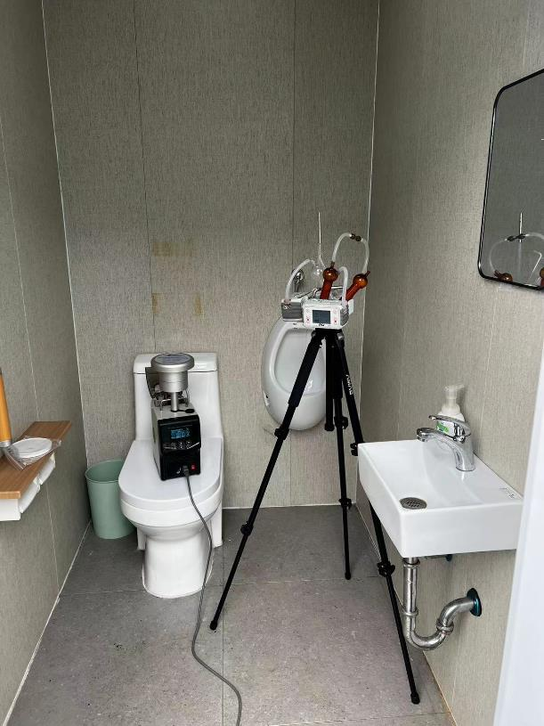
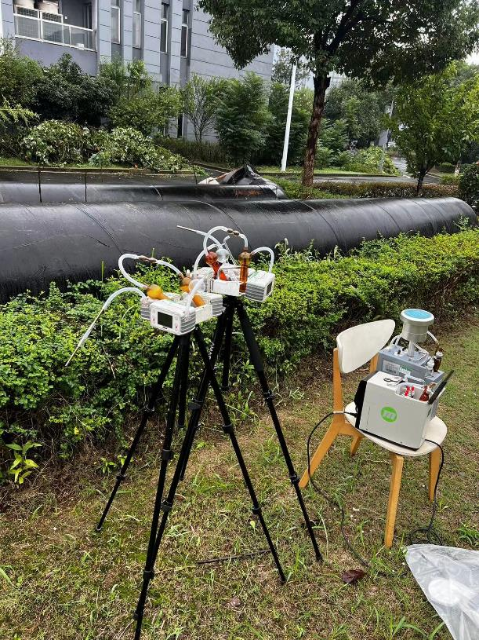
Air Emissions Testing
Indoor

Slide 23
Air Emissions Parameters
General Technical Information
General Safety
Documentation Checks
Process Design Safety
CO₂
Material Safety
CO
Mech. & Elec. Safety
NO_{x}
User Interface Experience
Maintenance Design
CO₂
Sustainability
H₂S
ISO 30500
Loading Patterns
VOC
Mechanical Requirements
PM2.5
Controlled Laboratory Testing
Environmental Parameters
NH₃
Human Health Parameters
Indoor
Air Emissions Parameters
Stack
Acoustics Parameters
Odour Requirements
Electrical Requirements
Field Verification of Performance
Field Testing Guidelines
Environmental Parameters
Human Health Parameters
Notes:
The parameters tested for the frontend are as shown.

Slide 24
Air Emissions Parameters
General Technical Information
General Safety
Documentation Checks
Process Design Safety
Material Safety
NO_{x}
Mech. & Elec. Safety
User Interface Experience
CO
Maintenance Design
H₂S
ISO 30500
Sustainability
VOC
Loading Patterns
PM2.5
Controlled Laboratory Testing
Mechanical Requirements
NH₃
Environmental Parameters
SO₂
Human Health Parameters
Indoor
PAH
Air Emissions Parameters
O₂
Stack
Vol. Flow
Acoustics Parameters
Odour Requirements
Moisture Content
Electrical Requirements
Field Verification of Performance
Field Testing Guidelines
Environmental Parameters
Human Health Parameters

Slide 25
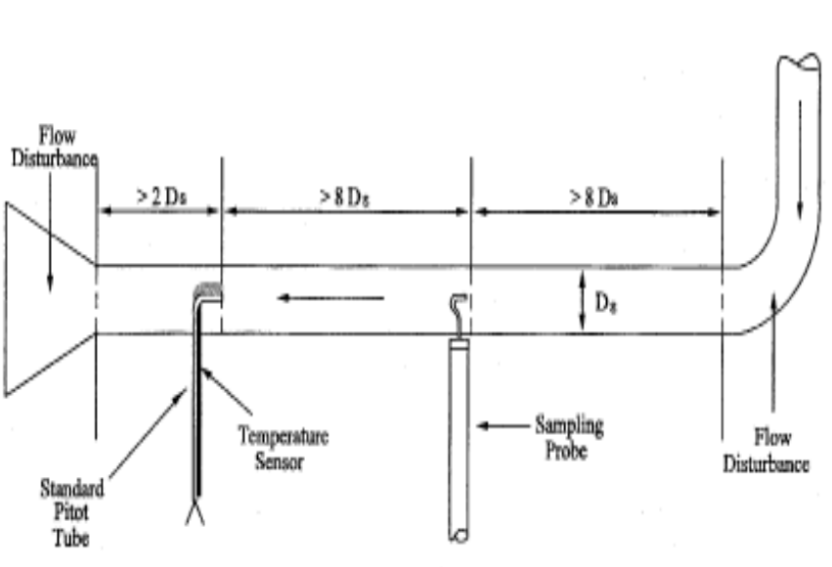
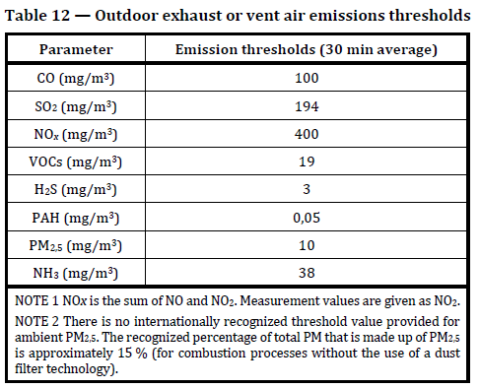
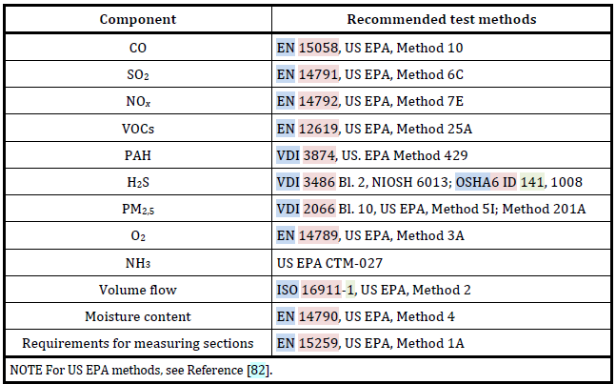
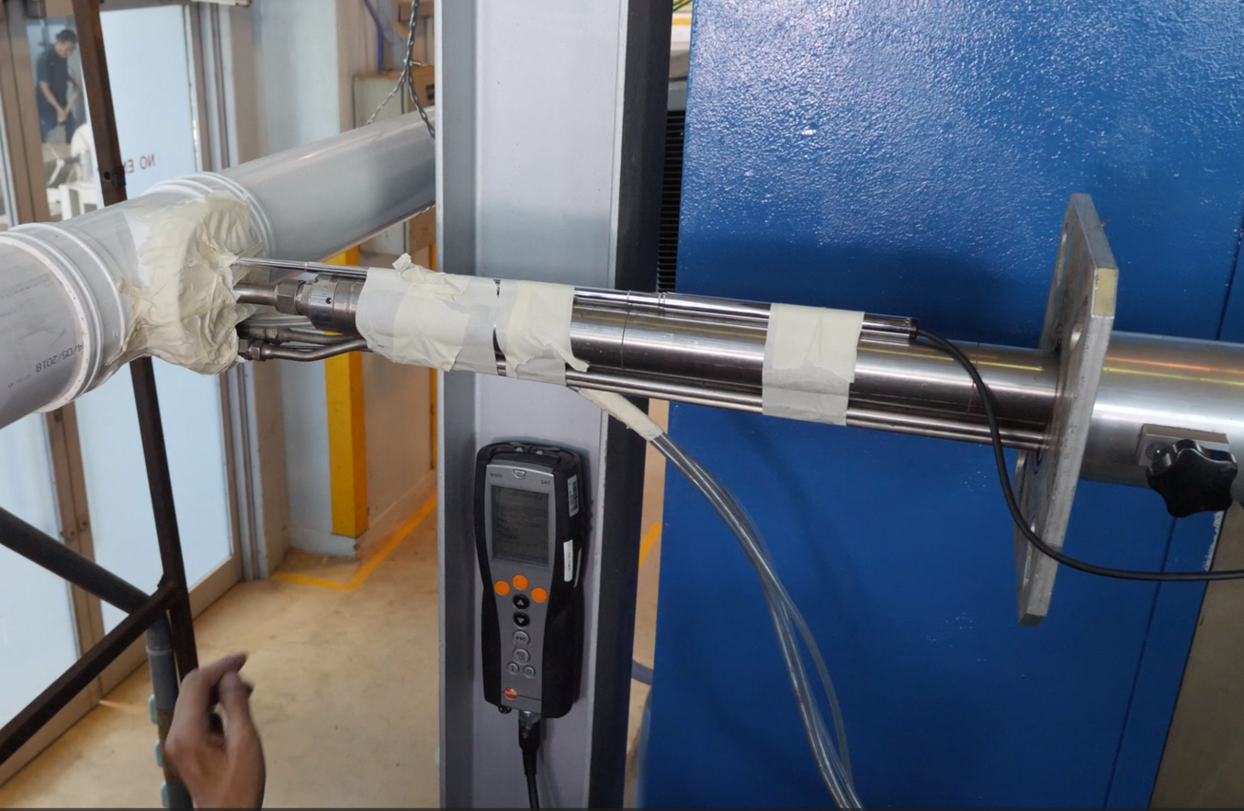
Air Emissions - Stack
EPA Method 1A
Sampling Methods and Location
Most significant sources of air pollutants within the NSSS
External gas vent/Stack as outlined in EPA Method 1A
10D
2D
8D
8D
Thresholds
Recommended Methods
Velocity and Temp. Measurement
Sampling Point
Notes:
For the stack emissions, the parameters are all based on 1 hour averages with concentrations normalised to ambient conditions. Similarly, equivalent national standards are acceptable as well.

Slide 26
Acoustics Parameters
Air Emissions Parameters
General Technical Information
General Safety
Documentation Checks
Process Design Safety
Material Safety
NO_{x}
Mech. & Elec. Safety
User Interface Experience
CO
Maintenance Design
H₂S
ISO 30500
Sustainability
VOC
Loading Patterns
PM2.5
Controlled Laboratory Testing
Mechanical Requirements
NH₃
Environmental Parameters
SO₂
Human Health Parameters
Indoor
PAH
Air Emissions Parameters
O₂
Stack
Vol. Flow
Acoustics Parameters
Odour Requirements
Moisture Content
Electrical Requirements
Field Verification of Performance
Field Testing Guidelines
Environmental Parameters
Human Health Parameters

Slide 27
Acoustics Parameters
General Technical Information
General Safety
Documentation Checks
Process Design Safety
Air Emissions Parameters
Material Safety
Mech. & Elec. Safety
User Interface Experience
Maintenance Design
ISO 30500
Sustainability
Loading Patterns
Controlled Laboratory Testing
Mechanical Requirements
Within Superstructure
Environmental Parameters
Human Health Parameters
Air Emissions Parameters
External
Acoustics Parameters
Odour Requirements
Electrical Requirements
Field Verification of Performance
Field Testing Guidelines
Environmental Parameters
Human Health Parameters

Slide 28
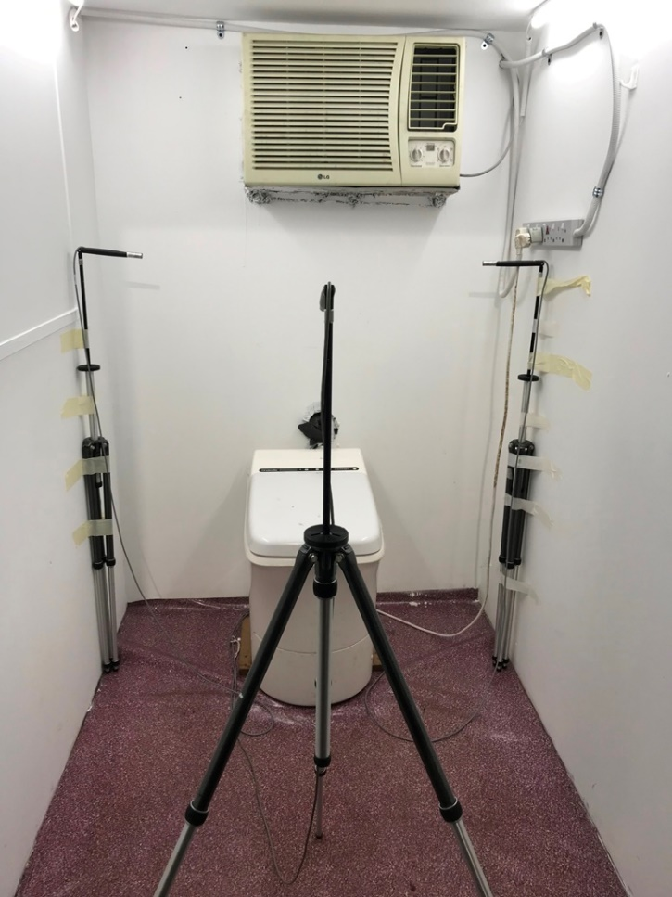
Acoustics Parameters (Internal)
Within superstructure / Frontend
For sanitation system that include a superstructure as part of the manufactured product, noise shall be measured within the superstructure at a single measurement point.
The measurement point shall be centred above the squatting or seat pan of the frontend at a height of 1,20 +/- 0,05 m from the ground.
Requirements: ≤ 60 dBA (average) & ≤ 85 dBA (max) across 24hrs
1.2 m
Notes:
For the frontend, the requirement is a single point measurement above the squat or seat pan of 1.2m.
For the backend as per the example, measurement points are 1m outward, 1.2m height and 1m apart from each measurement point. The measurement point shall be determined relative to the smallest imaginary rectangular parallelepiped.
Measurement points nearest to the corners are discarded.

Slide 29
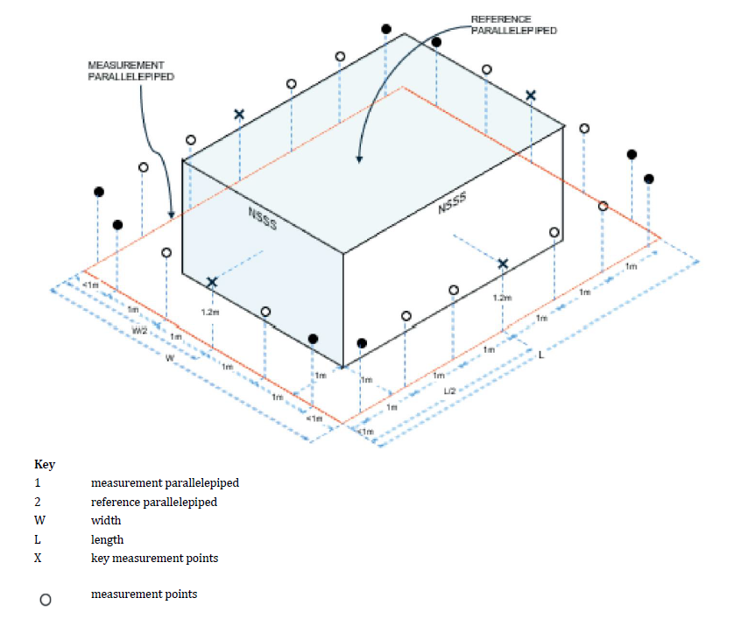

Acoustics Parameters (External)
External / Backend Measurement
External / Backend
The measurement points shall be positioned on the surface of a measurement parallelepiped whose planes are each 1 m outward (relative to the system) from those of the reference parallelepiped.
Requirements: ≤ 60 dBA (average) & ≤ 85 dBA (max) across 24hrs
REFERENCE PARALLELEPIPED
MEASUREMENT PARALLELEPIPED
NSSS
NSSS
1m
<1m
1.2m
1m
1m
1.2m
1m
W/2
1m
W
1m
L
1m
1m
1m
1m
L/2
1m
1m
<1m
<1m
W = WIDTH
L = LENGTH
= KEY MEASUREMENT POINT
= MEASUREMENT POINTS
= POINTS <1m NEAREST TO THE CORNERS TO BE DISCARDED
Notes:
For the frontend, the requirement is a single point measurement above the squat or seat pan of 1.2m.
For the backend as per the example, measurement points are 1m outward, 1.2m height and 1m apart from each measurement point. The measurement point shall be determined relative to the smallest imaginary rectangular parallelepiped.
Measurement points nearest to the corners are discarded.

Slide 30
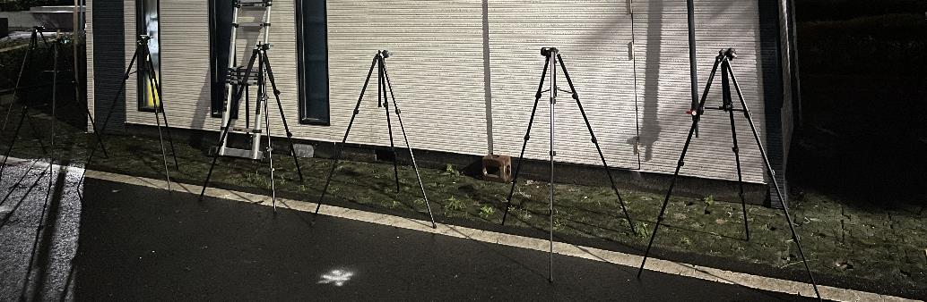
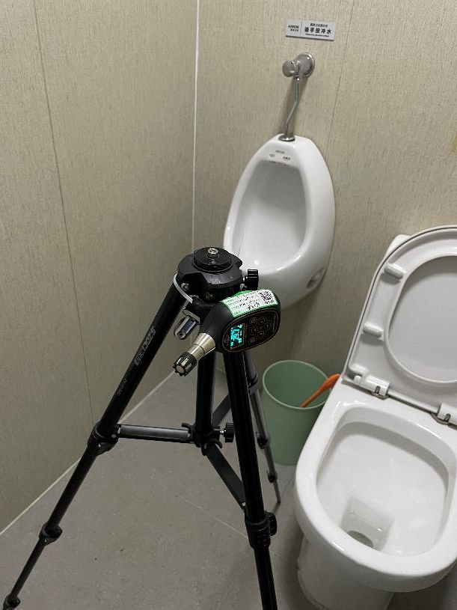
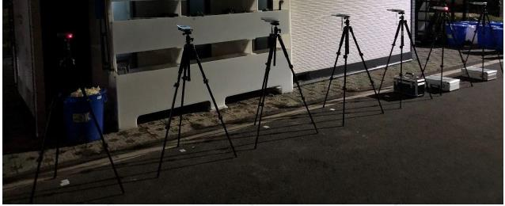
Noise Emissions Testing
Indoor and outdoor

Slide 31
Odour Requirements
Acoustics Parameters
General Technical Information
General Safety
Documentation Checks
Process Design Safety
Material Safety
Mech. & Elec. Safety
User Interface Experience
Maintenance Design
ISO 30500
Sustainability
Loading Patterns
Controlled Laboratory Testing
Mechanical Requirements
Within Superstructure
Environmental Parameters
Human Health Parameters
Air Emissions Parameters
External
Acoustics Parameters
Odour Requirements
Electrical Requirements
Field Verification of Performance
Field Testing Guidelines
Environmental Parameters
Human Health Parameters

Slide 32
Odour Requirements
General Technical Information
General Safety
Documentation Checks
Process Design Safety
Acoustics Parameters
Material Safety
Mech. & Elec. Safety
User Interface Experience
Maintenance Design
ISO 30500
Sustainability
Loading Patterns
Controlled Laboratory Testing
Mechanical Requirements
Environmental Parameters
Within Superstructure (Frontend)
Human Health Parameters
Air Emissions Parameters
Acoustics Parameters
External (Vicinity)
Odour Requirements
Electrical Requirements
Field Verification of Performance
Field Testing Guidelines
Environmental Parameters
Human Health Parameters

Slide 33
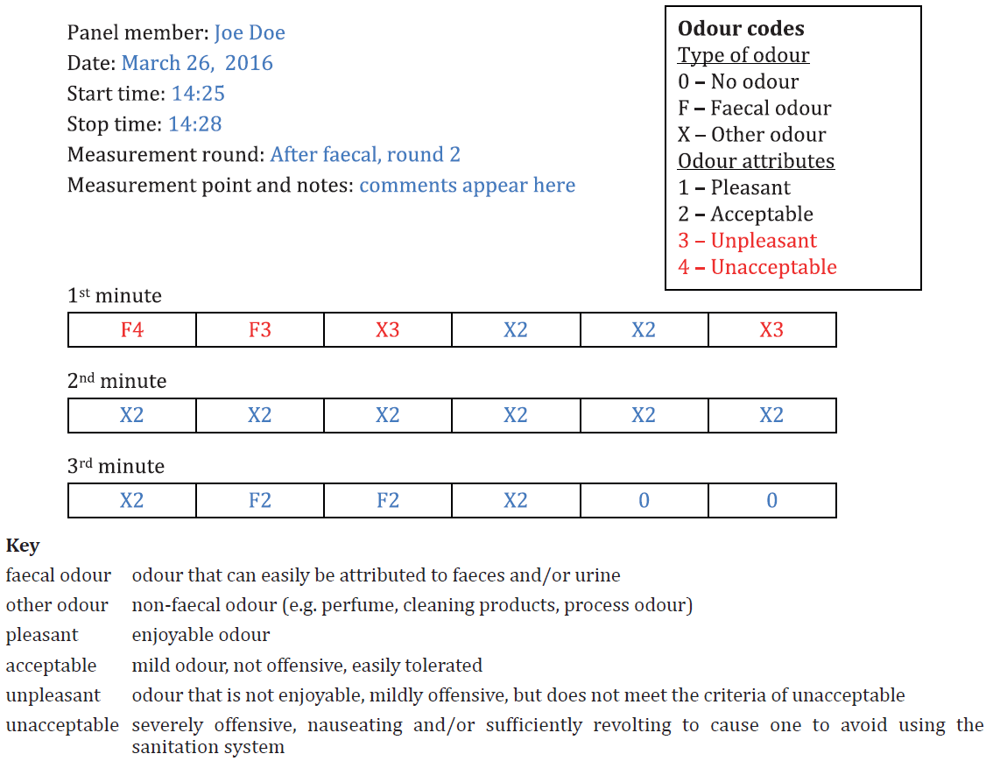
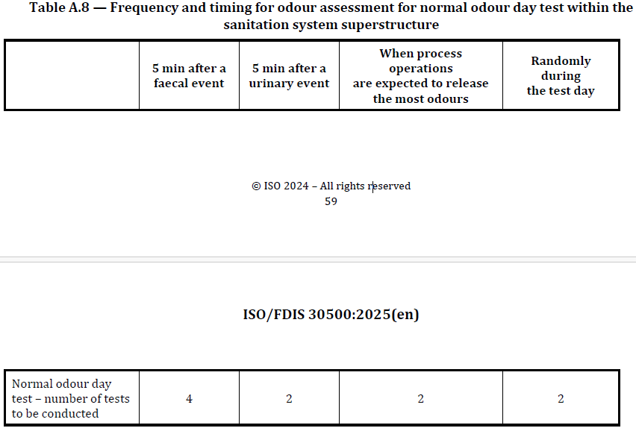
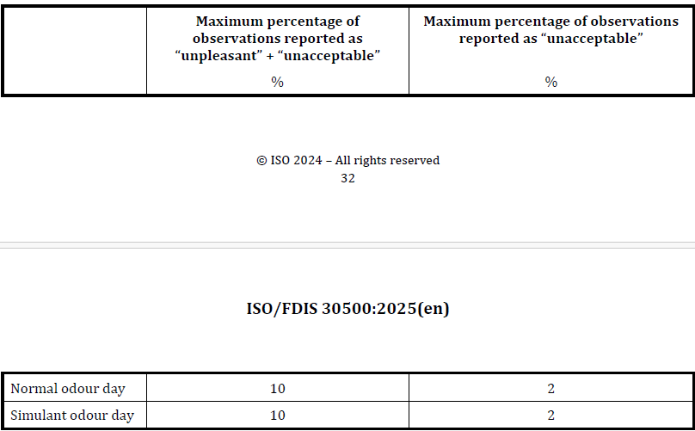
Odour – Requirements
Per test
Instruct the panelists to inhale the surrounding air and smell its odour at 10 s intervals, for total duration of 3 min per test
Sample Odour Assessment Report Sheet
1. Test Frequency
2. Threshold
Notes:
Location of test is at the frontend.
A record is done for every 10s for total of 3 minutes per event.
For a typical odour test day,
4 faecal events
2 urinary events
2 events when process is expected to release the most odours
2 randomly during the test
At the end of the test, the results have to be tabulated and meet the maximum threshold percentage given.
For the indoor testing, systems with 2 – 5 front ends is required to minimally test for 2 frontends. Systems with more than 5 frontends will need to test for minimally 3 frontends.

Slide 34
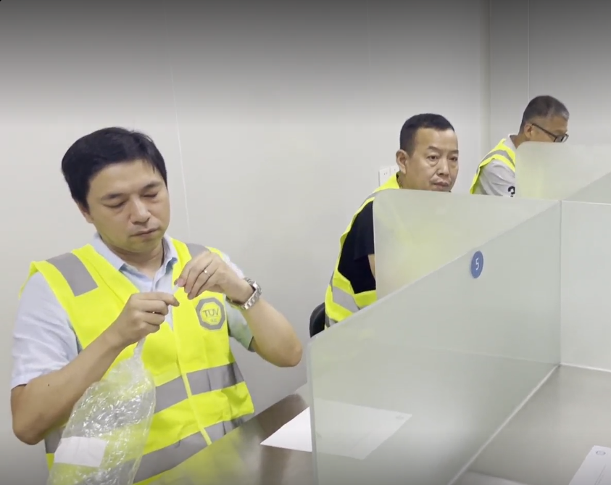
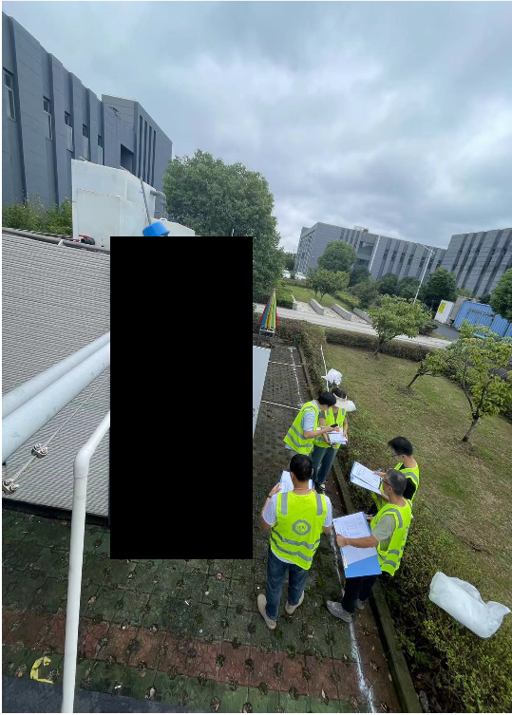
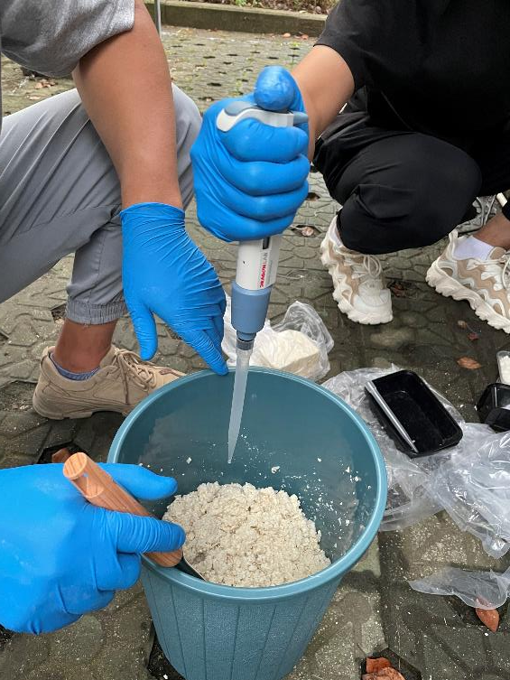
Odour Emissions Testing
Simulant Preparations
Panelist Odour Screening
Odour Assessment by panelist

Slide 35
Electrical Requirements
Odour Requirements
General Technical Information
General Safety
Documentation Checks
Process Design Safety
Material Safety
Mech. & Elec. Safety
User Interface Experience
Maintenance Design
ISO 30500
Sustainability
Loading Patterns
Controlled Laboratory Testing
Mechanical Requirements
Environmental Parameters
Within Superstructure (Frontend)
Human Health Parameters
Air Emissions Parameters
Acoustics Parameters
External (Vicinity)
Odour Requirements
Electrical Requirements
Field Verification of Performance
Field Testing Guidelines
Environmental Parameters
Human Health Parameters

Slide 36
Field Testing Guidelines
Electrical Requirements
General Technical Information
General Safety
Documentation Checks
Process Design Safety
Odour Requirements
Material Safety
Mech. & Elec. Safety
User Interface Experience
Maintenance Design
ISO 30500
Sustainability
Loading Patterns
Control System (A.3.2)
Tested prior to test sequence.
To develop test plan to test each control function independently
Controlled Laboratory Testing
Mechanical Requirements
Environmental Parameters
Human Health Parameters
Air Emissions Parameters
1. Disconnect and discharge remaining energy.
2. Record energy remaining in system.
3. If backup energy is present, check and record capacity of backup source.
Acoustics Parameters
Energy discharge (A.3.8.4)
Odour Requirements
Electrical Requirements
Field Verification of Performance
Field Testing Guidelines
Environmental Parameters
Human Health Parameters

Slide 37
Field Testing Guidelines
Class
Class 1: Non-biological treatment processes one frontend – backend
Class 2: Biological treatment processes one frontend – multiple backends
Class 3: NSSSs – Biological treatment process multiple frontend – multiple backends
Class 4: Non-biological treatment processes multiple frontend – backend
General Technical Information
General Safety
Documentation Checks
Process Design Safety
Material Safety
Electrical Requirements
Mech. & Elec. Safety
User Interface Experience
Maintenance Design
ISO 30500
Sustainability
Human Health & Environmental Testing Weekly
Loading Patterns
Class 1 & 4
Controlled Laboratory Testing
Mechanical Requirements
Environmental Parameters
Test Duration 30 days
Human Health Parameters
Air Emissions Parameters
Test Duration 5 Months
Acoustics Parameters
Odour Requirements
Class 2 & 3
Environmental Testing Weekly
Electrical Requirements
Field Verification of Performance
Field Testing Guidelines
Human Health Testing Monthly
Environmental Parameters
Human Health Parameters

Slide 38
Field Testing Guidelines
 |  | Month 1 |  |  |  | Month 2 |  |  |  | Month 3 |  |  |  | Month 4 |  |  |  | Month 5
Week | 0 | 1 | 2 | 3 | 4 | 5 | 6 | 7 | 8 | 9 | 10 | 11 | 12 | 13 | 14 | 15 | 16 | 17 | 18 | 19 | 20 | 25
Class 1
Environmental | D | W | W | W | W | C
Human Health |  | W | W | W | W | C
Class 2 & 3
Environmental | D | W | W | W | W | W | W | W | W | W | W | W | W | W | W | W | W | W | W | W | W | C
Human Health |  | M |  |  |  | M |  |  |  | M |  |  |  | M |  |  |  | M |  |  |  | C
Legends
B = Inlet Baseline study (daily). Total N & P only
D = Daily sampling
W = Weekly sampling
M = Monthly sampling
C = Complete

Slide 39
Environmental Parameters (Field)
Field Testing Guidelines
Class
Class 1: Non-biological treatment processes one frontend – backend
Class 2: Biological treatment processes one frontend – multiple backends
Class 3: NSSSs – Biological treatment process multiple frontend – multiple backends
Class 4: Non-biological treatment processes multiple frontend – backend
General Technical Information
General Safety
Documentation Checks
Process Design Safety
Material Safety
Electrical Requirements
Mech. & Elec. Safety
User Interface Experience
Maintenance Design
ISO 30500
Sustainability
Human Health & Environmental Testing Weekly
Loading Patterns
Class 1 & 4
Controlled Laboratory Testing
Mechanical Requirements
Environmental Parameters
Test Duration 30 days
Human Health Parameters
Air Emissions Parameters
Test Duration 5 Months
Acoustics Parameters
Odour Requirements
Class 2 & 3
Environmental Testing Weekly
Electrical Requirements
Field Verification of Performance
Field Testing Guidelines
Human Health Testing Monthly
Environmental Parameters
Human Health Parameters

Slide 40
Human Health Parameters (Field)
Environmental Parameters (Field)
Input samples to be collected and analysed daily for a period of 1 week to collect total nitrogen and total phosphorus baseline values.
General Technical Information
Field Testing Guidelines
General Safety
Documentation Checks
Process Design Safety
Material Safety
Mech. & Elec. Safety
COD
User Interface Experience
Maintenance Design
TSS
ISO 30500
Sustainability
Loading Patterns
BOD
Controlled Laboratory Testing
Mechanical Requirements
Environmental Parameters
75% Pass Requirement
Total Nitrogen
Human Health Parameters
Air Emissions Parameters
Acoustics Parameters
Total Phosphorus
Odour Requirements
Electrical Requirements
Colour
pH
Field Verification of Performance
Field Testing Guidelines
Environmental Parameters
Human Health Parameters

Slide 41
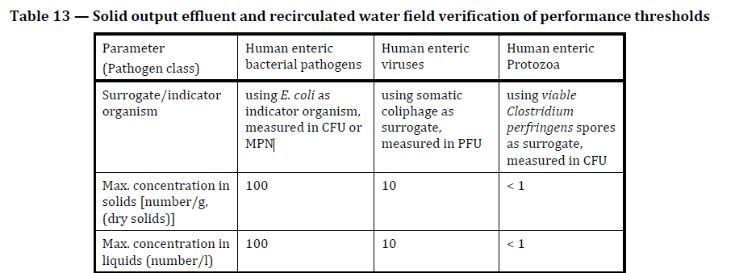
Human Health Parameters (Field)
General Technical Information
Environmental Parameters (Field)
General Safety
Documentation Checks
Process Design Safety
Material Safety
Mech. & Elec. Safety
User Interface Experience
Maintenance Design
ISO 30500
Sustainability
Loading Patterns
Human enteric Protozoa validates treatment efficiency for human enteric Helminths
Controlled Laboratory Testing
Mechanical Requirements
Environmental Parameters
Human Health Parameters
Bacteria
Air Emissions Parameters
Acoustics Parameters
Protozoa
Odour Requirements
100% Pass Requirement
Electrical Requirements
Virus
Field Verification of Performance
Field Testing Guidelines
Environmental Parameters
Human Health Parameters

Slide 42
Frequent Asked Questions
What is the cost of certification of one unit?
What is the breakdown of cost for the different testing?
Is it still possible to make any changes to the document?

Slide 43

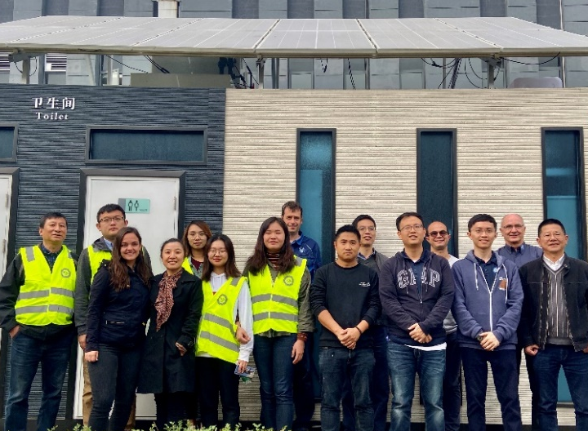

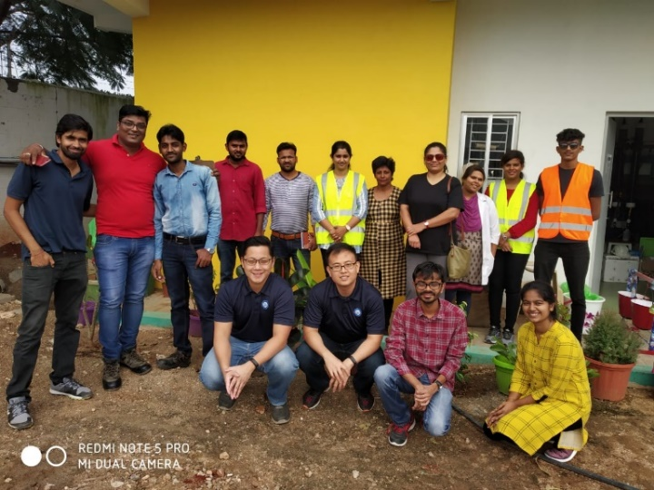
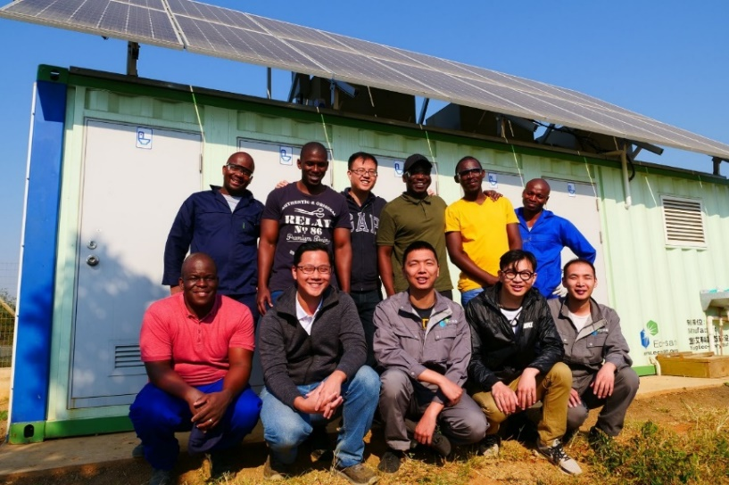

Thank You!
Dakar, Senegal
Laboratories Kickoff Meeting
Yixing, China
ISO 30500 Preliminary Testing
Kathmandu, Nepal
ISO 30500 Project Committee
Coimbatore, India
ISO 30500 Validation Testing
Durban, South Africa
ISO 30500 Validation Testing

