Slide 1
ISO 24521
a management standard we can use now
Presenter name
Organization
Date
Location

Slide 2

ISO 24521: A Standard We Can Use Now
English
Français
Português
中文
Notes:
Watch a short video explaining ISO 24521 in your preferred language:
ISO 24521: A Standard We Can Use Now (English Subtitles): https://www.youtube.com/watch?v=zn61wIUbN7k
ISO 24521: une norme que nous pouvons utiliser maintenant (sous-titres Français) https://www.youtube.com/watch?v=Qkzcp9bm8fQ
ISO 24521: Uma Norma que podemos usar agora (legendas) https://www.youtube.com/watch?v=R29RXSfCxjk
ISO 24521: A Standard We Can Use Now // ISO 24521: 我们现在就能使用的的标准 （中文字幕）https://www.youtube.com/watch?v=3bYncEG8Y8U or https://v.youku.com/v_show/id_XNDc4MjcyOTg3Ng==.html?spm=a2hbt.13141534.app.5~5!2~5!2~5~5~5!2~5~5!2~5!2~5!2~5~5!5~A
Please see all videos here: https://www.youtube.com/user/ansidotorg/playlists?view=50&sort=dd&shelf_id=5

Slide 3
agenda: a new management standard
the need
the technical guidelines
objectives & opportunities
your role & next steps

Slide 4
the need
countless communities around the world use non-sewered sanitation systems that require management of wastewater services…
and we need a consistent set of guidelines to safely manage those systems
Notes:
Non-sewered sanitation systems are a great for many communities around the world, and cut down on water waste and other problems that arise with sewered systems. However with the specific needs of these types of systems, we need a set of guidelines to ensure we’re protecting the health and safety of operators, users, and the community as a whole.

Slide 5
a solution
ISO 24521 is a technical document containing specifications to optimize and improve management of existing on-site domestic wastewater services and their component parts
access to toilet (user interface + collection)
emptying & transport
treatment
disposal & reuse
Notes:
ISO 24521 provides guidelines on the management of basic on-site domestic wastewater services for both users and operators, on the design and construction of basic wastewater systems, and on planning, operation, and maintenance and health and safety issues.
taking into account social norms through stakeholder communication, management of assets and better management of human waste and wastewater.
In this presentation, we will go over the main objectives for ISO 24521 in detail.
The standard is broken into two main parts.
The first part covers protecting the user and public health.
Then it moves beyond this, and covers the smaller details which are critical for the quality and performance of basic domestic wastewater systems.
This standard is intended to be given to a wastewater treatment facility operator to use to improve EXISTING management techniques.
It can assist with the formulation of checklists, best practices, and common sense guidance to improve safety, health, and communication practices and plans.

Slide 6
global consensus
ISO 25421 was developed by ISO Technical Committee (TC) 224, with the input of 61 countries from six continents
Notes:
This is truly a global effort, and a process that included inputs from technical experts and practitioners from all around the world.
The biggest priority when writing this standard was to ensure it works and is realistic for the communities which rely on non-sewered sanitation options.

Slide 7
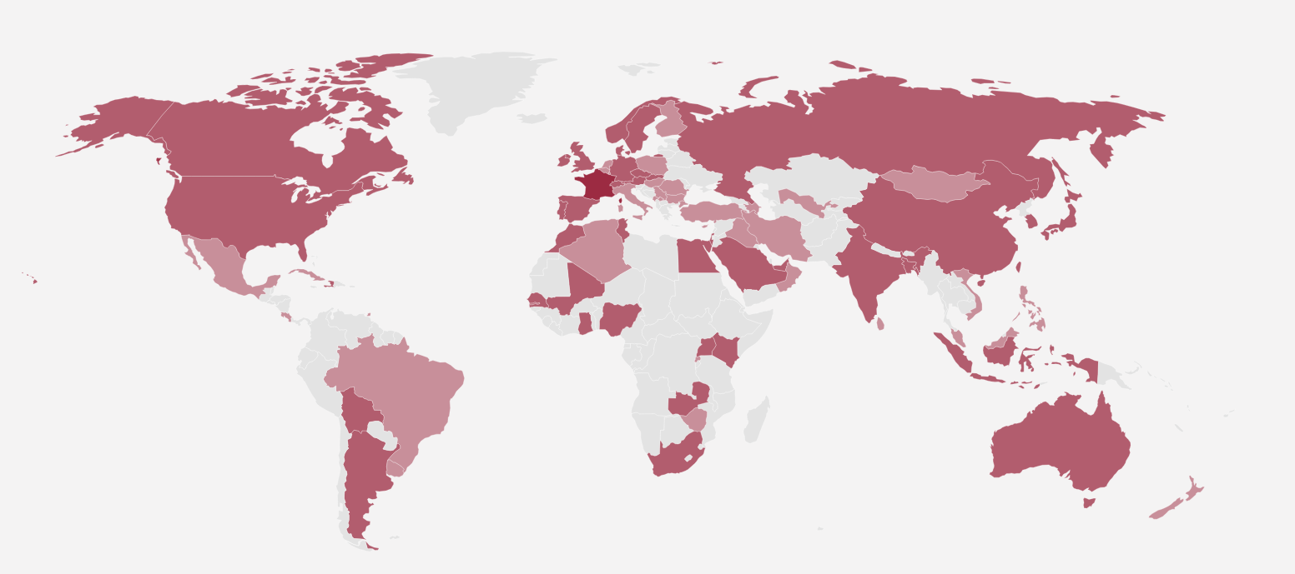



Technical Committee 224 members
Notes:
TC 224 at ISO level membership

Slide 8
together: revolutionizing WASH
simultaneous review, adoption and use of ISO 24521 and ISO 30500 has the potential to revolutionize the sanitation sector
ISO 24521 optimizes existing wastewater services
ISO 30500 encourages development of new technology and solutions
Notes:
ANSI encourages you to consider adopting ISO 24521 and ISO 30500 together. They work hand in hand to improve health, reduce the environmental impact of wastewater treatment, and offer affordable options for users and communities.
ISO 24521 optimizes existing wastewater services (that currently handle incoming fecal sludge)
ISO 30500 encourages the development of new technologies and solutions as current technologies are failing to address underlying challenges behind the lack of sanitation, including poverty, infrastructure and resources.
ANSI encourages national standards bodies to consider reviewing & nationally adopting ISO 30500 and ISO 24521 simultaneously.
However, please note that this presentation will focus primarily on ISO 24521—Guidelines for the management of basic on-site domestic wastewater services.

Slide 9

ISO 30500 and ISO 24521: Hand in Hand
English
Français
Português
中文
Notes:
Watch a short video of ISO 30500 and ISO 24521: Hand in Hand in your preferred language:
ISO 30500 and ISO 24521: Hand in Hand (English Subtitles) https://www.youtube.com/watch?v=13bG0cFeuLQ
ISO 30500 et ISO 24521: main dans la main (sous-titres Français) https://www.youtube.com/watch?v=Qkzcp9bm8fQ
ISO 30500 e ISO 24521: Lado a lado (legendas) https://www.youtube.com/watch?v=mbpXRaz9gs4
ISO 30500 and ISO 24521: Hand in Hand // ISO 30500 和 ISO 24521: 携手共进 （中文字幕）https://www.youtube.com/watch?v=QGnZL4zCvrk or https://v.youku.com/v_show/id_XNDY2MzIxMzIxMg==.html?spm=a2hbt.13141534.app.5~5!2~5!2~5~5~5!2~5~5!2~5!2~5!2~5~5!6~A
Please see all videos here: https://www.youtube.com/user/ansidotorg/playlists?view=50&sort=dd&shelf_id=5

Slide 10

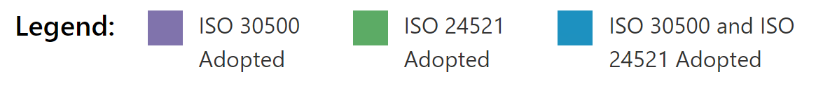
National Adoption of ISO 30500 & ISO 24521
National Adoption Map current as of June 2026
Notes:
Please visit https://sanitation.ansi.org/Standard/StandardAdoptionMap for the latest map

Slide 11
together: revolutionizing WASH
ISO 24521 contains normative references to ISO 24510 and ISO 24511.
Please consider simultaneous review and adoption of ISO 24521, ISO 24510, and ISO 24511
Notes:
ISO 24521 complements two other standards: ISO 24510, which provides guidelines for the assessment and improvement of services to users; and ISO 24511, which provides guidelines for the management of wastewater utilities and the assessment of wastewater services. This presentation does not cover ISO 24510 or ISO 24511, but ANSI or your NSB can provide direction for you to get additional information on them if you’re interested.

Slide 12
the standards
Standards for Activities relating to drinking water and wastewater services:
ISO 24521, Guidelines for the management of basic on-site domestic wastewater services
ISO 24510, Guidelines for the assessment and for the improvement of the service to users
ISO 24511, Guidelines for the management of wastewater utilities and for the assessment of wastewater services
Notes:
You can obtain these standards through your national standards body, or downloading free of charge at: https://sanitation.ansi.org/Download.

Slide 13
why it matters
a national standard enables our communities to streamline sanitation services to protect health and promote sustainable community development (and ultimately economic growth)
Notes:
Why does this matter?
When you connect the dots, a national standard reaches far beyond the experts and engineers who developed it, and can benefit all of us
this is about protecting the health of our families and our children, and sustainable community development which ultimately leads to economic growth

Slide 14
ISO 24521 objectives
protect public health
promote sustainable community development
protect operators & field workers
improve user experience & safety
Notes:
ISO 24521 can help address some of the biggest challenges our communities face when it comes to optimizing non-sewered sanitation systems – here are the four key takeaways, which are further detailed in the following slides.
To put it simply, ISO 25421 can help protect employees against harmful situations and hazardous materials that they come in contact with every day.
The four main objectives of basic on-site domestic wastewater services are:
— public health and safety;
— occupational health and safety;
— environmental protection;
— sustainable development
This International Standard Provides guidelines on the management of such basic on-site domestic wastewater services with a focus on improving hygiene.
ISO 24521 takes into account social norms through suggested stakeholder communication, management of assets, and better management of human waste and wastewater.

Slide 15
protect public health
ensure clean drinking water
avoid human exposure to pathogens
prevent disease-carrying animals from accessing waste
eliminate odor and aesthetic nuisances
Notes:
This is ultimately about protecting public health. Safe and sanitary disposal of wastewater should be a public health priority.
ISO 24521 helps us achieve just that.

Slide 16
protect operators & field workers
techniques for design, planning, construction, management, operation & maintenance
best practices, education, & training for transporting & handling wastewater for plant operators, wastewater collectors, field workers, & the trucks that transport wastewater
  protective clothing & equipment
  regular check-ups & health monitoring
  monitor & test sub-products
Notes:
ISO 24521 prioritizes the health & education of those directly and indirectly involved, as well as monitoring of sub-products and technologies used in the process (including both the owners of the premises housing the facility, as well as the workers who are providing emptying services).
Protective equipment must be worn when handling wastewater for users & operators.
Workplace health and safety
Regular medical check-ups: for users, service provider & operators who handle waste
Protective equipment: Must be provided for users & operators when handling waste
Monitor for any infectious or parasitic diseases: for stakeholders who come in contact with wastewater and/or sub-products of basic onsite domestic wastewater.
Education/Training: Should be conducted to avoid any health risk.
Training is necessary for proper transport and handling of waste/wastewater to prevent or minimize operator risk and risk to the public (community) or environment .
Health and hygiene education, including promotion of washing hands with soap and/or an equivalent washing agent;
It should be confirmed that the operator is sufficiently trained before given permission to transport waste/wastewater.
Monitoring: The health programs should include:
Testing of sub-products for any pathogenic microorganisms or other hazardous materials;
Review of the use of system technologies to establish any improper use or faults that could promote activity of pathogenic microorganisms and, where possible, the kind of routes of exposure as a result of using the system;
Pre-evaluation of a particular technology for possible failure that could promote the activity of pathogenic microorganisms as well as other hazards, where feasible.

Slide 17
improve user experience
best practices for households and community members when handling waste and building/using on-site domestic wastewater systems (e.g. pit latrines)
provide clear communication
promote cultural acceptance
prioritize the needs and expectations of users
  safety, hygiene, security, comfort, convenience & privacy
  accessibility & sustainability
  in some cases, re-useable wastewater or byproducts
  economic benefits
Notes:
User needs and expectations should be central to planning.
safety and privacy improve living conditions
clear communication streamlines service delivery
Widespread adoption and use leads to cultural acceptance and economic benefits
in some cases, re-useable wastewater
Basic on-site domestic wastewater systems should be secure, comfortable, convenient and safe for all kinds of users (children, adults, elderly and disabled persons).
Users’ expectations typically relate to:
— response to complaints;
— reporting of financial results;
— consultation on plans for changes;
— involvement in electing or appointing management positions;
— expectations that public health and the environment will be protected.
A system function and stakeholder communication process should be developed (see Figure 2 in ISO 24521). The organization should provide information using data between the users and the service provider or utility, so that the community is informed, supports the use of the basic on-site domestic wastewater systems and sees the benefit to its needs and the environment.
To reach out to various stakeholders, different communication channels should be adapted.
How is user integration expected in ISO 24521? Waste operators should actively engage with stakeholders.
Management of operation, maintenance and disposal of waste should meet the requirements of the various stakeholders, have clearly communicated objectives and ensure proper education and training of stakeholders, so that the stakeholders understand and support the basic on-site domestic wastewater system objectives.
It includes education and training activities such as:
— public awareness campaigns;
— one to one basis;
— school curriculum;
— media;
— community-based organization/community user groups;
— community engagement/mobilization programs (government or donor), such as community-led total sanitation;
— school health clubs/youth groups;
— neighboring municipalities operating their own similar or larger wastewater collection, treatment and disposal facilities.

Slide 18
promote sustainable community development
sustainable wastewater services are key to creating sustainable communities
scale capacity to meet current and future needs
recover nutrients & re-use waste for fertilizer
conserve & protect drinking water
prevent pollution
generate renewable energy
Notes:
Demand for re-use of sanitation system products: Need to consider health & safety requirements
Nutrient recovery: For feces & urine used at household level as fertilizer or soil improver, safety and hygiene requirements must be considered.
Revenue sources: To ensure cost recovery of services; To ensure financially stability
Maintenance of onsite domestic system: Provide capacity to meet current & future needs; periodic desludging & preventative maintenance
Sustainable development in ISO 24521 promotes the growth and prosperity of communities within the environmental, infrastructural, & economic resources available to it.

Slide 19
other benefits
ISO 24521 includes special protocols to ensure provision of service in an emergency
Notes:
This standard also provides protocols for emergency situations. Wastewater services should be available on a continuous basis;
where an emergency applies, emergency calls & response actions should be initiated appropriately;
and user interfaces intended for emergency situation should be portable and easy to assemble.

Slide 20
your role
governments, parliaments, & local public authorities play an essential role in protecting drinking water and improving access to basic sanitation
institutional involvement will make the water & sanitation sector more productive, and the management of water resources more sustainable
Notes:
As decision-makers and leaders in your community, your role is essential in protecting community members from harmful, unhygienic, or unsafe sanitation systems.

Slide 21
next steps
how can you work toward review, adoption and use of the standards?
identify key sanitation standards, regulations, or laws already in place
understand the process for nationally adopting a new international standard
host a national workshop to educate stakeholders in your country or community
gather ideas from key stakeholders and earn their buy-in
conduct trainings for government sanitation employees
Notes:
Any national adoption strategy for [country] needs to be informed by you, the stakeholders, but ANSI wanted to provide a starting point for today’s discussion. As you discuss these points, keep in mind that ANSI and/or your national standards body (NSB) is here to support the activities in any way we’re able.

Slide 22
ANSI is here to help
partnerships and networking
one-on-one technical assistance in working toward adoption
ongoing and follow-up assistance to support implementation and use
additional education and training materials

Slide 23
https://sanitation.ansi.org/
sanitation@ansi.org

