Slide 1
How to use an ISO Standard

Slide 2
What actions can I take?

Slide 3
What actions can I take?
Now that ISO 30500 is published, it is available for reference by policy makers, manufacturers, testing and certification bodies, and anyone else.
Now that ISO 30500 is published, it is available for reference by policy makers, manufacturers, testing and certification bodies, and anyone else.
Depending on your role, there are actions you can take to support recognition of the standard, and ultimately, marketization of reinvented toilet products.
Depending on your role, there are actions you can take to support recognition of the standard, and ultimately, marketization of reinvented toilet products.
Select the category that interests you to learn more:
1
1
1
Certification process
for manufacturers
National adoption
of ISO 30500
ISO 30500 to support
public policy
Notes:
Generally speaking, the requirements of ISO 30500 touch on… The quality of the outputs from the sanitation system for:
Solid discharges
Liquid discharges
Odor
Air emissions
Noise emissions
And criteria for:
Safety
Functionality
Usability
Reliability
Maintainability
compatibility with environmental protection goals

Slide 4
Section 4.2.1 Basics of the certification process for manufacturers

Slide 5
What is conformity assessment?
Standards are just good ideas unless products, processes, systems, and personnel reliably conform to them.
Conformity assessment provides assurance that the requirements of a standard are being met.
Certification bodies provide that assessment, determining whether the standard’s requirements are being met.

Slide 6
What is conformity assessment?
You can think about a certification body as a protective layer, as in the layers of an onion.
Based on the requirements of the standard, a certification body assesses the product or system to help the manufacturer demonstrate compliance – that’s conformity assessment.

Slide 7
Find out more with TÜV SÜD
Testing and Certification for ISO 30500
Have a product that might meet ISO 30500?
Interested in value of third party testing and certification?

Slide 8
Section 4.3.1 National adoption of ISO 30500

Slide 9
About National Adoptions
ISO standards are available for adoption as national standards by ISO members, or national standards bodies.
The procedures for nationally adopting ISO standards are covered in ISO guidance documents, including instructions on copyright, sales, and distribution considerations for national standards bodies to follow.

Slide 10
About National Adoptions
Relevant ISO policies are:
ISO Policy on Copyright and Sales (POCOSA)
ISO Guide 21: National adoptions
Countries may vary in how and when ISO standards are adopted nationally. A national consensus process can be used to determine whether national adoption of ISO 30500 is appropriate for the market.

Slide 11
Is national adoption right for
my country?
National policy and legislation, as well as local considerations should be considered when examining national adoption of ISO 30500.

Slide 12
Is national adoption right for
my country?
Each country is different, but elements of a potential strategy for national adoption could include:
Host a workshop with the national standards bodies and stakeholders to inform them of ISO 30500
Establish national technical committee to oversee national adoption
Examine key sanitation standards/regulations/laws
Gather ideas from key stakeholders on the best approach to nationally adopting the standard and deploy products to communities
If needed, conduct trainings for government (national/provincial/ municipal) sanitation employees

Slide 13
We’re Here to Help
As secretariat of PC 305, ANSI is committed to supporting the adoption and recognition of ISO 30500 in countries where reinvented toilet technologies are needed most.
sanitation@ansi.org
https://sanitation.ansi.org/

Slide 14
Section 4.3.1a ISO Policy on Copyright and Sales

Slide 15
Rights of an ISO Member
Member’s rights in its national territory:
For a list of ISO members: www.iso.org/members
Reproduce or distribute ISO Standards
Develop and distribute National Adoptions
Develop products derived from ISO Standards
Set the price for ISO publications and national adoptions
Receive retrocession payments

Slide 16
POCOSA covers
Sales, distribution and reproduction
Copyright
©
Notes:
Champ d’application de POCOSA: ventes, distribution et reproduction et droits d’auteur

Slide 17
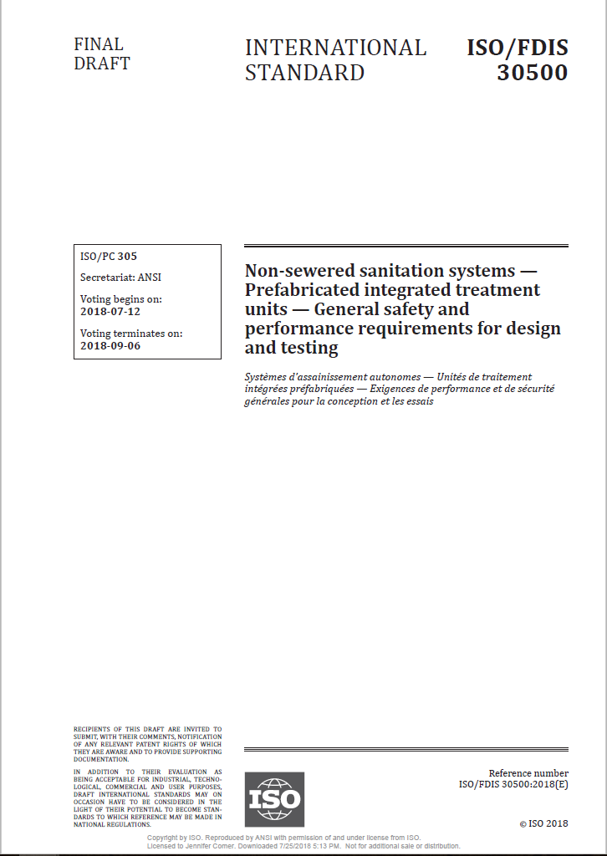
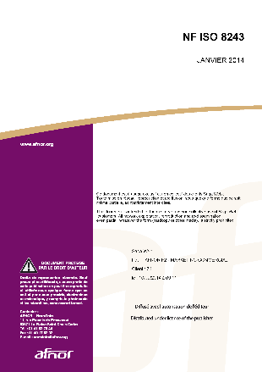
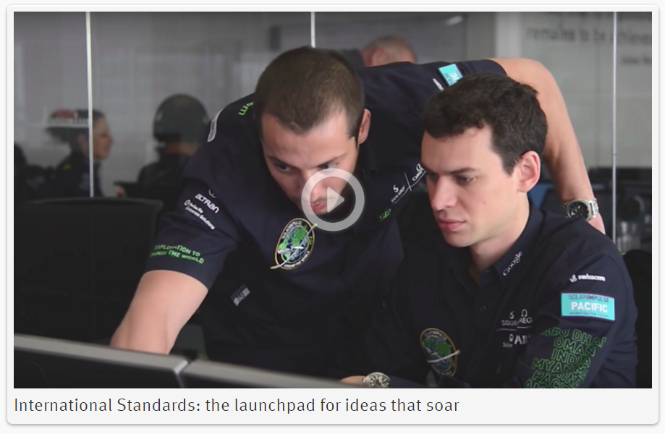
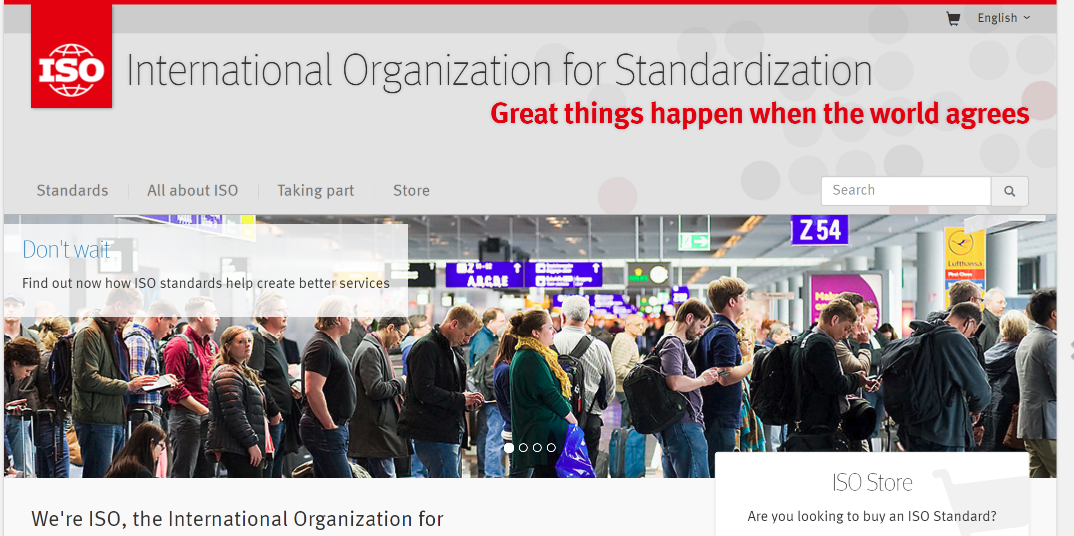
Products covered in POCOSA
Other
Works
ISO Publications
National Adoptions
Notes:
Les produits couverts par POCOSA comprennent : les publications ISO, les adoptions nationales et d’autres travaux (comme par exemple site internet, vidéos, manuels, fils d’actualités…)

Slide 18
ISO Publications – Translations
All ISO Standards are published in English.
Members have the primary right to translate ISO publications into their national language.

Slide 19
Section 4.3.1b ISO Guide 21 National Adoptions

Slide 20
National adoption: definition
A national adoption is a publication, based on an International Standard, or endorsement of that International Standard, having the same status as a national normative document, with any deviations from the International Standard identified.

Slide 21
National adoption: degrees of correspondence
Identical | Modified | Non-identical
No additions or deletions. Modifications allowed specifically described in Guide 21, e.g.: Decimal comma instead of decimal point Addition of national information Information of recalculated values in different units | Can contain technical deviations, such as additions, deletions and changes introduced in the adopting regional or national standard. Each of the modifications needs to be clearly identified, preferably in a separate annex or in the preface or introduction. Changes to the structure of the standard must be limited so that an easy comparison is possible between the adopted and the International Standard. The allocated number cannot be the same as the ISO standard. | The technical content of the regional or national standard is not equivalent to the International Standard. Structure is changed. Changes have not been clearly identified Does not constitute an adoption. The allocated number cannot be the same as the ISO standard.

Slide 22
Methods for adoptions
The endorsement method | The republication method
The regional or national standards body issues an endorsement notice in an official bulletin or as an independent document stating that the International Standard has the status of a regional or national standard with or without assigning a regional or national reference number to the adopted International Standard. Basically, just adding a cover page to the ISO Standard. | Three possible approaches: reprinting translation redrafting

Slide 23
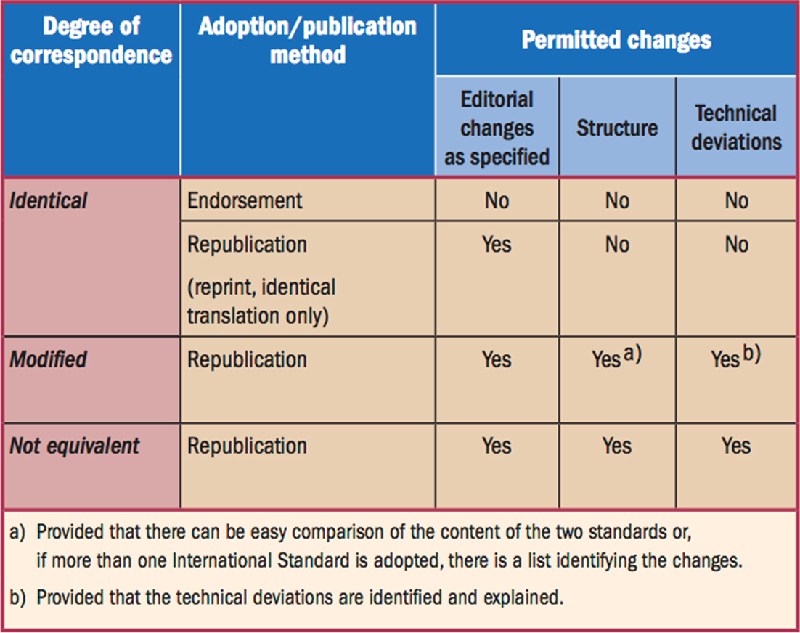
To sum up…

Slide 24
Section 4.4.1 ISO 30500 to support public policy

Slide 25
Standards: Powerful instruments for governments
Efficient and cost-effective tools
WTO TBT Obligations
Greater transparency and competition, e.g., in public procurement

Slide 27
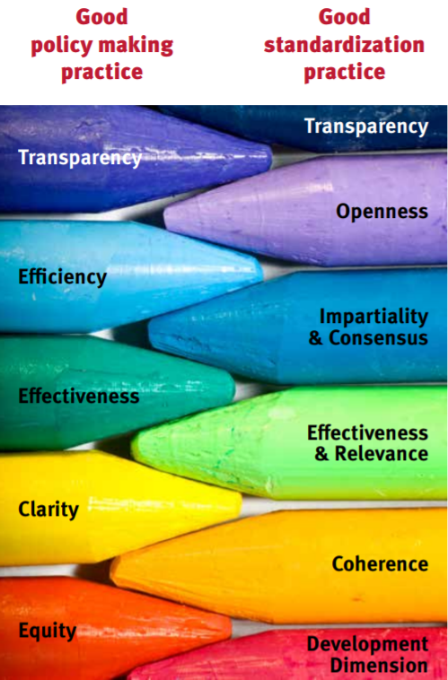
Benefits of using and referencing ISO Standards
Multi-stakeholder environment and double layer of consensus
Facilitating regulator compliance
Globally applicable
Basis for conformity assessment
Notes:
Clearly, there is strong synergy between Standards and Public Policy, where both are looking at….
Voluntary standards* are very important and powerful instruments supporting the efficient and effective functioning of markets: they can be used by regulators to complement regulations or, if appropriate, as an alternative to regulations
Standards covering certain areas may be made mandatory, for legitimate objectives (such as health, safety, environmental protection, …): they can be incorporated in regulations or can be used as a basis for technical regulations
A very important and interesting topic – ISO addresses in a variety of contexts and with the contribution of partner organizations such as the WTO, the OECD, UN agencies (e.g. UN/ECE and UN/ESCAP) and others

Slide 29
How International Standards are used in governance and regulation
Legislative actions
Laws (or Acts of Parliament)
Technical regulations (which support the requirements of laws)
Other actions include rules, notices, orders, determinations, and warrants
Non-legislative actions
Funding priorities
Incentive systems
Awareness campaigns
Public procurement
Codes of conduct

Slide 30
Examples of non-legislative actions
Incentive System
Canada: Grants for industrial organizations that adopt systems and processes to improve energy performance. One of the criteria for eligibility to receive a grant is that companies must implement the CAN/CSA ISO 50001 Energy Management Systems Standard.
Public Procurement
Japan: Government’s ‘Basic Policy for the Promotion of Procurement of Eco-Friendly Goods and Services’ defines 267 items as eco-friendly goods and, as of 2014, it references 72 JIS standards (including IEC and ISO standards that have been nationally adopted as JIS standards) as test and product standards.

Slide 31
Examples of legislative actions
1
Direct reference
46 CFR (U.S. Code of Federal Regulations) 111.105-11 Title 46 — Shipping Chapter I — Coast Guard, Department Of Homeland Security, Part 111_Electric Systems — General Requirements, Subpart 111.105_Hazardous Locations, Sec. 111.105-11 Intrinsically safe systems. Sec. 111.105-11 Intrinsically safe systems.
Extract from the regulation: “(a) Each system required by this subpart to be intrinsically safe must use approved components meeting UL 913 or IEC 60079-11 (both incorporated by reference; see 46 CFR 110.10-1).”
1
Indirect reference
Regulation (EC) 1223/2009 Cosmetics. Article 8, clause 2: “Compliance with good manufacturing practice shall be presumed where the manufacturer is in accordance with the relevant harmonised standards, the references of which have been published in the Official Journal of the European Union.”
The reference to EN ISO 22716:2007 Cosmetics - Good Manufacturing Practices (GMP) - Guidelines on Good Manufacturing Practices (ISO 22716:2007) can be found in the Harmonised standards (HAS) database,
Notes:
http://ec.europa.eu/enterprise/policies/european-standards/harmonised-standards/cosmetic-products/index_en.htm

Slide 32
Standards: Many ways
to support public policies
procurement
technical regulations
legislation
international
standards
trade
policy
consumer protection
environmental protection
awareness

Slide 33
We’re Here to Help
As secretariat of PC 305, ANSI is committed to supporting the adoption and recognition of ISO 30500 in countries where reinvented toilet technologies are needed most.
For more information:
https://sanitation.ansi.org/
sanitation@ansi.org

