Slide 1
ANSI Sanitation: Website & Resources
For ISO non-sewered sanitation standards
sanitation.ansi.org
Presenter name
Organization
Date
Location

Slide 2
How can https://sanitation.ansi.org help you?
Learn how to navigate the website and use tools available to share information on ISO non-sewered sanitation standards
Notes:
This PowerPoint is intended to help familiarize WASH stakeholders with ANSI's website and use the tools available to share information on ISO non-sewered sanitation standards. Resources include standards available for download, explainer videos, virtual trainings, PowerPoint presentations, examples of toilet technologies, expert testimonials, etc.

Slide 3
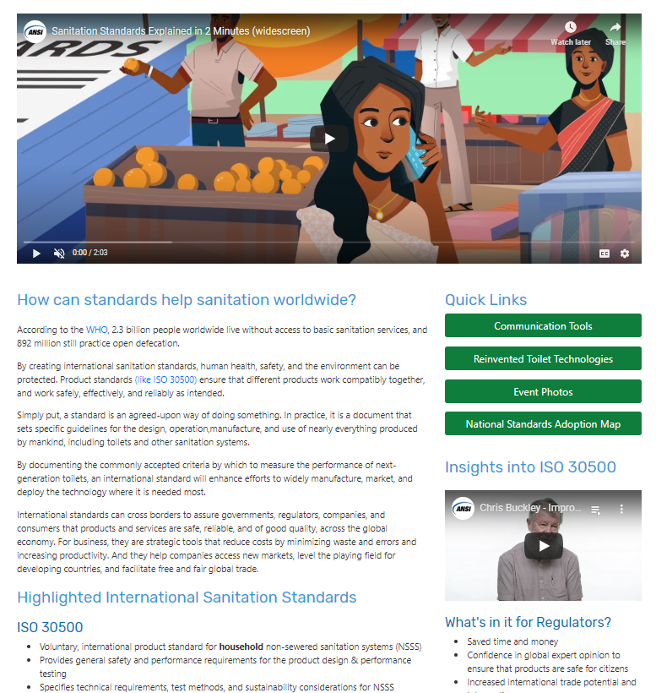
Homepage
https://sanitation.ansi.org/

Slide 4
Learn more about ANSI:
https://sanitation.ansi.org/

Slide 5
Learn how to download the standards

Slide 6
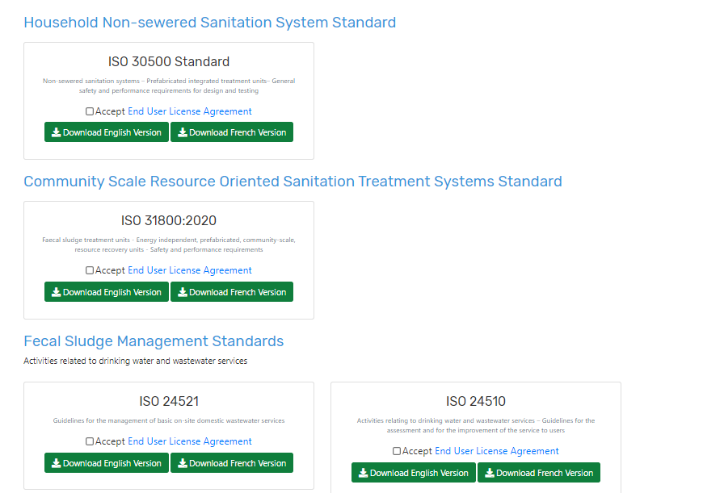
https://sanitation.ansi.org/Download

Slide 7
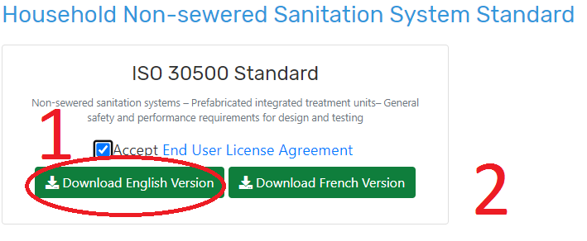
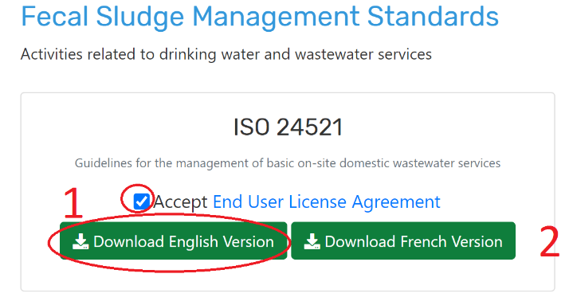
Creating an account
1. Go to https://sanitation.ansi.org/ and click “Download Standards” in the upper right hand corner of the page.
2. Click “Accept End User License Agreement” and then click “Download English Version” for ISO 30500 or ISO 24521, or other available standards
You will be taken to a new page to create a username and password. You must register on the site in order to download the standards as this is copyrighted material.

Slide 8
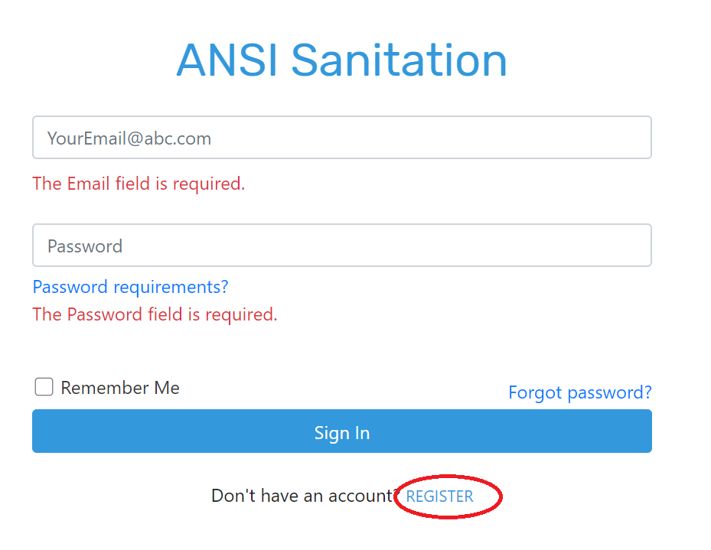
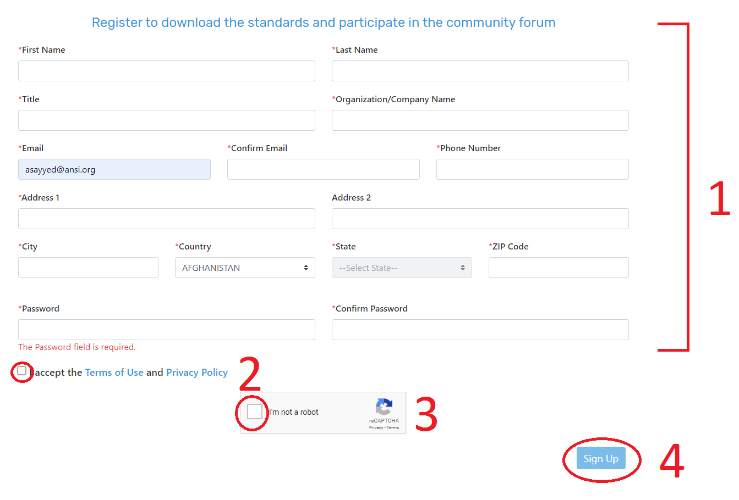
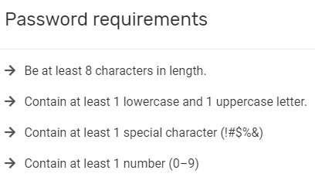
Creating an account
3. To create an account click the “Register” button at the bottom of the page
4. You must enter all the information with the “*” in order to move forward (1). Please then accept the “Terms of Use” and “Privacy Policy” (2). Then click the “I’m not a robot” box (3) and "Sign up" (4).
Please be mindful of the password requirements:

Slide 9
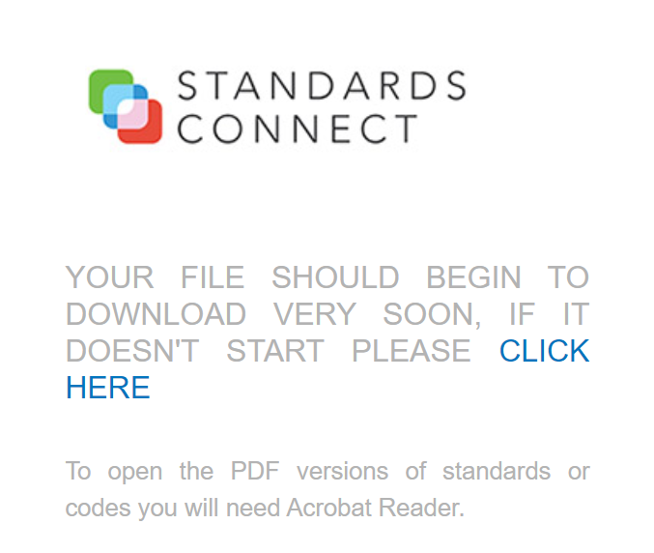
Creating an account
5. Your download should automatically begin and the following page will appear in a new tab:
You may login anytime and return to https://sanitation.ansi.org/Download to download additional standards.
Please remember: We do ask that there be only one download of each standard per agency, which can be shared internally after being downloaded by 1 user. Once downloaded, you may NOT share with stakeholders outside of your organization.

Slide 10
Explore https://sanitation.ansi.org

Slide 11
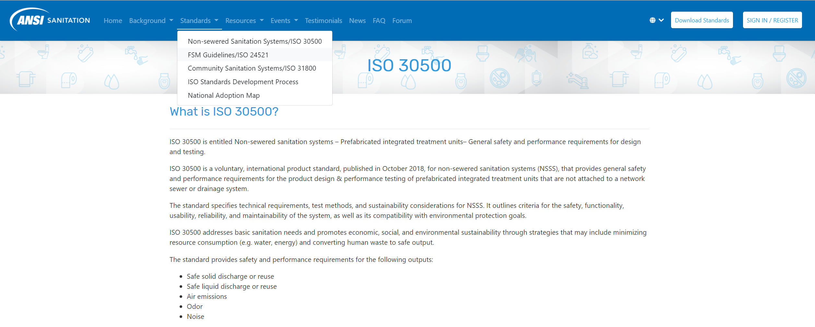
Learn more about the NSS standards:
https://sanitation.ansi.org/

Slide 12
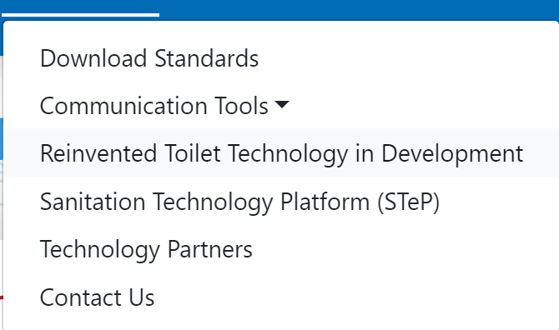
https://sanitation.ansi.org/RTTech

Slide 13
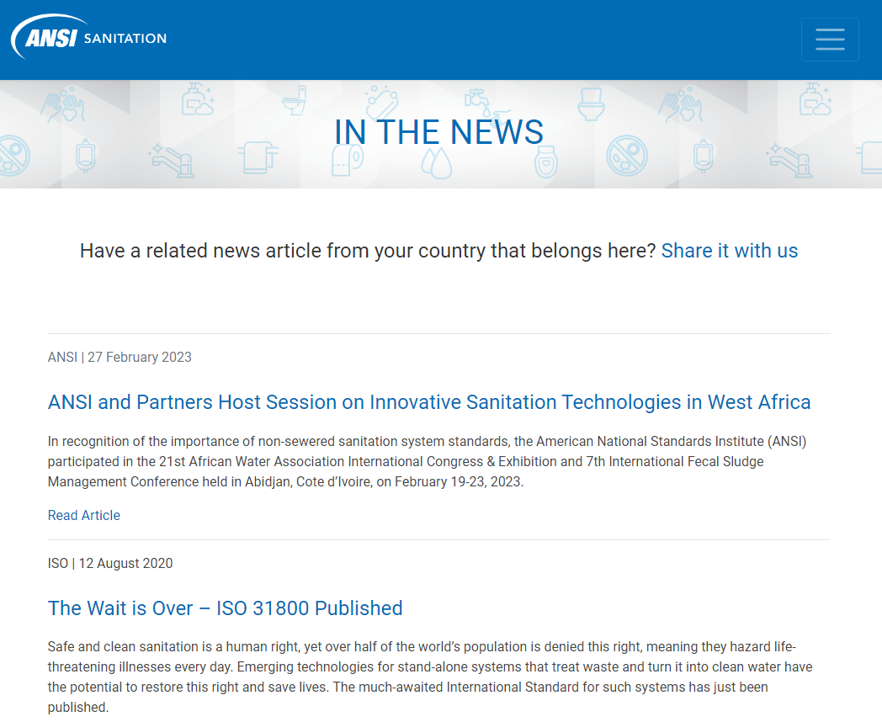
Engage with ANSI: Send us your news!
https://sanitation.ansi.org/News

Slide 14
How to use the Communication Toolboxes
(available in English, French, Chinese, and Portuguese)

Slide 15
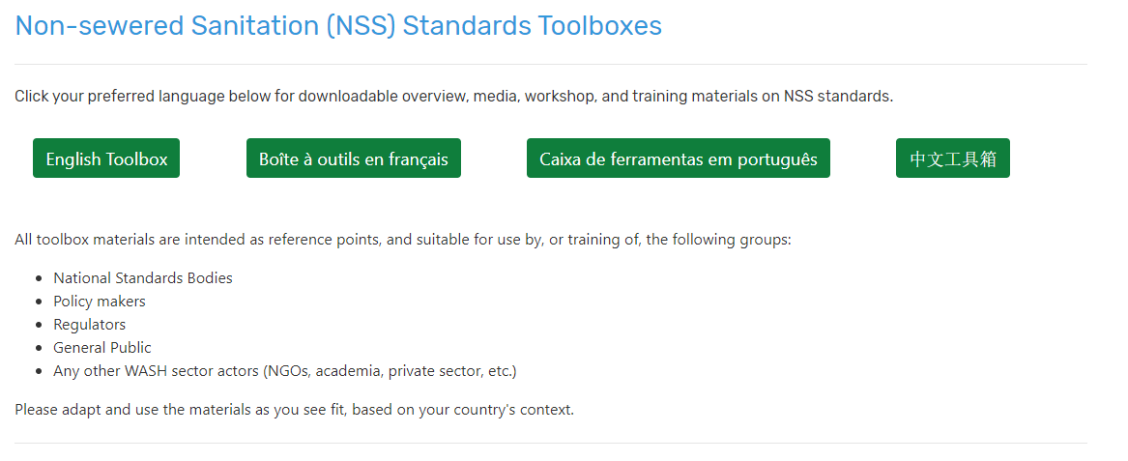
https://sanitation.ansi.org/Resources

Slide 16
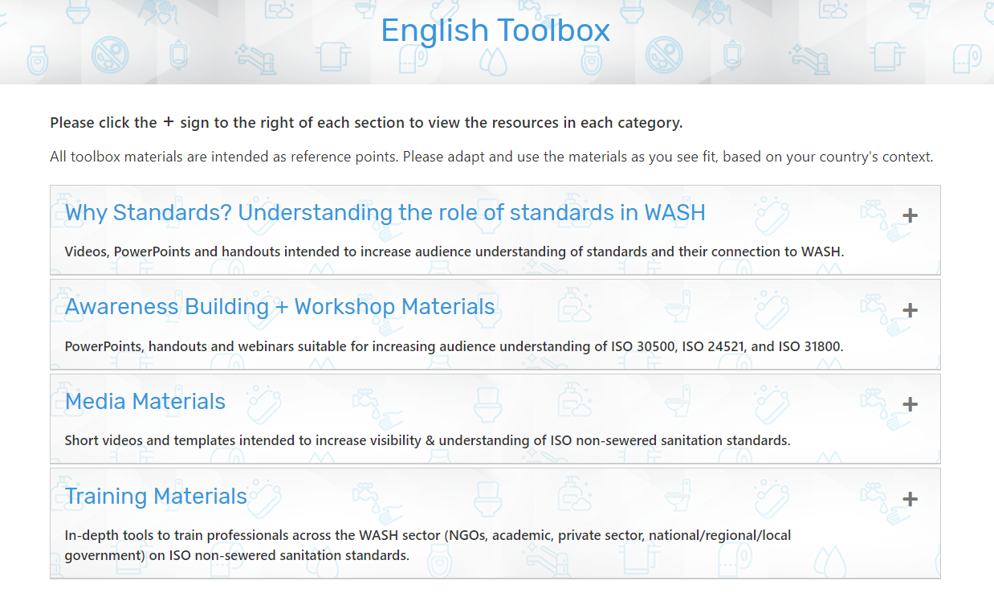
Communications Toolboxes
Use the toolbox (in your language) to access materials you can tailor for use in your meetings, awareness building, and training sessions
Expand each section to download materials
Materials are appropriate for all stages:
Before national review of NSS standards by a national standards body
During national review and technical committee meeting periods
For review by WASH stakeholders
After national adoption/publication
English Toolbox: https://sanitation.ansi.org/EnglishToolbox
French Toolbox: https://sanitation.ansi.org/FrenchToolbox
Portuguese Toolbox: https://sanitation.ansi.org/PortugueseToolbox
Chinese Toolbox; https://sanitation.ansi.org/ChineseToolbox

Slide 17
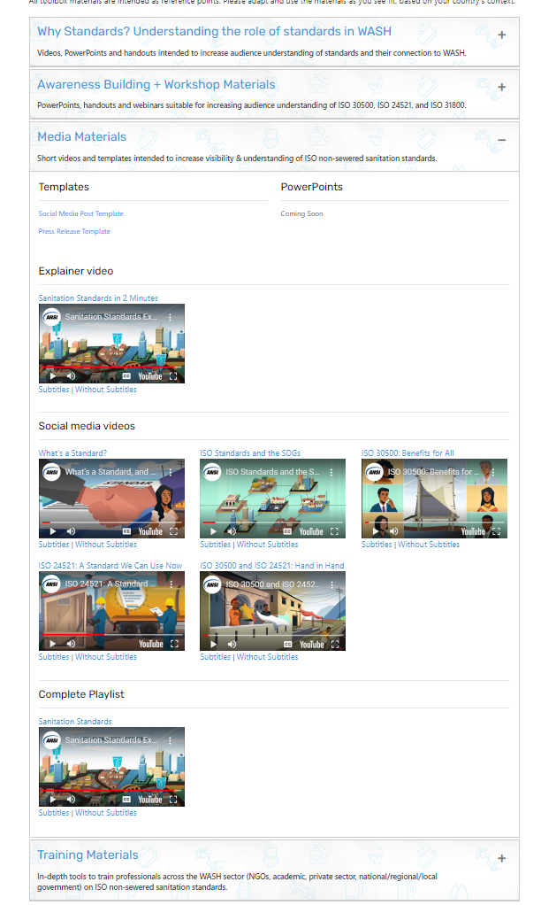
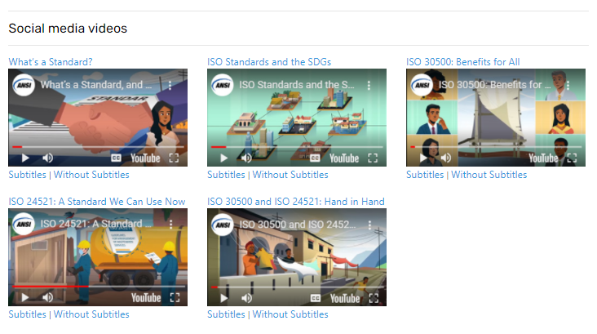
Media Materials
Show short videos about sanitation standards to educate your stakeholders:
On your organization’s social media pages
In your organization’s newsletter
During informational and technical meetings
Notes:
Copy+ paste this link into your web browser to visit the toolbox: https://sanitation.ansi.org/EnglishToolbox
Social Media (English with subtitles)
What’s a Standard, and How Does it Benefit Global Water and Sanitation? (English Subtitles) https://www.youtube.com/watch?v=tH-UzBsslSc
ISO Standards and the SDGs (English Subtitles) https://www.youtube.com/watch?v=Bv1ClEujMuk
ISO 30500: Benefits for All (English Subtitles) https://www.youtube.com/watch?v=7y7od4kXe8w
ISO 24521: A Standard We Can Use Now (English Subtitles) https://www.youtube.com/watch?v=zn61wIUbN7k
ISO 30500 and ISO 24521: Hand in Hand (English Subtitles) https://www.youtube.com/watch?v=13bG0cFeuLQ

Slide 18
Sanitation Standards Explained in 2 Minutes
English
Français
Português
中文
Notes:
Copy+ paste the following links into your web browser to view in your language
Watch a 2 minute video on Sanitation Standards in your preferred language:
Sanitation Standards Explained in 2 Minutes (English Subtitles) https://www.youtube.com/watch?v=DhNaJqEZvoM&feature=youtu.be
Normes d'assainissement en 2 minutes (sous-titres Français) https://www.youtube.com/watch?v=Gxl_DB-peqc
Normas de saneamento em 2 minutos (legendas em Português) https://www.youtube.com/watch?v=9TJPg1AkoJ0&
Sanitation Standards Explained in 2 Minutes (Chinese subtitles)/ 两分钟了解卫生标准 （中文字幕）https://www.youtube.com/watch?v=ASPT3YMJdNo or https://v.youku.com/v_show/id_XNDc4MzA0OTkyOA==.html?spm=a2hbt.13141534.app.5~5!2~5!2~5~5~5!2~5~5!2~5!2~5!2~5~5~A
Please see all videos here: https://www.youtube.com/user/ansidotorg/playlists?view=50&sort=dd&shelf_id=5

Slide 19
Tailor the materials
Engage with WASH experts to edit powerpoints and training materials to add country-specific information such as:
WASH statistics
National priorities related to sanitation
National sanitation strategy
Number of wastewater treatment plants
Relevant sanitation regulations
Not sure what to include?
Review South African Water & Sanitation Regulations PowerPoint_WRC for an example
Please feel free to use these materials to suit your country's needs. You may add your logo, include relevant national information, etc.
Notes:
Copy+ paste this link into your web browser to visit the toolbox: https://sanitation.ansi.org/EnglishToolbox
To download South African Water & Sanitation Regulations PowerPoint_WRC copy+ paste this link into your web browser: https://sanitation.ansi.org/pdfs/South-African-Water-Sanitation-Regulations-PowerPoint-WRC.pptx

Slide 20
Templates
Social media template
Access relevant hashtags, links, and handles for NSS standards
Tailor several posts for Twitter, Facebook, and LinkedIn to:
announce a country’s adoption of ISO NSS standards
share information
generate buzz about the standards during conferences or trainings.
Press release template
Has your national standards body adopted ISO 30500 or ISO 24521? Tailor the press release template to your national standards body needs and share with:
National media
Newsletters
Notes:
Copy+ paste this link into your web browser to visit the toolbox: https://sanitation.ansi.org/EnglishToolbox

Slide 21
Questions or comments? Email us at:
sanitation@ansi.org
https://sanitation.ansi.org/

