Slide 1
A snapshot of standardization policies in Africa & Asia
Jeffrey G. Weiss Tyler G. Welti
Partner Counsel
Venable LLP Venable LLP

Slide 2
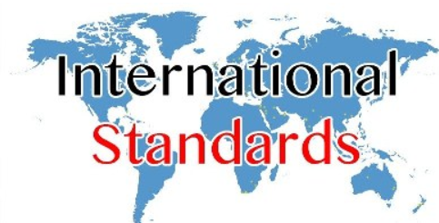
National and regional policies on using standards to support public policy

Slide 3

Standardization Policies in Key Regions
Africa:
  ARSO
  ECOWAS
  Senegal
  Kenya
  South Africa
Asia:
  China
  India

Slide 4

African Organization of Standardization (ARSO)
What is ARSO?
  Intergovernmental standards body in Africa that develops,
  harmonizes, and implements national and/or sub-regional
  standards as “African Standards”
  Eight Regional Economic Communities (RECs) also develop
  regional standards applicable within their jurisdictions
African Standards Harmonization Model (ASHAM)
  Process for adopting/harmonizing ISO Standards as African Standards
  Process: standards “accepted” by 2/3 vote of member states; “endorsed” by the ARSO Council; formally “adopted” by ARSO General Assembly; member states are directed to adopt the standard within their jurisdictions

Slide 5
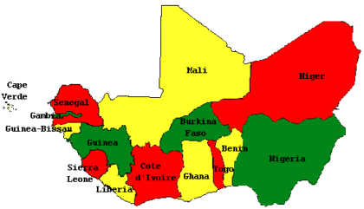
Economic Community of West African States (ECOWAS)
What is ECOWAS?
  Regional organization of 15 member states.
  Mission: promote economic cooperation & integration across West Africa
Develops “ECOSTANDs” to harmonize standards
  Automatically supersede national standards
  Shortens timeline for adoption of standards & reduces implementation costs
Senegal is expected to propose creation
of a Technical Harmonization
Committee to review ISO 30500 and
24521 for harmonization.

Slide 6

Senegal
National standards body: Senegalese Association for Standardization (ASN)
ASN is a member of the African Electrotechnical Standardization Commission (AFSEC), ARSO, ECOWAS, the IEC Affiliate Country Program, and ISO
Standardization process is not well-defined

Slide 7

Kenya
Kenya Bureau of Standards (KEBS)
KEBS is implementing a National Standardization Plan under ISO’s Technical Support Program for developing countries
  The Plan “[p]rovides a framework for . . . deciding how to use limited standardization resources through prioritization and planning”
    Economic Impact Strategy
    Social Impact Strategy
    Government Policy Priority
    Stakeholder Engagement Strategy

Slide 8


South Africa
South African Bureau of Standards (SABS)
  Develops, promotes, and maintains voluntary standards pursuant to the Standards Act.
  Provides conformity assessment services.
  Runs voluntary SABS “Mark Scheme” to indicate
  products conform to standards.

Slide 9
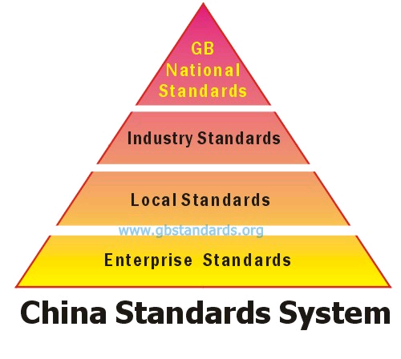
China
Standardization Administration of China supervises standardization
Standards are developed and enforced pursuant to the recently revised “Standardization Law”
  National, sector, local, association, and enterprise standards
  Mandatory National Standards are proposed and drafted by administrative departments, subject to approval by Standardization Administration. Products that do not comply cannot be sold
  Voluntary National Standards also developed
  by administrative departments through
  technical committees of stakeholders
  Sector and local standards are always voluntary

Slide 10
India
Bureau of Indian Standards is national body for standards development, conformity assessment, and quality assurance
  Producers of certain metals and other goods must have products tested at testing and marking centers for conformity with standards
  Products that conform to standards must bear Hallmark (for precious metals) and Standards Mark (for other goods)

