Slide 1
SA Water and Sanitation Regulations and Status and the role of ISO Standards
Dr Konstantina Velkushanova
UKZN, Pollution Research Group

Slide 2
Acronyms
ISO International Organisation for Standardisation
SA South Africa
WSA Water Services Act
WPSS White Paper on Water Supply and Sanitation
SDG Sustainable Development Goal
WASH Water, Sanitation and Hygiene
COGTA Cooperative Governance and Traditional Affairs
SALGA SA Local Government Association
CBO Community Based Organisation

Slide 3
Current state of Water and Sanitation
South Africa and the World

Slide 4
The World
“Despite progress, accelerated action is needed to provide billions of people with safely managed drinking water and sanitation” (SDG Report 2019, UN)
Global coverage of sanitation, drinking water and hygiene services, 2000-2017, %
Level of water stress: freshwater withdrawal as a proportion of total renewable freshwater resources, latest available year, 2000-2015 (percentage)
https://unstats.un.org/sdgs/report/2019/The-Sustainable-Development-Goals-Report-2019.pdf

Slide 5
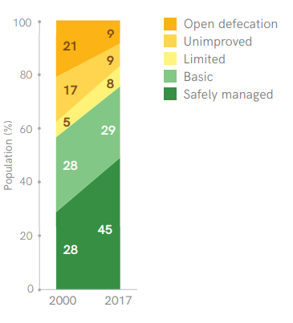
The World
Population lacking basic sanitation services decreased from 2.7 billion to 2 billion
2.1 billion people gained access to at least basic sanitation services
4 out of 10 people used safely managed sanitation services in 2017
Population using safely managed sanitation services increased from 28% to 45%
Rural coverage of safely managed sanitation services increased from 22% to 43%
https://unstats.un.org/sdgs/report/2019/The-Sustainable-Development-Goals-Report-2019.pdf

Slide 6
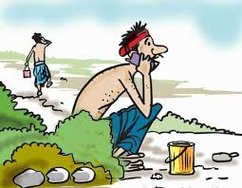
The World
Open defecation reduced by half (but 673 million – 9% – still practice open defecation!)
23 countries reduced open defecation rates >1%
51 countries had >99% basic sanitation coverage; 1 in 4 of them close to achieving ‘nearly universal’ coverage by 2030
Less than 1 in 3 ‘high burden’ countries with open defecation >5% on track to achieve ‘near elimination’ (<1%) by 2030.
www.google.com/search/opendefecation
https://unstats.un.org/sdgs/report/2019/The-Sustainable-Development-Goals-Report-2019.pdf

Slide 7
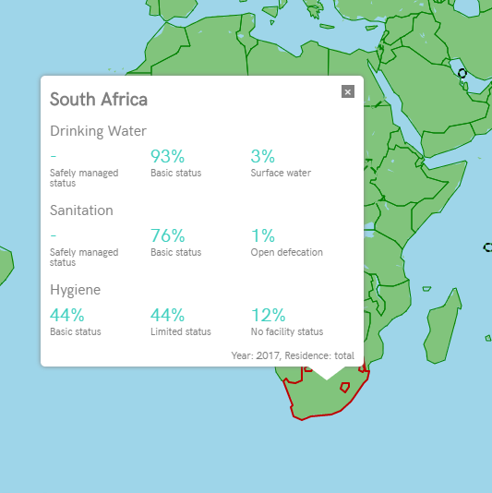
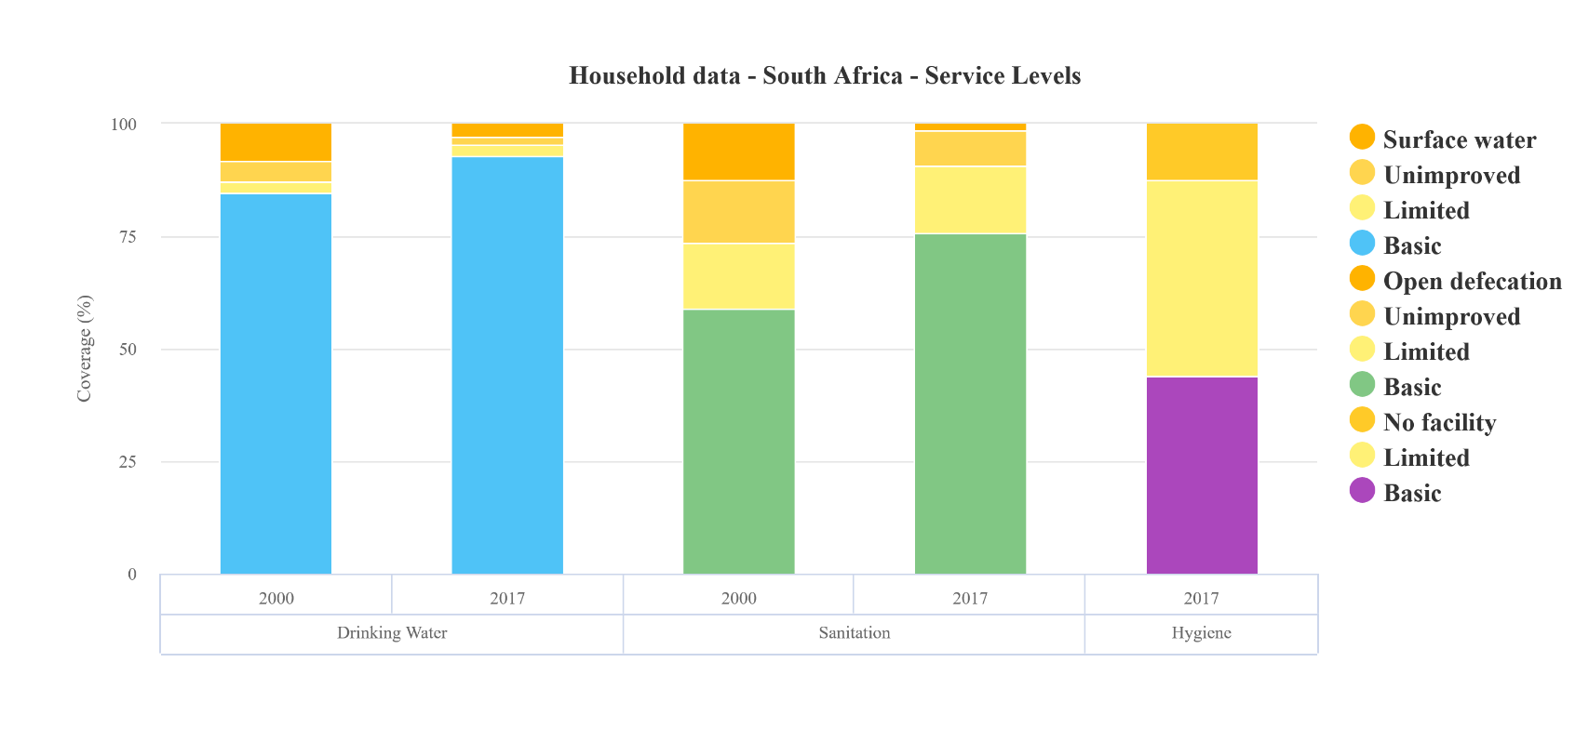
Current status in South Africa
https://washdata.org

Slide 8
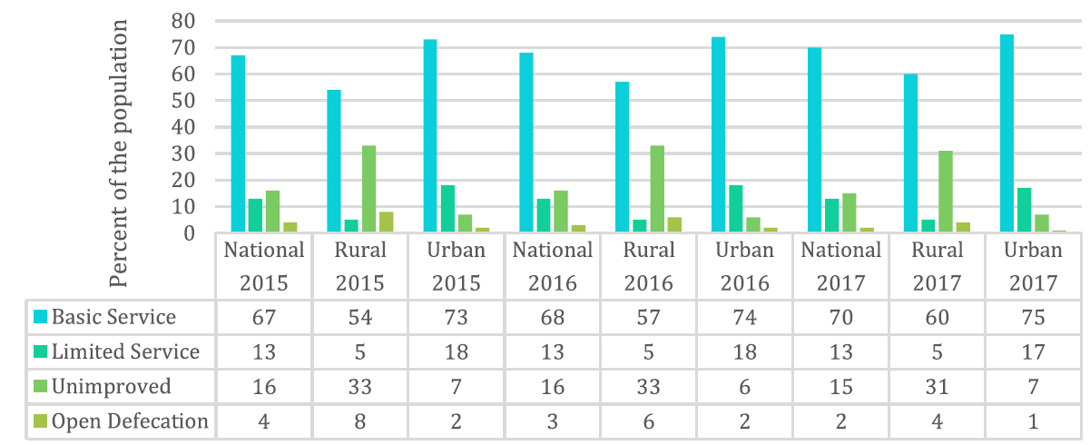
Current status in South Africa
Increased access to improved sanitation between 2015 and 2017 (from 80% to 83%)
70% with access to basic service
13% with access to limited service
17% without access to improved sanitation
2% practicing open defecation
GHS 2015 2017, StatsSA

Slide 9
Current status in South Africa
Open defecation practiced (not necessarily daily) at household level is 19% of the population (according to selected national households surveys between 2015-2018)
Access to improved sanitation facilities at the national level as at 2017:
  58% sewered connections,
  29% ventilated improved pit latrines or similar
  3% septic tanks
Urban South Africa 86% sewered vs rural SA 5% sewered.
Rural South Africa 71% uses pit latrines or similar and 5% septic tanks

Slide 10
Current status in South Africa
93% urban sanitation coverage achieved by 2017, exceeding the 2019 target of 90% coverage
Annual budgets for WASH from South African Government almost US$ 3 billion
In 2018 South Africa spent 2.32% of the GDP towards WASH expenditures with the total WASH expenditure per capita being 141US$
* GLAAS 2018/2019 country survey

Slide 11
Stakeholders in Water & Sanitation in South Africa

Slide 12
INSTITUTIONAL ARRANGEMENTS IN THE SANITATION SECTOR
Stakeholders in the Sanitation sector
Central Government
Provincial Government
Local Government
National Water Advisory Council
Private Sector
Non-Governmental Organisations (NGOs)
International Co-operation
Dept. of Water and Sanitation
Dept. of Human Settlements
National Water and Sanitation Advisory Committee
Water Services
Authorities
Water Services Providers
Dept of COGTA
SALGA
NGO & CBO
COGTA – Cooperative Governance and Traditional Affairs
SALGA – SA Local Government Association
CBO – Community Based Organisation

Slide 13
Water and Sanitation – National Level
The Department of Water and Sanitation (DWS)
  The water and sanitation sector leader in South Africa.
  The custodian of SA’s water resources, the National Water Act and the Water Services Act.
The Department of Human Settlements (DHS)
  The custodian of the national Housing Act and the National Housing Programmes contained in the National Housing Code.
The Department of Cooperative Governance and Traditional Affairs (CoGTA)
  The custodian of the Municipal Systems Act and the Municipal Structures
  Coordinate and oversee the implementation of the FBS policy
The Department of Health (DOH)
  Coordinate the planning and interventions for health and hygiene behaviour of communities
  Create a demand for sanitation services through health and hygiene awareness and education programmes.
National Treasury
  In terms of sanitation relates to the funding of the different departments and spheres of government for rollout of programmes.

Slide 14
Water service institutions
Water Services Authority (WSA)
  Any Municipality ensuring access to water services in the Act
  Can perform as a Water Services Provider
  May form a joint venture with another water services institution
  Must prepare a WSDP to ensure effective, efficient, affordable and sustainable access to water services
  WSDP is a link between water services provision and water resources management
Water Services Provider (WSP)
  To provide water services in accordance with the Constitution, the Water Services Act and by-laws of the water services authority
  WSA may perform the functions of the Water Services Provider
Water Boards
  Government-owned
  Key role in the South African water sector
  Provide technical assistance to Municipalities
  Report to the Department of Water and Sanitation
  15 water boards in SA
  The three largest are Rand Water, Umgeni Water, Overberg Water
  Provide water services to WSAs
Water Research Commission (WRC)

Slide 15
INSTITUTIONAL ARRANGEMENTS IN THE WATER SECTOR

Slide 16
South Africa’s Water & Sanitation Regulations

Slide 17
South Africa’s Water & Sanitation Regulations
Legislation National Water Services Act (1997)
Policies The White Paper on Water Supply and Sanitation (1994)
The White Paper on a National Water Policy of South Africa (1997)
The White Paper on Basic Household Sanitation (2001)
Strategies National Water & Sanitation Masterplan (2018)
National Sanitation Policy Frame work (2016)
Water Service regulation strategy
Certification Green drop (2008)
Blue drop (2008)
Standards BS/ISO 30500 (2018)
ISO 24521 (2016)

Slide 18
History of Sanitation in South Africa: Overview
Pre-1994
Post-1994
White Paper on Water Supply and Sanitation
Water Services Act
White Paper on Basic Household Sanitation
Green Drop and Blue Drop certification
National Sanitation Policy Framework & ISO:24521
Only Water Act (1956)
dealing with water resources
No legislation on water services and sanitation
2018
2016
National Water & Sanitation masterplan & SANS/ISO:30500
2008
2001
1997
1994

Slide 19
South African Legislation
1994 New South Africa
1994 White Paper on Water Supply and Sanitation Policy
1996 Constitution of the Republic of South Africa
  Section 24: “Everyone has a right to an environment that is not harmful to their health or well-being”
1996 National Sanitation Policy
1997 Water Services Act 108
1998 National Water Act 36
2000 Municipal Systems Act 32
2000 Free Basic Services (FBS) policy
    Free basic services for the poor including water supply, sanitation, refuse removal and electricity
2001 White Paper on Basic Household Sanitation

Slide 20
2001Free Basic Water (FBW) Implementation Strategy
2001 Compulsory National Standards (water conservation)
2001 Norms and Standards (water tariffs)
2002 Sanitation Technology Options
2003 Strategic Framework for Water Services
    Water is Life, Sanitation is dignity
2003 A Protocol to Manage the Potential of Groundwater Contamination from On-Site Sanitation
2004 National Water Resource Strategy
2005 National Sanitation Strategy
2005 National Health and Hygiene education strategy
2005 Municipal-Public-Private-Partnership Regulations
2007 Guidelines for the Costing of Household Sanitation Projects

Slide 21
2007 Strategy for sanitation services for informal settlements
2008 National Water Services Regulation Strategy
2009 Free Basic Sanitation (FBSan) Implementation Strategy
  “providing all citizens with free basic sanitation by 2014”
2011 Revision of the White Paper on Basic Household Sanitation
2013 National Development Plan (NDP)
2013 National Water Resource Strategy (update from 2004)
2016 National Sanitation Policy Frame work
2018 National Water & Sanitation Masterplan
2018 BS/ISO 30500

Slide 22
The development of innovative sanitation solution standards is a national priority according to the Industrial Policy Action Plan (IPAP) and the National Development Plan (NDP) of South Africa*
Non‐sewered sanitation systems are included in the Water and Sanitation Master Plan
The urgency of addressing the issue of inadequate sanitation was highlighted by the former Public Protector following the untimely passing of Michael Komape, who drowned in a pit latrine in 2014, furthermore this was an issue of focus in the recent Medium-Term Budget Policy Statement
*SABS Volume 1 / Issue 1/ October 2018

Slide 23
Water Services Act (1997)

Slide 24
Background of the WSA-1997
Water Services Act (Act 108 of 1997)
  Main objectives – providing for the right of access to basic water supply and sanitation necessary to secure sufficient water and an environment not harmful to human health and well-being
  It establishes the institutional arrangements for water services provision
  Sets out the responsibilities for each of the institutions
  Sets the “right to basic sanitation”

Slide 25
Right of access to basic water supply and basic sanitation
“Everyone has a right of access to basic water supply and basic sanitation
Every water services institution must take reasonable measures to realise these rights
Every water services authority must, in its water services development plan, provide for measures to realise these rights
The rights mentioned in this section are subject to the limitations contained in this Act”

Slide 26
National Sanitation Policy Framework (2016)

Slide 27
National Sanitation policy Frame- Work
Vision of the National Sanitation policy framework
Sanitation services in South Africa contribute significantly to public health and are hygienic, equitable, sustainable and efficient for all people
The focus of the National Sanitation Policy 2016 is to ensure and strengthen:
Integrated sanitation services
Institutional arrangements for sanitation services
Participation in sanitation services
Capacity and resources for sanitation services delivery
Financial effectiveness and efficient sanitation services
Sustainable sanitation provision in the country
Regulation of sanitation services

Slide 28
It is not all about flushing
“We must introduce new technologies that appreciate that water is a scarce resource and as such provide solutions to dispose of effluent via alternative methods. It’s not all about flushing…...We must begin by challenging the property development sector through regulation and licensing requirements to invest itself in developing properties less reliant on water for sanitation in order to ensure we introduce the alternative solutions to low-, middle- and high-income areas” (Previous Minister of Water and Sanitation Ms. Nomvula Mokonyane, 2016)
Sanitation is one of the basic necessities, which contributes to human dignity and quality of life and is an essential prerequisite for success in the fight against poverty, hunger, child deaths, gender inequality and empowerment.

Slide 29
National Water & Sanitation masterplan (2018)
“Water is Life, Sanitation is Dignity”

Slide 30
Water is Life, Sanitation is dignity
The National Water & Sanitation Masterplan is based on 5 key objectives that define the “New Normal” for Water & Sanitation management in SA:
          Resilient & fit-for-use water supply
          Universal water & sanitation provision
          Equitable sharing & allocation of water resources
          Effective infrastructure management, maintenance & operation
          Reduction in future water demand

Slide 31
Key Challenges identified in the Master plan relating to sanitation:
Waterborne sanitation is unsustainable, need to adopt “water-less” sanitation technology. Pragmatic management of the Free Basic Water policy is required
77% of rural households are indigent (poverty-stricken) and therefore entitled to free basic water which is placing a significant strain on municipalities with a low revenue base
South Africa invests R42 billion per year into water infrastructure, and R13 billion into sanitation. The estimated capital investment requirement is R90 billion per year over the next ten years, which is R33 billion per annum more than the current investment.

Slide 32
Certification

Slide 33
A regulatory approach that gained a significant momentum in South Africa is an incentive-based regulation introduced in September 2008 by the Department of Water and Sanitation to encourage continuous progress and to acknowledge excellence in two programmes:
  Blue Drop Certification Programme for Drinking Water Quality Management Regulation, and
  Green Drop Certification Programme for Wastewater Quality Management Regulation.

Slide 34

The Blue Drop
What is Blue Drop (BD)?
Annual national municipality water audit by the Department of Water & Sanitation.
This involves auditing of municipal water supply systems based on defined assessment criteria per audit cycle. The assessment criteria include drinking water quality compliance as prescribed through SANS 241.
Status is an award of excellence only to municipalities with score higher than 95%
The BD Certification Programme allows for proactive management and regulation of drinking water quality management based upon legislated norms and standards, as well as international best practice.

Slide 35

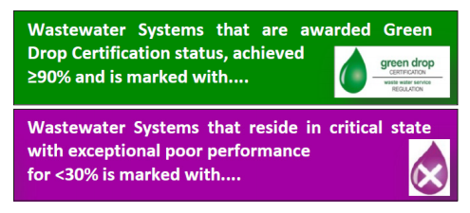
The Green Drop
What is Green Drop (BD)?
The Green Drop Programme aims to sustainably improve the quality of wastewater management in South Africa by identifying and developing the core competencies required to achieve this
Incentive-based mechanism − Aims to facilitate compliance with regulatory objectives and standards through motivation and reward rather than direct regulation
Administered by the Water Services Directorate within DWS (DWA, 2010)

Slide 36

The Brown Drop
“Brown Drop” or Shit Flow Diagram (SFD) is a tool to support understanding and communication on excreta ‘flows’ through a city or town; it shows how all excreta generated in a city that are or are not contained as they move from containment to disposal/end-use.
Brown Drop/SFDs are a useful tool to inform urban sanitation programming, by visualizing the status of urban sanitation services in terms of the ultimate fate of excreta.
They offer an innovative way to engage city stakeholders from political leaders to sanitation experts and civil society organizations in a coordinated dialogue about excreta management.
Resource: An excreta flow diagram – A Sanitation Game Changer for South Africa, WRC (2017)
https://sfd.susana.org/about/the-sfd

Slide 37
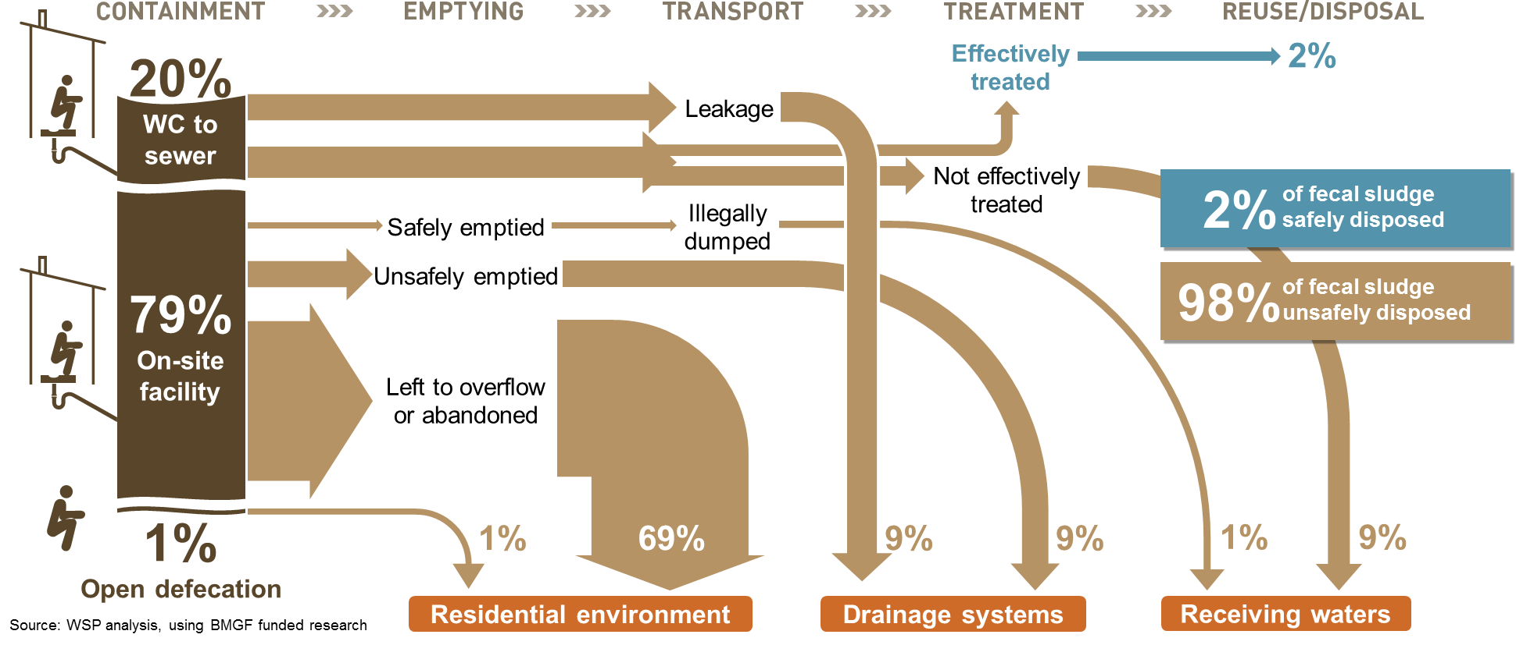
Example of Poor Fecal Sludge management (FSM)
Institutional open defecation − Sludge direct to the environment: no service chain
37
Notes:
Analysis of Dhaka, Bangladesh

Slide 38
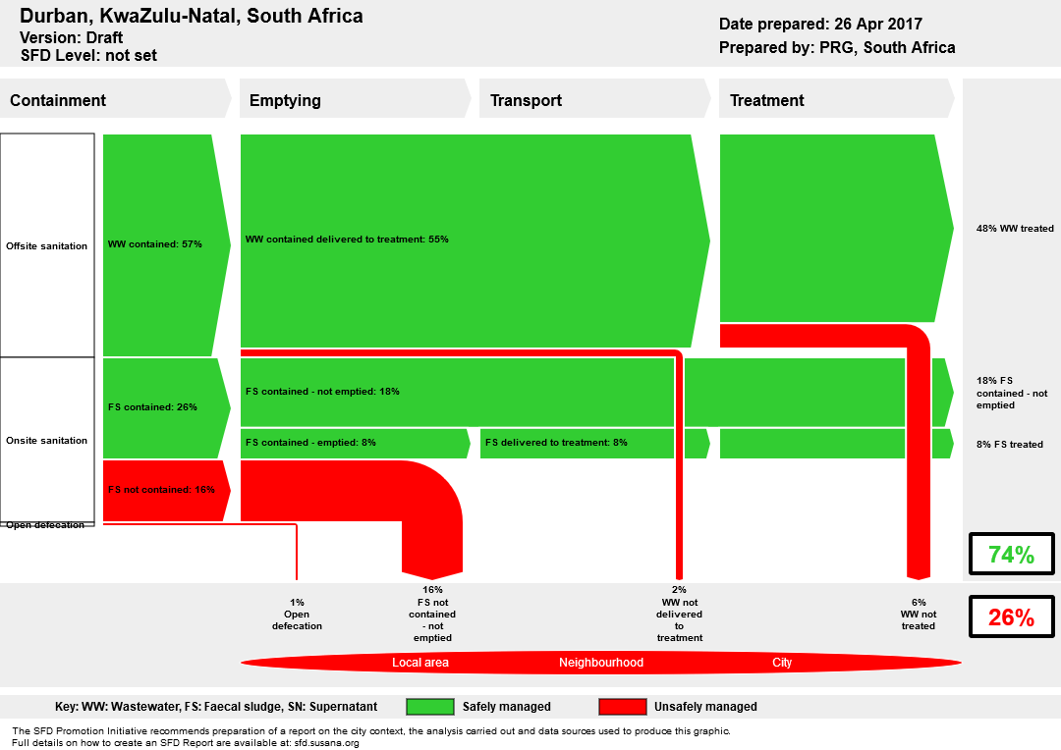
SFD in Durban
https://sfd.susana.org/data-to-graphic

Slide 39





Thank You!
SABS & WRC team
QUESTIONS
Content collated by Pollution Research Group, University of KwaZulu-Natal

