Slide 1
what’s included in ISO 30500?
a workshop for the technical expert
Presenter name
Organization
Date
Location

Slide 2
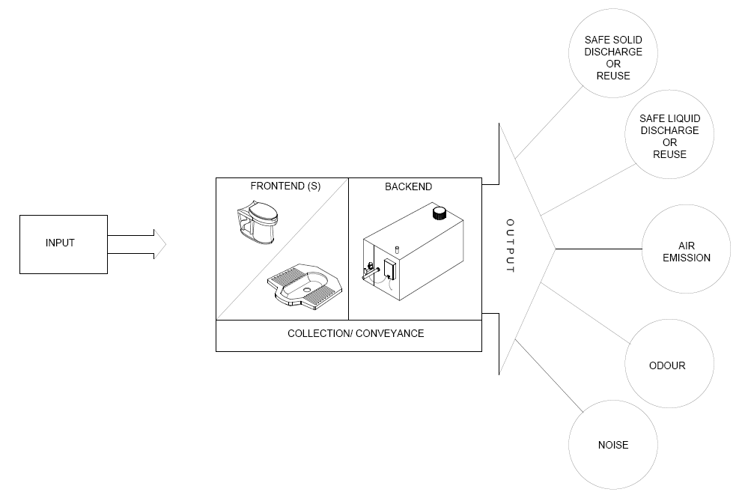
a non-sewered sanitation system
Notes:
A sanitation system, for the purposes of this document, ISO 30500, is a prefabricated integrated treatment unit, comprising frontend (toilet facility) and backend (treatment facility) components.
The sanitation system:
a) collects, conveys, and fully treats the specific input within the system, to allow for safe reuse or disposal of the generated solid, liquid, and gaseous output, and
b) is not connected to networked sewers or networked drainage systems.

Slide 3
ISO 30500 overview
General Technical Information
General Safety
Documentation Checks
Process Design Safety
Material Safety
Mech. & Elec. Safety
User Interface Experience
Maintenance Design
ISO 30500
Sustainability
Loading Patterns
Controlled Laboratory Testing
Mechanical Requirements
Environmental Parameters
Human Health Parameters
Air Emissions Parameters
Acoustics Parameters
Odour Requirements
Electrical Requirements
Field Verification of Performance
Environmental Parameters
Human Health Parameters
Notes:
This document specifies general safety and performance requirements for design and testing as well as sustainability considerations for non-sewered sanitation systems (sanitation system).
There are 3 main requirements in the ISO30500.
They are namely Document Checks, Controlled Laboratory Testing, and Field testing.
Within each pillar, there are fundamental requirements that need to be met for the certification of the technology.

Slide 4
Document Checks
General Technical Information
ISO 30500
General Safety
Process Design Safety
Documentation Checks
Material Safety
Mech. & Elec. Safety
User Interface Experience
Maintenance Design
Sustainability
Notes:
**/click Document Checks in slideshow mode to populate the slide**
The first component to meet the certification of the standard is to comply with the required document checks. Document checks are requirements the manufacturer has to provide in a formal document to prove various requirements such as performance, reliability, safety and sustainability.
Categories for Document checking include:
General Technical Information
General Safety
Process design safety
Material Safety
Mechanical and electrical safety
User Interface Experience
Maintenance design
Sustainability

Slide 5
General Technical Information
General Technical Information
4.2 Metric system
General Safety
Documentation Checks
Process Design Safety
4.3.1 Treatable Input
Material Safety
Mech. & Elec. Safety
User Interface Experience
4.3.2 Capacity
Maintenance Design
ISO 30500
Sustainability
Loading Patterns
4.3.3 Menstrual Hygiene Products
Controlled Laboratory Testing
Mechanical Requirements
Environmental Parameters
4.3.8 Usage Intervals
Human Health Parameters
Air Emissions Parameters
Acoustics Parameters
4.5 Design Lifetime
Odour Requirements
Electrical Requirements
Field Verification of Performance
Environmental Parameters
Human Health Parameters
Notes:
**/click General Technical information in slideshow mode to populate the slide. This will allow you to zoom into the section showing the text clouds.**
General Technical Information requirements ensure that the manufacturer produces general documentation to ensure that operators and purchasers are equipped with the required information to own and operate the unit. For example, manufacturers have to clearly state the design capacity in known metric units, declare its minimum design lifetime of 10 years, and declare that the system is able to treat “at a minimum, human faeces and urine, menstrual blood, bile, flushing water, anal cleansing water, toilet paper, and other bodily fluids/solids.”

Slide 6
General Safety
4.7 Secure design
General Technical Information
General Safety
Process Design Safety
4.8 Operating conditions
Documentation Checks
Material Safety
Mech. & Elec. Safety
4.12.1 Edges, Angles & Surfaces
User Interface Experience
Maintenance Design
ISO 30500
Sustainability
4.12.2 Fire & Explosion protection
Loading Patterns
Controlled Laboratory Testing
Mechanical Requirements
Environmental Parameters
4.12.3 Structural Integrity
Human Health Parameters
4.12.5 Underground Systems
Air Emissions Parameters
Acoustics Parameters
4.12.6 External Impacts
Odour Requirements
Electrical Requirements
Field Verification of Performance
5.1 Safety Assessment
Environmental Parameters
Human Health Parameters
Notes:
**/click General Safety in slideshow mode to populate the slide. This will allow you to zoom into the section showing the text clouds.**
General safety requirements ensure that the manufacturer has considered designing the system to ensure the user would be not be injured by the physical system in any way. This includes end-user needs requirements such as ergonomics of the units, structural integrity, and technical considerations for conducting safety assessments to known internal standards such as ISO 12100.

Slide 7
Process Design Safety
4.9.1 Component performance adequacy
General Technical Information
General Safety
Documentation Checks
Process Design Safety
Material Safety
4.9.2 Hygienic Design
Mech. & Elec. Safety
User Interface Experience
Maintenance Design
4.12.4 Unsafe effluent reuse
ISO 30500
Sustainability
Loading Patterns
Controlled Laboratory Testing
Mechanical Requirements
5.7 Conveyance devices
Environmental Parameters
Human Health Parameters
Air Emissions Parameters
6.7 Water Seal
Acoustics Parameters
Odour Requirements
Electrical Requirements
Field Verification of Performance
Environmental Parameters
Human Health Parameters
Notes:
**/clicks Process Design Safety in slideshow mode to populate the slide. This will allow you to zoom into the section showing the text clouds.**
Process Design Safety requirements ensure manufacturers consider aspects of process safety during the design of the system. Critical materials, equipment, components, connections, and joining elements of the sanitation system that are indispensable to the proper operation of the system shall be selected based on their suitability for sanitation applications and interoperability.

Slide 8
Material Safety
4.9.4 Cleanability of surface
General Technical Information
General Safety
Process Design Safety
4.9.5 Chemical & Biological Additives
Documentation Checks
Material Safety
Mech. & Elec. Safety
User Interface Experience
Maintenance Design
4.10.1 Durability
ISO 30500
Sustainability
Loading Patterns
Controlled Laboratory Testing
Mechanical Requirements
4.10.2 Fire Resistance
Environmental Parameters
Human Health Parameters
Air Emissions Parameters
4.11 Connections & Joints
Acoustics Parameters
Odour Requirements
Electrical Requirements
Field Verification of Performance
Environmental Parameters
Human Health Parameters
Notes:
**/click Material Safety in slideshow mode to populate the slide. This will allow you to zoom into the section showing the text clouds.**
This section ensures that materials used for the product shall be structurally stable, durable, fire resistant, and, where relevant, water tight, and shall be resistant to the effects of local conditions for the intended and reasonably foreseeable misuse.

Slide 9
Mechanical & Electrical Safety
5.4.1 Pressure/ Vacuum Equipment
General Technical Information
General Safety
Documentation Checks
Process Design Safety
5.4.2 Pipes, Hoses & Tanks
Material Safety
Mech. & Elec. Safety
User Interface Experience
5.4.3 Moving and Rotating Parts
Maintenance Design
ISO 30500
Sustainability
5.4.4 Backflow
Loading Patterns
Mechanical Requirements
5.5.1 High Temperature Surfaces
Controlled Laboratory Testing
Environmental Parameters
Human Health Parameters
5.5.2 Low Temperature Surfaces
Air Emissions Parameters
Acoustics Parameters
5.5.3 Other sources of Radiation
Odour Requirements
Electrical Requirements
Field Verification of Performance
5.6.1 Electrical & Electronic Systems
Environmental Parameters
Human Health Parameters
Notes:
**/click Mechanical & Electrical Safety in slideshow mode to populate the slide. This will allow you to zoom into the section showing the text clouds.**
Mechanical and electrical requirements for the sanitation system
Mechanical requirements include pipes, hoses, and tanks, as well as temperature surfaces and radiation considerations to minimize contact risks.
Electrical and Electronic System reliability of equipment such as pumps, drives, fans, or control systems shall be durable, require minimal maintenance, be adequately protected from any aggressive environment, and be capable of being easily serviced.
It is common that these requirements will require a separate visual inspection and/or test as well.

Slide 10
User Interface Experience
General Technical Information
4.6 Aspirational & Ergonomic
General Safety
Documentation Checks
Process Design Safety
4.13.1 Information & Warning
Material Safety
Mech. & Elec. Safety
User Interface Experience
4.13.2 Marking & Labelling
Maintenance Design
Sustainability
5.8 Transitions from backend
ISO 30500
Loading Patterns
Mechanical Requirements
6.2.1 General Usability Requirements
Controlled Laboratory Testing
Environmental Parameters
Human Health Parameters
6.2.2 Ease of Cleaning
Air Emissions Parameters
6.2.3 Ease of Operations
Acoustics Parameters
Odour Requirements
6.2.4 Cultural Requirements
Electrical Requirements
Field Verification of Performance
Environmental Parameters
Human Health Parameters
Notes:
**/click User interface experience in slideshow mode to populate the slide. This will allow you to zoom into the section showing the text clouds.**
Information and warnings on sanitation system shall be provided through clear and unambiguous symbols or pictograms to ensure the user’s comprehension. In addition, information and warnings on sanitation system shall also take into account user requirements to minimize risk and increase usability.

Slide 11
Maintenance Design
4.14.1 Reasonable Adjustment
General Technical Information
General Safety
Documentation Checks
Process Design Safety
Material Safety
4.14.2 Location & Access points
Mech. & Elec. Safety
User Interface Experience
Maintenance Design
4.14.3 Discharge & Cleaning
ISO 30500
Sustainability
Loading Patterns
4.14.4 Tools & Devices
Controlled Laboratory Testing
Mechanical Requirements
Environmental Parameters
Human Health Parameters
4.14.5 User Manual
Air Emissions Parameters
Acoustics Parameters
4.14.6 Handling & Transportation
Odour Requirements
Electrical Requirements
Field Verification of Performance
Environmental Parameters
Human Health Parameters
Notes:
**/click Maintenance Design in slideshow mode to populate the slide. This will allow you to zoom into the section showing the text clouds.**
This section sets out provisions to ensure that operators of such a product are adequately equipped with knowledge about how to adjust the system, where the access points of the unit are, how to clean the unit, as well as what type of spare parts are required.
A comprehensive user manual with clear and definitive instructions to users and service personnel for configuration, adjustment, and maintenance is also required.

Slide 12
Sustainability
General Technical Information
General Safety
Process Design Safety
8.2 Nutrient Recovery
Documentation Checks
Material Safety
Mech. & Elec. Safety
User Interface Experience
8.3 Water Consumption & Reuse
Maintenance Design
ISO 30500
Sustainability
Loading Patterns
8.4 Energy Consumption & Reuse
Controlled Laboratory Testing
Mechanical Requirements
Environmental Parameters
8.5 Life Cycle Assessment
Human Health Parameters
Air Emissions Parameters
8.6 Recurring Operational Requirements
Acoustics Parameters
Odour Requirements
Electrical Requirements
Field Verification of Performance
Environmental Parameters
Human Health Parameters
Notes:
**/click Sustainability in slideshow mode to populate the slide. This will allow you to zoom into the section showing the text clouds.**
These provisions are recommendations to manufacturers to ensure they produce a product that is environmentally sustainability, with considerations for life cycle analysis and total operating requirements. Provisions mentioned are related to the sanitation system’s use and recovery of resources.

Slide 13
Controlled Laboratory Testing
Loading Patterns
ISO 30500
Mechanical Requirements
Environmental Parameters
Controlled Laboratory Testing
Human Health Parameters
Air Emissions Parameters
Acoustics Parameters
Odour Requirements
Electrical Requirements
Notes:
**/click Controlled Laboratory Testing in slideshow mode to populate the slide**
Another category of testing to ISO30500 is Controlled Laboratory Testing.
Set within a superstructure, with a prescribed loading pattern and test sequence of at least 32 days, this portion of testing aims to ensure the performance of the unit is reliable under a strict set of conditions.
Testing during this phase includes:
Mechanical testing
Environmental testing
Human Health (Pathogen) parameters
Air emissions
Acoustics, or Noise
Odour
Electrical requirements

Slide 14
Loading Patterns
General Technical Information
General Safety
Documentation Checks
Process Design Safety
Material Safety
Mech. & Elec. Safety
7.2.8.1 Normal
User Interface Experience
Maintenance Design
ISO 30500
Sustainability
Loading Patterns
7.2.8.2 Stress
Controlled Laboratory Testing
Mechanical Requirements
Environmental Parameters
A3.8.10 Diarrhoea
Human Health Parameters
Air Emissions Parameters
Acoustics Parameters
Odour Requirements
Electrical Requirements
Field Verification of Performance
Environmental Parameters
Human Health Parameters
Notes:
**/click Loading Pattern in slideshow mode to populate the slide. This will allow you to zoom into the section showing the text clouds.**
Critical to conducting the Controlled Laboratory Testing section of ISO30500, the sanitation system is subjected to varying types of load (namely, Normal, Stress, and Diarrahoea) throughout the 32 days controlled laboratory testing schedule.
It shall be ensured that the sanitation system is loaded according to its specified treatment capacity with all additional system input specified by the manufacturer.

Slide 15
7.2.8.1 Normal Loading Pattern
The loading of the system shall be performed as a percentage of daily load (kg/day of faeces, l/day of urine), derived from capacity calculations indicated by the manufacturer
Daily load is determined through multiplying:
uses per day (faecal uses/day and urine uses/day); by
the average amount of faeces (kg/use) and urine (l/use).
Loading shall be conducted at the corresponding timing:
35 % from 6 am to 9 am;
25 % from 11 am to 2 pm;
40 % from 5 pm to 8 pm.
Back

Slide 16
7.2.8.2 Stress
Sanitation system is loaded with treatment capacity + “Sn”, where Sn is 80% of the difference between maximum capacity and treatment capacity.
Loading shall be conducted at the corresponding timing:
35 % from 6 am to 9 am;
25 % from 11 am to 2 pm;
40 % from 5 pm to 8 pm.
Back

Slide 17
A3.8.10 Diarrhoea
For the diarrhoea test days, 50 % of the normal faeces loading shall be ‘diarrhoea input’ instead of solid faeces.
Half of this load is to be as normal faecal load (solid faeces), the other half diluted as diarrhoea input.
35 % of daily capacity from 6 am to 9 am.
25 % of daily capacity from 11 am to 2 pm.
40 % of daily capacity from 5 pm to 8 pm.
Combine fresh faeces with water at a ratio of 2 l of water per kg of fresh faeces. The target dry matter content of the diarrhoea input should be between 3 % and 10.
For this testing, the assumption is that each diarrhoea user produces 1,2 l of diarrhoea per day.
Back

Slide 18
Mechanical Requirements
General Technical Information
General Safety
6.3 Visibility of Faeces
Documentation Checks
Process Design Safety
Material Safety
Mech. & Elec. Safety
6.4 Evacuation Performance
User Interface Experience
Maintenance Design
ISO 30500
Sustainability
6.5 Integrity against external impacts
Loading Patterns
Controlled Laboratory Testing
Mechanical Requirements
6.6 Slip, trip and falling
Environmental Parameters
Human Health Parameters
A3.1 Tightness Test
Air Emissions Parameters
Acoustics Parameters
A3.3 Evacuation Mechanism
Odour Requirements
Electrical Requirements
Field Verification of Performance
Environmental Parameters
Human Health Parameters
Notes:
**/click Mechanical Requirements in slideshow mode to populate the slide. This will allow you to zoom into the section showing the text clouds.**
This section provides provisions for inspection and testing of the sanitation system to ensure that it has:
No faeces visible (through a robust evacuation system)
The frontend shall reliably resist mechanical loads incurred during transport, installation, normal operation, and maintenance
Frontend areas of the sanitation system in which users and/or service personnel are expected to move about, stand, or sit shall be designed in such a way as to prevent slipping, tripping, or falling on, or off, these areas.
Areas where required are water tight.

Slide 19
Environmental Parameters
General Technical Information
General Safety
Documentation Checks
Process Design Safety
Material Safety
Mech. & Elec. Safety
COD
User Interface Experience
Maintenance Design
TSS
ISO 30500
Sustainability
Loading Patterns
Total Nitrogen
Controlled Laboratory Testing
Mechanical Requirements
Environmental Parameters
Total Phosphorus
Human Health Parameters
Air Emissions Parameters
pH
Acoustics Parameters
Odour Requirements
Electrical Requirements
Field Verification of Performance
Environmental Parameters
Human Health Parameters
Notes:
**/click Environmental Parameters in slideshow mode to populate the slide. This will allow you to zoom into the section showing the text clouds.**
Environmental provisions ensure that effluent output performance thresholds address human health parameters for safe disposal and all reuse purposes.
The environmental requirements for effluent shall be met by achieving all of the thresholds indicated in Table 6, Table 7 and Table 8 in at least 4 out of 5 test events, with no more than 20 % variance from the threshold for any failed parameter. Results shall not be averaged.

Slide 20
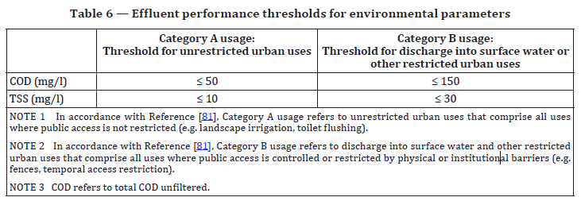
Environmental Parameters Threshold
Back

Slide 21
Human Health Parameters
General Technical Information
General Safety
Documentation Checks
Process Design Safety
Material Safety
Mech. & Elec. Safety
User Interface Experience
Maintenance Design
Bacteria
ISO 30500
Sustainability
Loading Patterns
Helminth
Controlled Laboratory Testing
Mechanical Requirements
Environmental Parameters
Protozoa
Human Health Parameters
Virus
Air Emissions Parameters
Acoustics Parameters
Odour Requirements
Electrical Requirements
Field Verification of Performance
Environmental Parameters
Human Health Parameters
Notes:
**/click Human Health Parameters in slideshow mode to populate the slide. This will allow you to zoom into the section showing the text clouds.**
Provisions for Bacteria, Helminth, Protozoa, and viruses with Log removal values and thresholds are integral to safe disposal and reuse outputs.
Indicator organisms are chosen for each class of pathogen, and spiked in a controlled environment to ensure performance addressing human health parameters for safe disposal and all reuse purposes.
Depending on the type of system and system input, the spike amount and duration will vary.

Slide 22
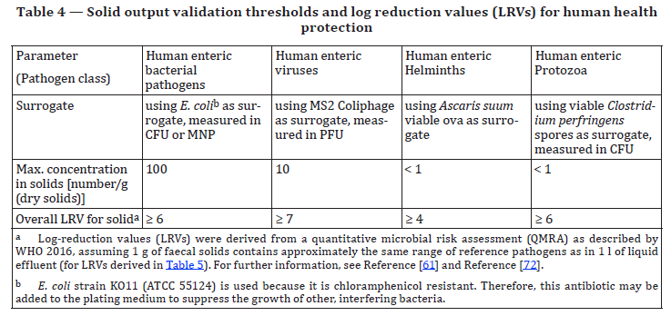
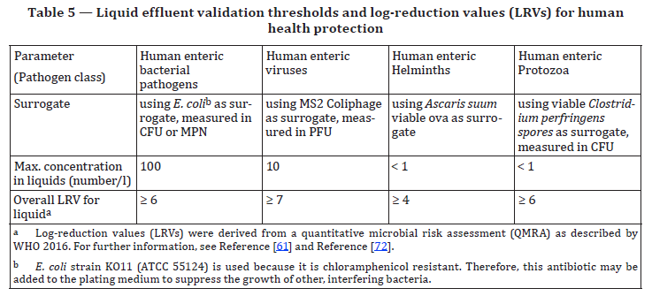
Human Health Parameters Threshold & Log Reduction
Control Parameters
Spiking
Back

Slide 23
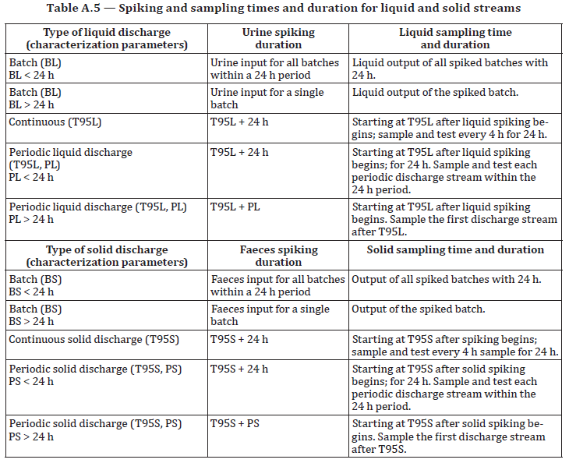
Human Health Parameters Spiking
Control Parameters
Spiking
Back

Slide 24
Air Emissions Parameters
General Technical Information
General Safety
Documentation Checks
Process Design Safety
Material Safety
Mech. & Elec. Safety
User Interface Experience
Maintenance Design
ISO 30500
Sustainability
Loading Patterns
Controlled Laboratory Testing
Mechanical Requirements
Environmental Parameters
Human Health Parameters
Indoor
Air Emissions Parameters
Stack
Acoustics Parameters
Odour Requirements
Electrical Requirements
Field Verification of Performance
Environmental Parameters
Human Health Parameters
Notes:
**/click Air emissions Parameters in slideshow mode to populate the slide**
The sanitation system shall be designed in such a way as to ensure that air pollutants released indoors and, where applicable, at the stack do not exceed the thresholds for environment and human health & safety.
Click on the two different types of measurement (indoor and stack) to find out more about the parameters required for testing, and general requirements for sampling.

Slide 25
Air Emissions Parameters: Indoor
General Technical Information
General Safety
CO
Documentation Checks
Process Design Safety
NO_{x}
Material Safety
CO₂
Mech. & Elec. Safety
H₂S
User Interface Experience
Maintenance Design
VOC
ISO 30500
Sustainability
PM2.5
Loading Patterns
NH₃
Controlled Laboratory Testing
Mechanical Requirements
Environmental Parameters
Human Health Parameters
Indoor
Air Emissions Parameters
Stack
Acoustics Parameters
Odour Requirements
Electrical Requirements
Field Verification of Performance
Environmental Parameters
Human Health Parameters
Notes:
**/click Indoor in slideshow mode to populate the slide. This will allow you to zoom into the section showing the text clouds.**
Indoor air provisions are to ensure that the end-user is safe from any harmful gases such as CO, NOx, PM2.5, amongst others.
The measurement shall be carried out inside the superstructure, about 1 m to 1,5 m above the squatting or seat pan of the frontend. The door of the superstructure shall remain closed before and during sampling.
Click any of the parameters to find out the specific threshold values

Slide 26
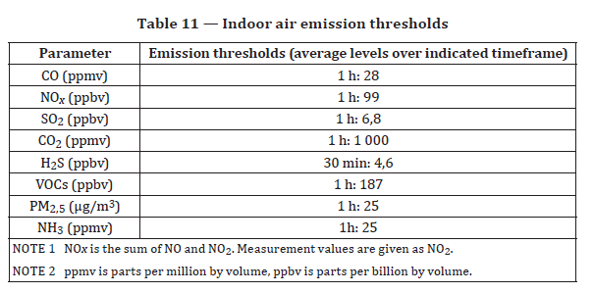
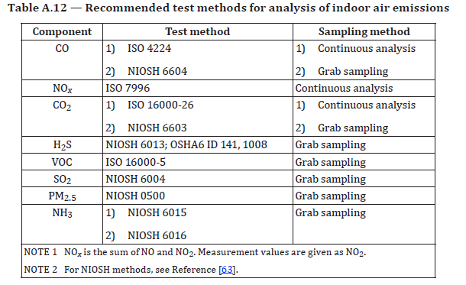
Air Emissions - Indoor
Back

Slide 27
Air Emissions Parameters: Stack
General Technical Information
General Safety
NO_{x}
Documentation Checks
Process Design Safety
CO
Material Safety
H₂S
Mech. & Elec. Safety
User Interface Experience
VOC
Maintenance Design
PM2.5
ISO 30500
Sustainability
NH₃
Loading Patterns
SO₂
Controlled Laboratory Testing
Mechanical Requirements
PAH
Environmental Parameters
O₂
Human Health Parameters
Indoor
Vol. Flow
Air Emissions Parameters
Stack
Moisture Content
Acoustics Parameters
Odour Requirements
Electrical Requirements
Field Verification of Performance
Environmental Parameters
Human Health Parameters
Notes:
**/click Stack in slideshow mode to populate the slide. This will allow you to zoom into the section showing the text clouds.**
Stack emissions are specific type provisions for thermal treatment units to ensure that their unit does not produce excessive amount of harmful gas to the environment.
Sample measurement shall be carried out in the external gas vent.
Click on the text clouds to find out more about the thresholds for measurements at the stack.

Slide 28
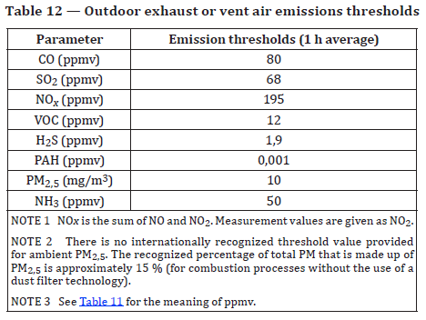
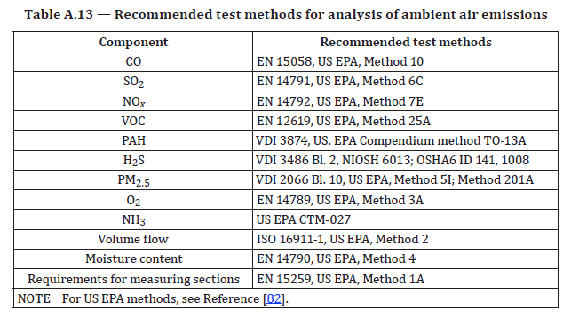
Air Emissions Outdoor
Back

Slide 29
Acoustics Parameters
General Technical Information
General Safety
Documentation Checks
Process Design Safety
Material Safety
Mech. & Elec. Safety
User Interface Experience
Maintenance Design
ISO 30500
Sustainability
Loading Patterns
Controlled Laboratory Testing
Mechanical Requirements
Within Superstructure
Environmental Parameters
Human Health Parameters
External
Air Emissions Parameters
Acoustics Parameters
Odour Requirements
Electrical Requirements
Field Verification of Performance
Environmental Parameters
Human Health Parameters
Notes:
**/click Acoustic parameters in slideshow mode to populate the slide. This will allow you to zoom into the section showing the text clouds.**
Provisions for noise ensure that the sanitation system does not pose a noise nuisance to neighbours and users.
Two types of noise measurements are considered in ISO30500:
Within the superstructure – to ensure that end-users do not suffer from noise pollution.
External noise – to be a “good neighbour”
Noise emissions from the sanitation system shall not pose risks to the health and psychological wellbeing of the user.
Click on the text clouds to find out more about the two different types of noise measurements.

Slide 30
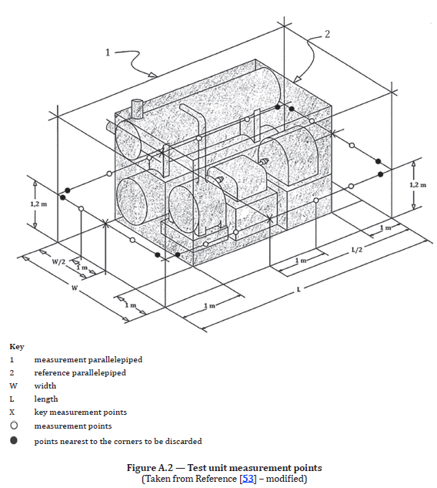
Acoustics Parameters
Within superstructure
For sanitation systems that include a superstructure as part of the manufactured product, noise shall be measured within the superstructure at a single measurement point. The measurement point shall be centred above the squatting or seat pan of the frontend at a height of 1,2 m.
External
The external measurement points shall be determined relative to a reference parallelepiped, which shall be determined as the smallest imaginary rectangular parallelepiped that could spatially enclose the system (see Figure A.2).
If a superstructure is provided as part of the manufactured product, then the reference parallelepiped shall enclose the superstructure.
The measurement points shall be positioned on the surface of a measurement parallelepiped whose planes are each 1 m outward (relative to the system) from those of the reference parallelepiped.
Back

Slide 31
Odour Requirements
General Technical Information
General Safety
Documentation Checks
Process Design Safety
Material Safety
Mech. & Elec. Safety
User Interface Experience
Maintenance Design
ISO 30500
Sustainability
Loading Patterns
Controlled Laboratory Testing
Mechanical Requirements
Environmental Parameters
Human Health Parameters
Within Superstructure
Air Emissions Parameters
Acoustics Parameters
External
Odour Requirements
Electrical Requirements
Field Verification of Performance
Environmental Parameters
Human Health Parameters
Notes:
**/click Odour Requirements in slideshow mode to populate the slide. This will allow you to zoom into the section showing the text clouds.**
Potential origins of odour emissions from the sanitation system include faecal odours (faeces and urine, and aging of faeces and urine), and process odours such as those emerging during drying, pyrolysis, combustion, and discharge of output. These odours should be kept to a minimum to avoid disturbance to surrounding communities.
Two types of odour are considered:
Within the superstructure – to ensure usability
External – to ensure that the sanitation system is a “good neighbour”
Click on either type of odour requirement to find out more about the test requirements

Slide 32
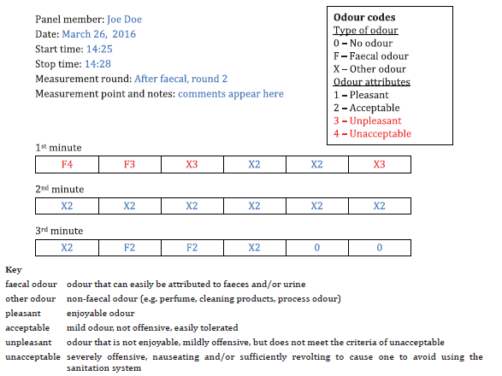
Odour – Within Superstructure
Control Parameters
Panelist
Back
Notes:
**/click Within Superstructure in slideshow mode to populate the slide**
For odour testing within the superstructure, a total of 2 panellists will be assessed and trained to conduct odour testing of the sanitation system indoors within the sanitation system superstructure. Panelists shall enter the sanitation system superstructure and close the door to begin the assessment immediately.

Slide 33
Odour – Vicinity of System
Control Parameters
Panelist
Back
Notes:
For odour testing in the vicinity of the system, position one panelist standing in front of the sanitation system, 2 m away from the sanitation system door. Position the second panelist standing at the backend of the sanitation system, 2 m away from the point designated as the point at which backend odour emissions are highest.

Slide 34
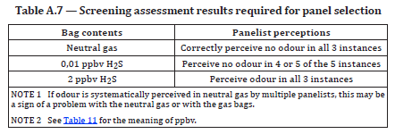
Panelist Assessment
Selection of panelist
The screening assessment procedure is as follows:
Present each panelist with a bag filled with neutral gas as defined in EN 13725:2003, 6.4.1. The bag should have a volume ranging from 1 l to 5 l and comply with EN 13725:2003, 6.3. The bag should have a port to allow direct smelling of the undiluted bag content.
Instruct the panelists to smell the neutral gas and indicate whether they perceive an odour. If the panel perceives an odour (or a change in the perceived odour) in the neutral gas, proceed with systematic testing to trace and eliminate the source of the odour.
Instruct the panelists to smell, in a randomly generated sequence of 11 total assessments:
neutral gas, a total of 3 times within the sequence;
0,01 ppbv H2S in neutral gas, a total of 5 times within the sequence;
2 ppbv H2S in neutral gas, a total of 3 times within the sequence.
Control Parameters
Panelist
Back
Notes:
a) In order to obtain a reliable panel, assessors with specific qualities shall be selected from the general population to serve as panelists.
b) Their olfactory responses should be as constant as possible from day to day, and within a day for repeatability of observations.
c) In order to ensure repeatability, the olfactory sensitivity of the panelists shall be within a defined bandwidth. To achieve this aim, candidates for the panel shall be screened to ensure a specific range of sensitivity to the reference odourant hydrogen sulfide (H2S)
d) To familiarize panelists with the olfactometric procedures, they shall first be trained by performing the screening assessment.

Slide 35
Electrical Requirements
General Technical Information
General Safety
Documentation Checks
Process Design Safety
Material Safety
Mech. & Elec. Safety
User Interface Experience
Maintenance Design
ISO 30500
Sustainability
A3.2 Control System
Loading Patterns
Controlled Laboratory Testing
Mechanical Requirements
Environmental Parameters
Energy source isolation
Human Health Parameters
Air Emissions Parameters
Energy discharge
Acoustics Parameters
Odour Requirements
Electrical Requirements
Field Verification of Performance
Environmental Parameters
Human Health Parameters
Notes:
**/click Electrical requirements in slideshow mode to populate the slide. This will allow you to zoom into the section showing the text clouds.**
These provisions validate the documents checked under Electrical Safety, ensuring that energy remaining or stored in the system that poses a potential hazard shall be discharged.
Energy discharge shall be executed following manufacturer’s instructions. Using an appropriate measuring device, verify and record whether all energy remaining or stored in the system is discharged.
If a backup source of energy is provided, check and record the capacity of the backup source of energy

Slide 36
Field Verification of Performance
ISO 30500
Field Verification of Performance
Environmental Parameters
Human Health Parameters
Notes:
**/click Field Verification of Performance in slideshow mode to populate the slide**
Field testing is required to ensure that the system is robust in real world conditions. This segment consists of environmental and human health parameter testing.
Depending on the class type of the system, minimum of one sanitation system, identical to the model subjected to controlled laboratory testing, shall be selected for field testing for a minimum duration of 1 to 5 months.
During field testing, the system shall be in use by the users at its specified treatment capacity (4.3.2). In order to pass field testing requirements, at least 75 % of all test results for environmental parameters shall satisfy the requirements defined.
Click on Environmental Parameters and Human Health Parameters to find out more about the requirements.

Slide 37
Environmental Parameters: Field
General Technical Information
General Safety
Documentation Checks
Process Design Safety
Material Safety
COD
Mech. & Elec. Safety
User Interface Experience
Maintenance Design
TSS
ISO 30500
Sustainability
Loading Patterns
Total Nitrogen
Controlled Laboratory Testing
Mechanical Requirements
75% Pass Requirement
Environmental Parameters
Human Health Parameters
Total Phosphorus
Air Emissions Parameters
Acoustics Parameters
pH
Odour Requirements
Electrical Requirements
Field Verification of Performance
Environmental Parameters
Human Health Parameters
Notes:
**/click Environmental Parameters in slideshow mode to populate the slide. This will allow you to zoom into the section showing the text clouds.**
During field testing, the system shall be in use by the users at its specified treatment capacity (4.3.2). In order to pass field testing requirements, at least 75 % of all test results for environmental parameters shall satisfy the requirements defined.
Parameters are similar to those required in the Controlled Laboratory testing

Slide 38
Human Health Parameters: Field
General Technical Information
General Safety
Documentation Checks
Process Design Safety
Material Safety
Mech. & Elec. Safety
User Interface Experience
Maintenance Design
Sustainability
Bacteria
ISO 30500
Loading Patterns
Mechanical Requirements
Protozoa
Controlled Laboratory Testing
100% Pass Requirement
Environmental Parameters
Human Health Parameters
Virus
Air Emissions Parameters
Acoustics Parameters
Odour Requirements
Electrical Requirements
Field Verification of Performance
Environmental Parameters
Human Health Parameters
Notes:
**/click Human Health Parameters in slideshow mode to populate the slide. This will allow you to zoom into the section showing the text clouds.**
During field testing, the system shall be in use by the users at its specified treatment capacity. In order to pass field testing requirements, at least 100 % of all test results for maximum bacterial, viral, helminth, and protozoa human health related parameters, using surrogates shall satisfy the requirements defined.
The same indicator organisms are used for each pathogen class. Helminths are not required. No spiking is conducted, hence only maximum concentration/thresholds are measured.

Slide 39
Summary
Documentation Checks
ISO 30500
Controlled Laboratory Testing
Field Verification of Performance

