Slide 1
ISO Organisation and SANS/ISO:30500
Dr Konstantina Velkushanova
UKZN, Pollution Research Group

Slide 2
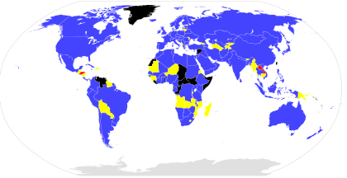
Background - ISO
The International Organization for Standardization (ISO) − founded in 1947
The world’s largest developer of voluntary International Standards
  67 original technical committees
Unified goal to ensure products and services that are safe, reliable and of good quality
Published 22803 International Standards covering almost all aspects of technology and business
https://www.iso.org

Slide 3
Background
ISO 30500:2018 published in October 2018, specifies general safety and performance requirements for design and testing as well as sustainability considerations for non-sewered sanitation systems (NSSS). Adopted by SABS in 2019 – SANS 30500:2019
ISO 30500:2018 was developed by experts from 32 participating countries and 16 observing countries (members)
Already adopted by 13 countries, 8 of them in Africa, including South Africa

Slide 4
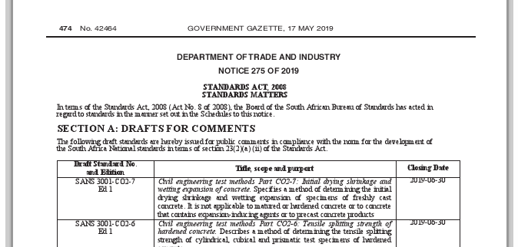
Background
On 17 May 2019, the Department of Trade and Industry, South Africa, published the adoption of ISO 30500:2018 as SANS 30500:2019 in their Notice 275 of 2019.

Slide 5
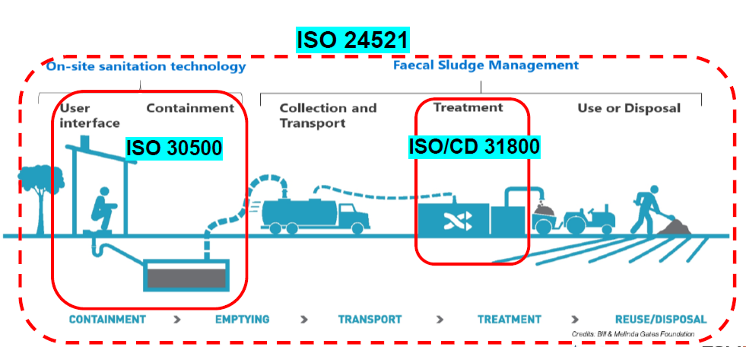
Background

Slide 6
SANS/ISO:30500

Slide 7
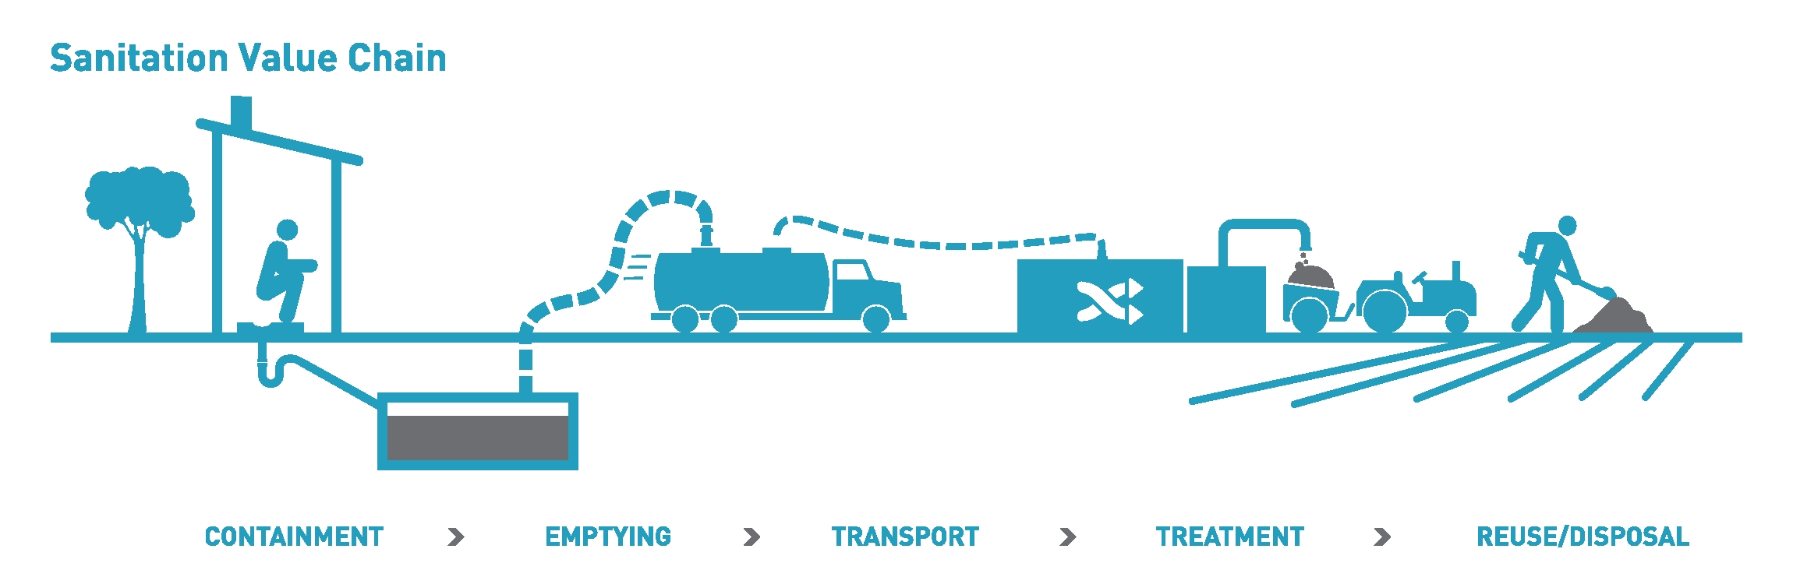
Scope of SANS/ISO30500

Slide 8
Non-Sewered Sanitation System (NSSS)
A prefabricated integrated treatment unit with
  A front-end component (Toilet facility)
  A back-end component (Treatment facility)
The NSSS:
  collects, conveys and fully treats the specific input within the system, to allow for safe reuse or disposal of the generated solid, liquid and gaseous output, and
  is not connected to a networked sewer or networked drainage system

Slide 9
Components of NSSS

Slide 10
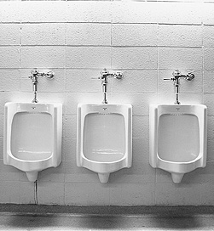

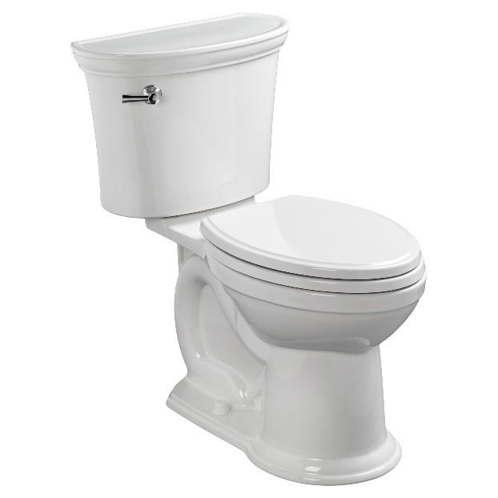
Front-end component (Toilet facility)
Includes user interfaces such as
  a urinal, squatting pan, or sitting pan

Slide 11
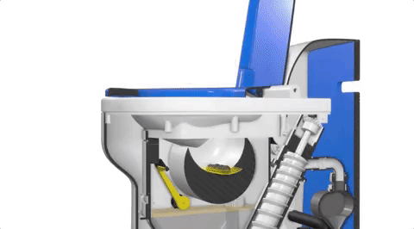
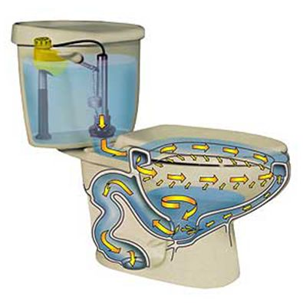
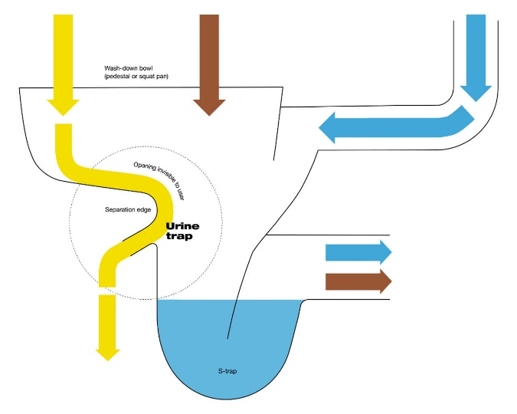
Front-end component (Toilet facility)
  Evacuation mechanisms: conventional flush, pour flush and dry toilets to novel evacuation mechanisms employing mechanical forces with little to no water.
https://sanitation.ansi.org

Slide 12
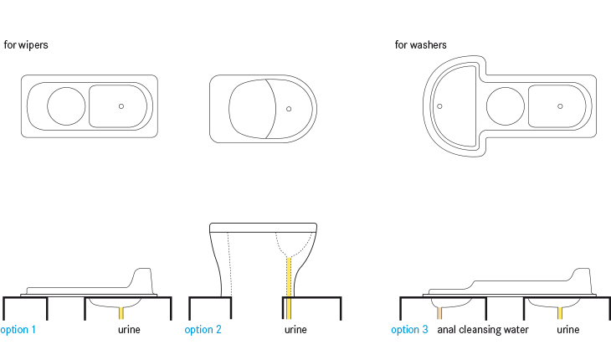
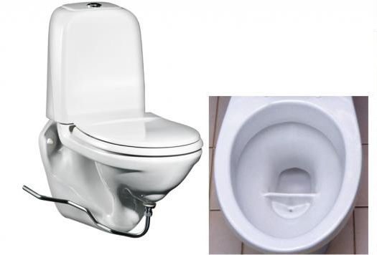
Front-end component (Toilet facility)
  Conventional and novel evacuation mechanisms may be combined with urine diversion applications (e.g. urine diversion flush toilet, urine diversion dry toilet).

Slide 13
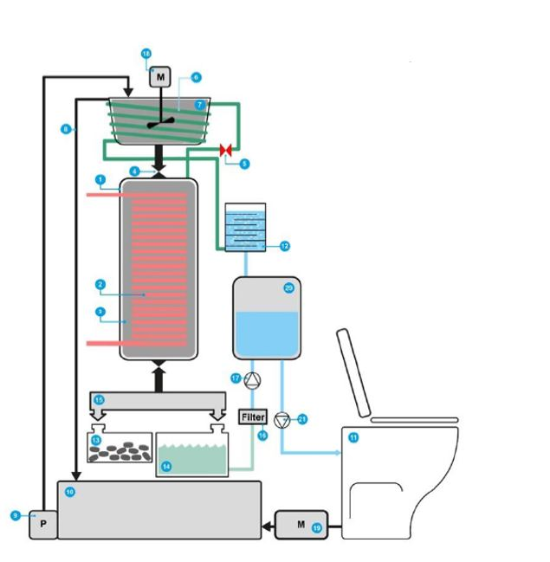
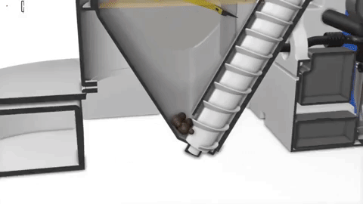
Back-end component (Treatment facility)
https://sanitation.ansi.org

Slide 14
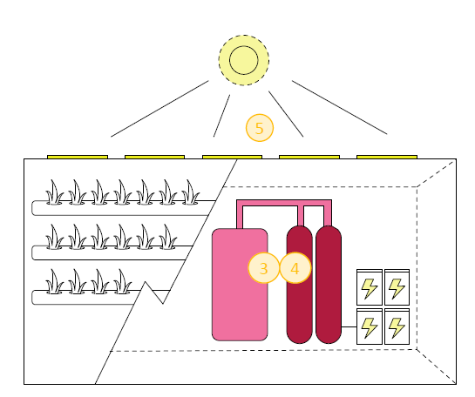
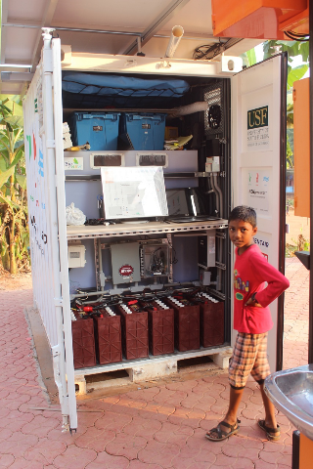
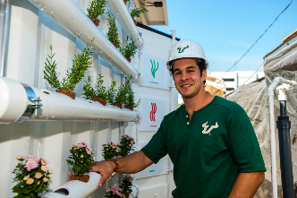
Back-end component (Treatment facility)
3. Liquid Processing; 4. Solids Processing; 5. Power System (Source: https://sanitation.ansi.org )
https://sanitation.ansi.org

Slide 15
Back-end component (Treatment facility)
Can range from biological or chemical to physical unit processes (e.g. anaerobic and aerobic digestion, combustion, electrochemical disinfection, membranes).
Some systems use only one of these processes while others apply work as a combination of processes through several treatment units (e.g. a combination of biological treatment, followed by an electro-chemical treatment).

Slide 16
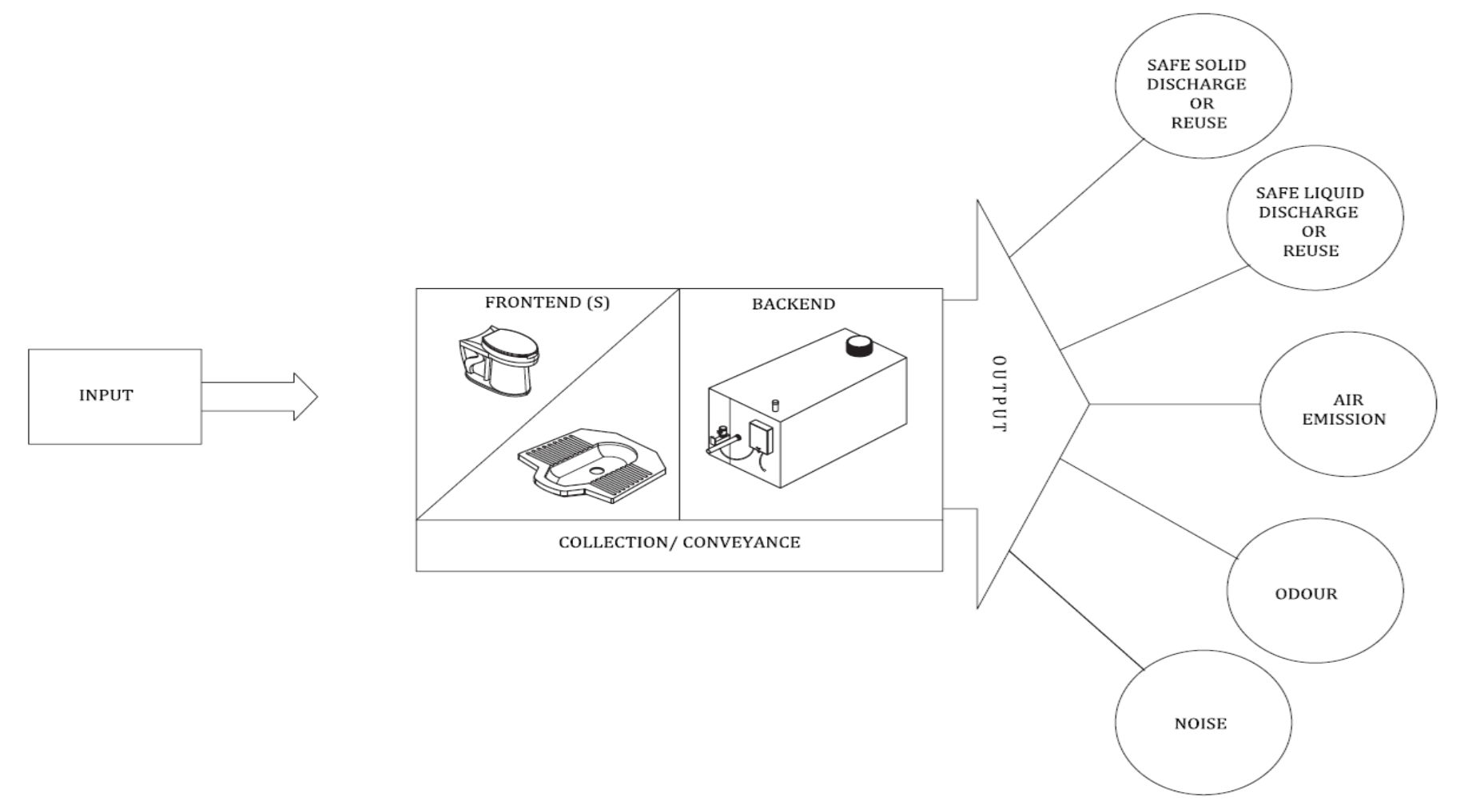
Scope of ISO 30500:2018
NSSS Classification:
Class 1: one front-end and non-biological back-end
Class 2: one front end and back-end with one or more biological treatment process
Class 3: multiple front-end with one or more biological or non-biological back-end

Slide 17
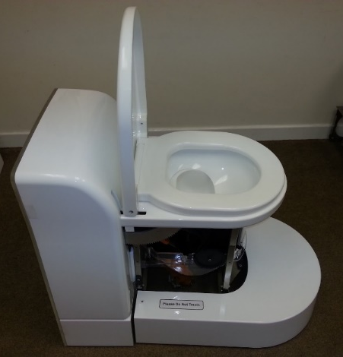
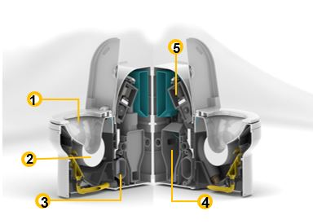
Classes of NSSS
Class-1: Single front end with Non-biological backend
1. Frontend; 2. Urine/ Faeces separation; 3. Liquid processing; 4. Solid processing; 5. Power system (Source: https://sanitation.ansi.org)
Singular Frontend

Slide 18
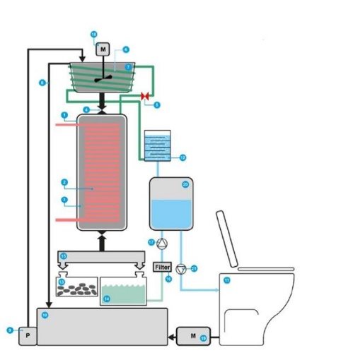
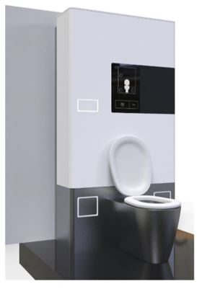
Classes of NSSS
Class-1: Single front end with Non-biological backend
Hydrothermal carbonisation unit, connected to a vacuum flush system, serving a household unit of up to 10 users per day (Source: https://sanitation.ansi.org)

Slide 19
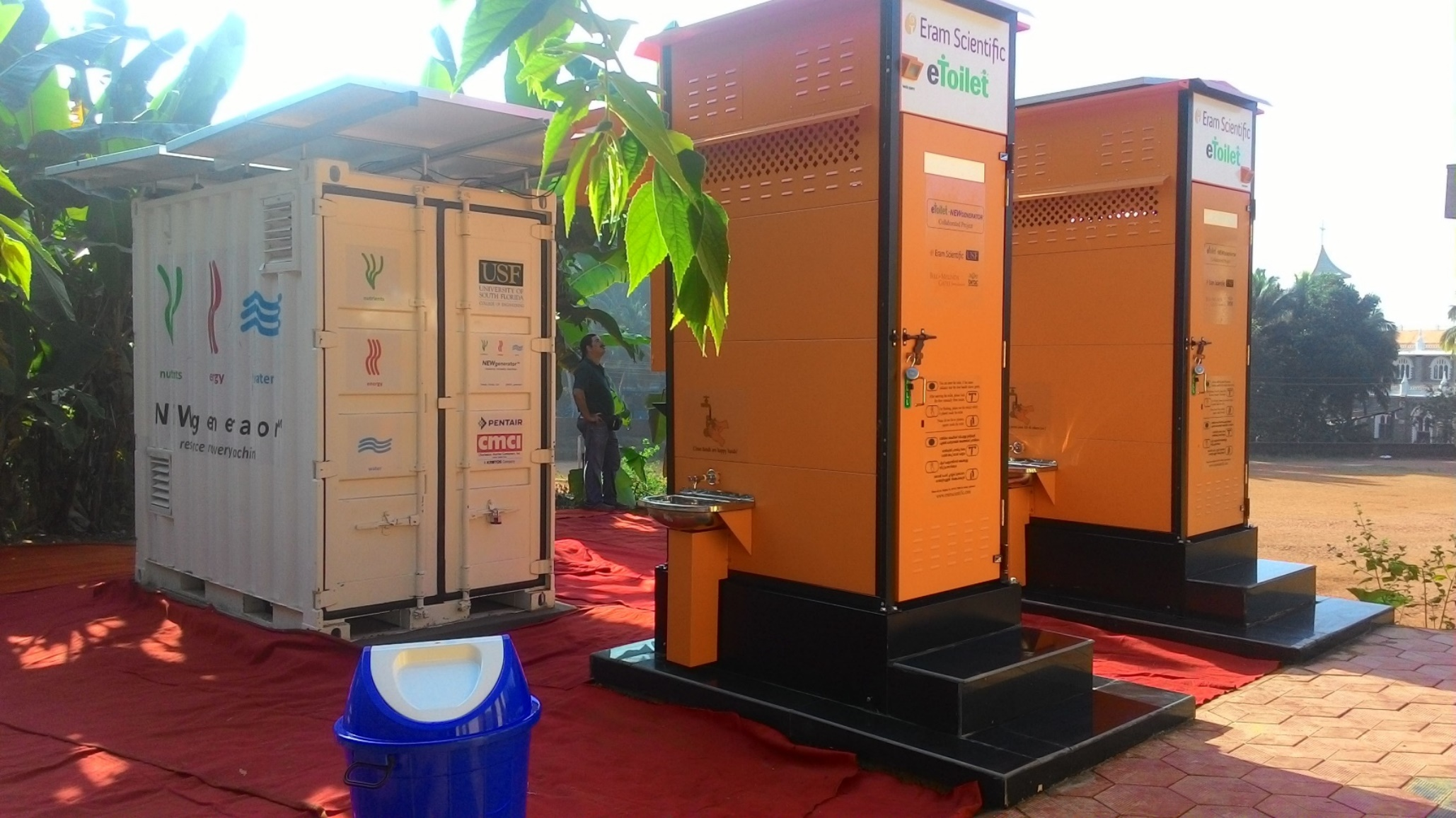
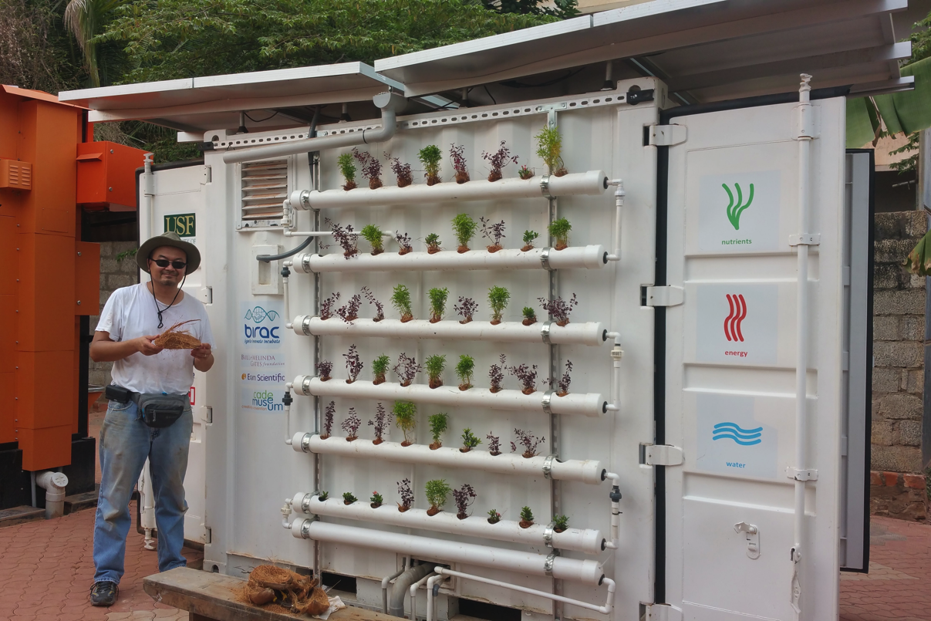
Classes of NSSS
Class-2: Single frontend with one or more biological backend
Backend example: (NEWgenerator solid processing via anaerobic membrane bioreactor)
https://sanitation.ansi.org

Slide 20
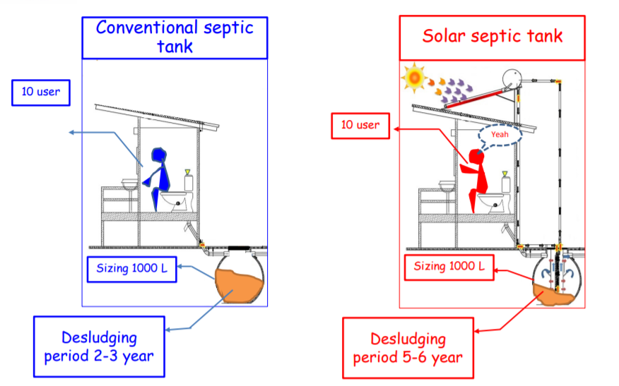
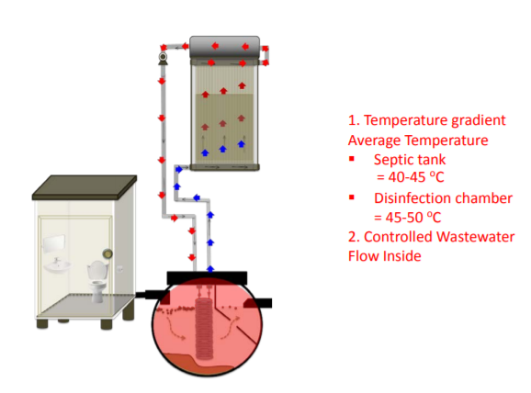
Class-2: Single frontend with one or more biological backend

Slide 21
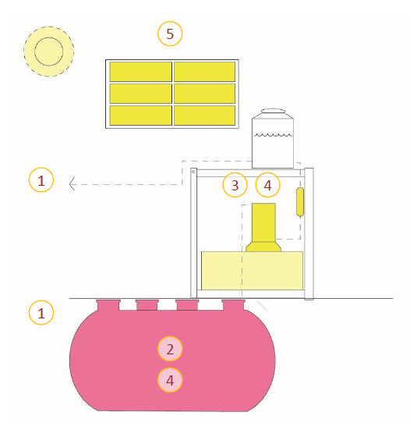
Classes of NSSS
Class-3: Multiple frontend with one or more Biological or non-biological backend
1. Frontend
2. Urine/Faeces Separation
3. Liquid Processing
4. Solids Processing
5. Power System
Example: (Caltech toilet backend, an electrochemical system, to be used with one or more frontend)
https://sanitation.ansi.org

Slide 22
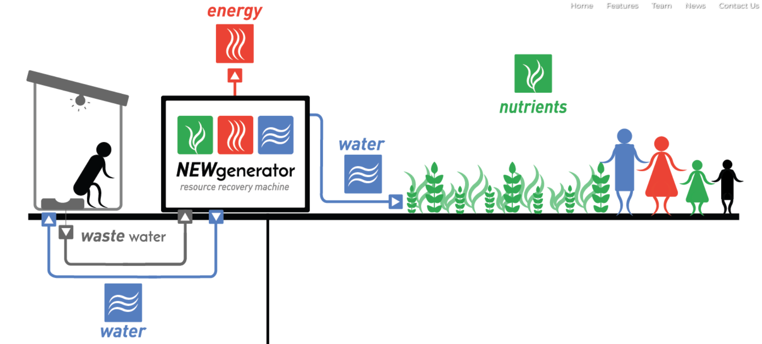
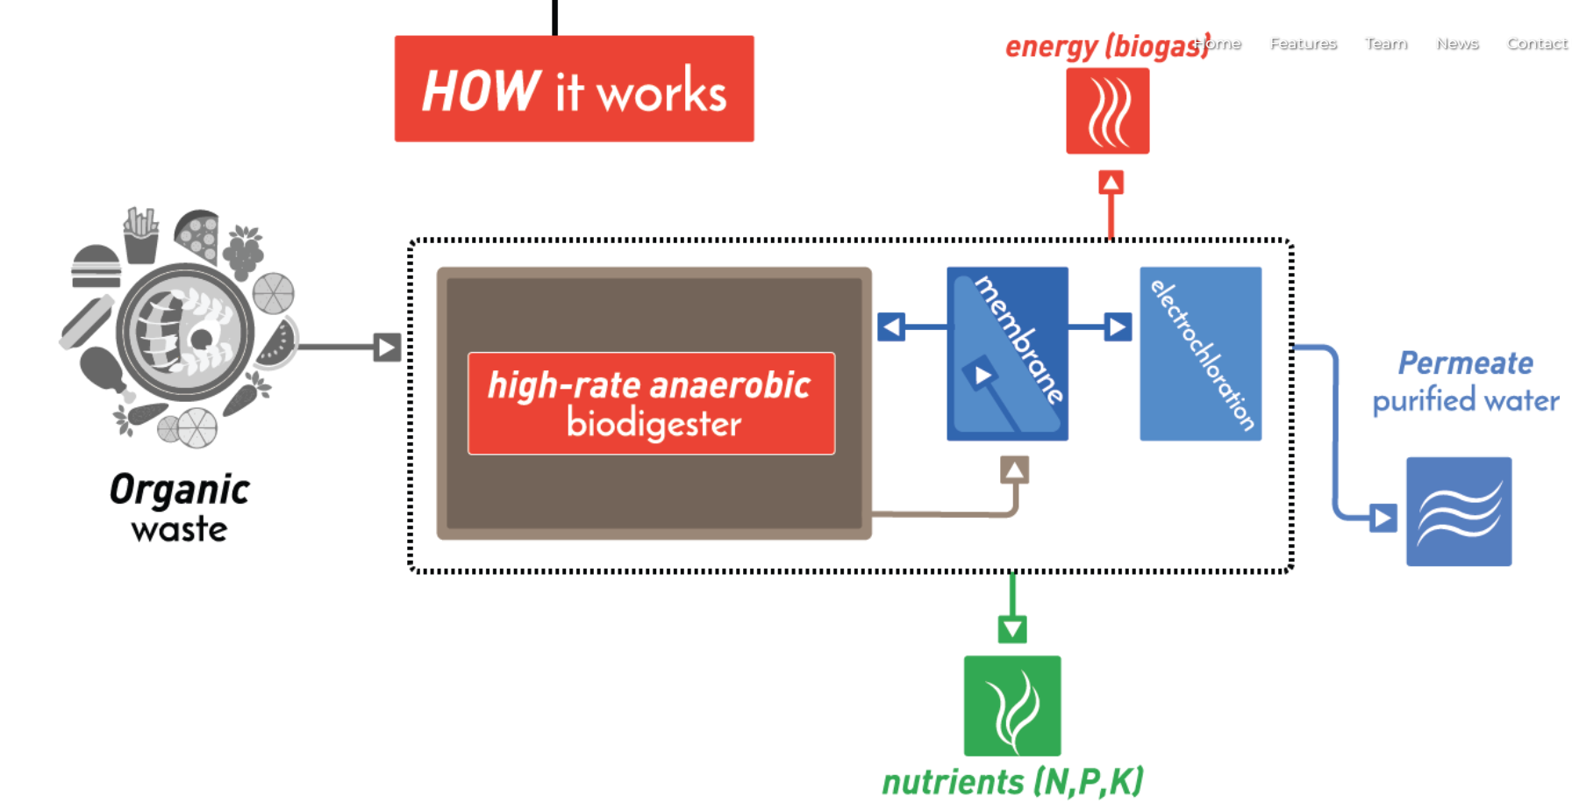
Class-3: Multiple frontend with one or more Biological or non-biological backend

Slide 23
For more information on innovative technologies, follow:
https://sanitation.ansi.org/
https://sanitation.ansi.org/RTTech

Slide 24
Understanding SANS/ISO:30500

Slide 25
ISO-30500 Certification process
Certification process
Document Checks
Field Testing
Certification
Controlled laboratory testing
Class-1:≥30 Days
Class-2: ≥50 Days
Class-3: ≥50 Days
≥ 32 Days
NSSS Classification:
Class-1: one front-end and non-biological back-end
Class-2: one front end and back-end with one or more biological treatment process
Class-3: multiple front-end with one or more biological or non-biological back-end

Slide 26
ISO-30500 Overview

Slide 27
4.1 User requirements:
  4.2 Metric system
  4.3 Design capacity
  4.3.1 Treatable input
  4.3.2 Treatment capacity
  4.3.3 Menstrual hygiene products
  4.3.8 Continuous use
  4.5 Expected design lifetime
Document Checks
Notes:
additional categories of input as acceptable for treatment, such as water from hand washing, menstrual hygiene products, and/or organic household waste at manufacturers discretion

Slide 28
4.7 Secure design
  4.8 Operating conditions
    4.8.1 Ambient temperature range
      4.8.2 Ambient air humidity
  4.12 General safety design requirements
  4.12.1 Safety of edges, angles, and surfaces
      4.12.2 Fire and explosion protection
  4.12.3 Structural integrity
      4.12.5 Underground systems
  4.12.6 External impacts
      5.1 Safety assessment
Document Checks

Slide 29
4.9 Requirements for sanitation system components
4.9.1 General requirements
  4.9.2 Hygienic design
4.12.4 Prevention of contact with unsafe effluent and reuse
5.7 Reliability of conveyance devices
6.7 Water seal
Document Checks
Notes:
When testing is conducted as part of the product certification process, the laboratory performing material testing shall meet the requirements in A.1.

Slide 30
4.9.4 Cleanability of surfaces
  4.9.5 Chemical and biological additives
4.10.1 Durability of materials
4.10.2 Fire resistance of materials
4.11 Connections and joining elements
Document Checks
Notes:
No. 3 100 to 120 grit steel is stainless steel featuring short, relatively coarse, parallel polishing lines, which extend uniformly along the length of the coil, achieved with 100 to 120 grit abrasives
Smooth surface: The surfaces shall be;
clear of pits and occlusions and have neither ridges nor crevices where organic materials could accumulate;
designed in such a way as to minimize projections, edges, and recesses

Slide 31
5.4 Mechanical Requirements
5.4.1 Pressurized or vacuum equipment
5.4.2 Pipes, hoses and tanks
5.4.3 Moving and rotating parts
  5.4.4 Backflow prevention
5.5.1 High temperatures of parts and surfaces
  5.5.2 Low temperatures of parts and surfaces
  5.5.3 Other radiation emissions
  5.6.1 Safety and reliability of electrical and electronic equipment
Document Checks

Slide 32
4.6 Aspirational and ergonomic design
4.13.1 Information and warnings
  4.13.2 Marking and labelling
  5.8 Transitions from the backend
  6.2 Use and operation of the frontend
  6.2.1 General usability requirements
  6.2.2 Requirements for ease of cleaning
  6.2.3 Requirements for ease of operation
  6.2.4 Cultural requirements
.
Document Checks
Notes:
Add Annex E.2 as handout for design consideration
Information warnings via Annexe E. 3.2 , user requirements 4.1

Slide 33
  4.14 Maintenance
  4.14.1 Reasonable configuration, adjustment, and maintenance activities
  4.14.2 Location and access of configuration, adjustment, and maintenance points
  4.14.3 Discharge and cleaning
  4.14.4 Tools and devices
  4.14.5 User manual
  4.14.6 Handling and transport of the sanitation system
Document Checks
Notes:
Annex C for information specified in this standard
Annex D.3 on the suitability of NSSS for a given location from point 4.14.1
Configuration, adjustment, and maintenance should not unnecessarily involve contact with input materials, intermediate process products, or residual products

Slide 34
8.2 Recovery of nutrients
8.3 Water consumption and reuse of effluent
8.3.1 Calculations
8.3.2 Water consumption
8.3.3 Reuse of effluent
8.4 Energy consumption and energy recovery
8.4.1 Calculations
8.4.2 Energy consumption
8.4.3 Direct and indirect energy recovery
8.5 Life Cycle Assessment
8.6 Recurring operational requirements
Document Checks
Notes:
8.2:
The nutrients of interest are those that facilitate plant growth such as phosphorus, nitrogen, and potassium.
This information can be used to determine the reasonable reuse of the final solid output and/or effluent.
8.3.1: Water use calculations do not need to consider related activities such as hand washing that do not directly involve operation of the sanitation system

Slide 35
Controlled laboratory testing
All three Classes of NSSS that can be installed in the laboratory shall be subjected to controlled laboratory testing
The assembly, installation, operation and maintenance of the NSSS system shall be done according to the manufacturer’s instruction
The NSSS should be housed in a super structure
according to the manufacturers instructions
Satisfying the requirements of A.3.6.6 of the ISO standard (Handout)
Specifications of the superstructure to be included in the test report
Noise tests to be done without the superstructure if the NSSS comes without the superstructure and to be indicated in the test report

Slide 36
Controlled laboratory testing
Duration of the testing period – not less than 32 days
May be extended to accommodate backend processes that require more time
The testing schedule shall be determined before testing commences
7.2.8 Loading pattern
7.2.8.1 Normal loading pattern
7.2.8.2 Stress loading pattern
A.3.8.10 Diarrhoea test day
Notes:
Normal loading pattern
While testing, specified treatment capacity with all additional system input specified by the manufacturer is considered.
Loading of the system shall be performed as a percentage of daily load (kg/day of faeces, l/day of urine)
7.2.8.2 Stress loading pattern
Stress loading pattern indicates the sanitation system is loaded with treatment capacity + 80 % of the difference between maximum capacity and treatment capacity
A.3.8.10 Diarrhoea test day
50 % of the normal faeces loading shall be ‘diarrhoea input’ instead of solid faeces.

Slide 37
Controlled laboratory testing
6.3 Visibility of faeces
The frontend shall ensure a visual barrier
6.4 Evacuation performance
6.5 Integrity against external impacts
6.6 Slipping, tripping or falling
A.3.1 Tightness
A.3.3 Evacuation mechanism

Slide 38
Controlled laboratory testing
Effluents from the NSSS should be within the range as below as be the ISO 30500 for the key parameters
Parameters | Test Methods | Category A usage: Threshold for unrestricted urban uses | Category B usage: Threshold for discharge into surface water or other restricted urban uses | Minimum load reduction percentage
Total nitrogen | APHA 4500-N C |  |  | 70 %
Total phosphorus | APHA 4500-P ISO 6878 |  |  | 80 %
pH | APHA 4500-H+ A | 6-9 | 6-9
COD | APHA 5220 B | ≤ 50 | ≤ 150
TSS | APHA 2540D EN 872 | ≤ 10 | ≤ 30

Slide 39
Controlled laboratory testing
Parameters | Surrogates | Test Methods | Max. conc. solids [number/g, (dry solids)] | Max. concentration in liquids (number/l)
Human enteric bacterial pathogen | E. coli | APHA 9221, APHA 9222 and APHA 9223 | 100 | 100
Human enteric Helminths | Ascaris suum viable ova | Methods for microbiological analysis of sewage sludges, SOP Helminth Test (Ascaris, Trichuris and Taenia) etc.
Human enteric viruses | MS2 coliphage or somatic coliphage | EPA 1602 For large samples use EPA 1601 or ISO 10705-1 | 10 | 10
Human enteric Protozoa | Clostridium perfringens | Solids: ISO 7937 Liquid: ISO 14189 | < 1 | < 1
The effluent and solids from the NSSS should be within the range as below

Slide 40
Controlled laboratory testing
Solid and liquid output validation thresholds and log reduction values (LRVs) for human health protection
Parameters | Surrogates | Max. concentration in solids [number/g (dry solids)], OR Max. concentration in liquid [number/L] | Overall LRV for solid OR liquid
Human enteric bacterial pathogen | E. coli | 100 | ≥ 6
Human enteric Helminths | Ascaris suum viable ova | < 1 | ≥ 4
Human enteric viruses | MS2 coliphage or somatic coliphage | 10 | ≥ 7
Human enteric Protozoa | Clostridium perfringens | < 1 | ≥ 6

Slide 41
Controlled laboratory testing
Potential air emissions from NSSS can be classified as pollutants or explosive gases
The NSSS shall be designed in such a way as to ensure that air pollutants released indoors and outdoors do not exceed the thresholds
CO and CO₂ shall only be tested if the NSSS applies combustion in its treatment processes
The manufacturers should document the GHG emissions
Indoor and outdoor air emission thresholds are detailed next

Slide 42
Controlled laboratory testing
Indoor air emissions
Parameter | Test method | Emission thresholds (average levels over indicated timeframe) | Sampling method
CO (ppmv) | ISO 4224 NIOSH 6604 | 1 h: 28 | Continuous analysis Grab sampling
NOx (ppbv) | ISO 7996 | 1 h: 99 | Continuous analysis
SO2 (ppbv) | NIOSH 6004 | 1 h: 6,8 | Grab sampling
CO2 (ppmv) | ISO 16000-26 NIOSH 6603 | 1 h: 1 000 | Continuous analysis Grab sampling
H2S (ppbv) | NIOSH 6013; OSHA6 ID 141, 1008 | 30 min: 4,6 | Grab sampling
VOCs (ppbv) | ISO 16000-5 | 1 h: 187 | Grab sampling
PM2,5 (μg/m³) | NIOSH 0500 | 1 h: 25 | Grab sampling
NH3 (ppmv) | NIOSH 6015 NIOSH 6016 | 1 h: 25 | Grab sampling

Slide 43
Controlled laboratory testing
Outdoor air emissions from the stack
Parameter | Test method | Emission thresholds (1 hr average) | Sampling method
CO (ppmv) | EN 15058, US EPA, Method 10 | 80 | Continuous analysis Grab sampling
NOx (ppbv) | EN 14792, US EPA, Method 7E | 195 | Continuous analysis
SO₂ (ppbv) | EN 14791, US EPA, Method 6C | 68 | Grab sampling
PAH | VDI 3874, US. EPA Compendium method TO-13A | 0,001 | Continuous analysis Grab sampling
H₂S (ppbv) | VDI 3486 Bl. 2, NIOSH 6013; OSHA6 ID 141, 1008 | 1,9 | Grab sampling
VOCs (ppbv) | EN 12619, US EPA, Method 25A | 12 | Grab sampling

Slide 44
Controlled laboratory testing
Outdoor air emissions from the stack
Parameter | Test method | Emission thresholds (1 hr average) | Sampling method
PM_{2,5} (μg/m³) | VDI 2066 Bl. 10, US EPA, Method 5I; Method 201A | 10 | Grab sampling
O₂ | EN 14789, US EPA, Method 3A
NH₃ (ppmv) | US EPA CTM-027 | 50 | Grab sampling
Volume flow | ISO 16911-1, US EPA, Method 2
Moisture content | EN 14790, US EPA, Method 4
Requirements for measuring sections | EN 15259, US EPA, Method 1A

Slide 45
Controlled laboratory testing
Controlled noise test with at least one sound-reflecting surface
NSSS tested under isolated conditions, represent the loudest operations
For NSSS with superstructure will have the noise level test done both inside the superstructure and externally
Noise tests inside at 1.2 meters above the frontend user interface

Slide 46
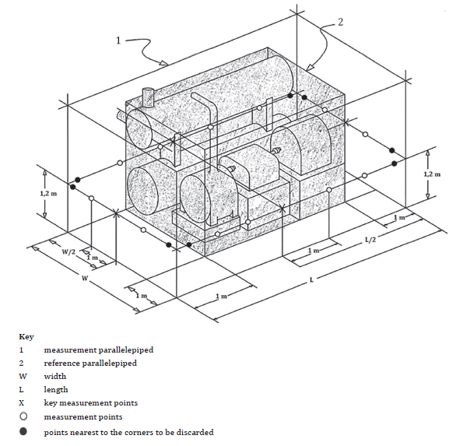
Controlled laboratory testing
External unit noise measurement at specific points as shown;

Slide 47
Controlled laboratory testing
Class 1, 2 and 3 sanitation systems shall meet the requirements specified below for NSSS with superstructures
Sanitation systems for which a superstructure is not part of the manufactured product shall be tested with a superstructure satisfying the requirements
 | Maximum percentage of observations reported as “unpleasant” | Maximum percentage of observations reported as “unacceptable”
Normal odour day (Within superstructure) | 10% | 2%
Simulant odour day (Within superstructure) | 10% | 2%
Normal odour day (Vicinity) | 10% | 2%
Simulant odour day (Vicinity) | 10% | 2%

Slide 48
Controlled laboratory testing
A.3.2 Control system
Control system testing protocols are adapted from IEC 61511 and based on industrial best practice
A.3.8.4 Energy supply
Testing procedure for systems with electrical energy as primary source
Separate and isolate the NSSS from its energy supply through the specific safety device
If the primary energy source is non-electrical, test the functioning of reliability and safety measures according to their intended use

Slide 49
Field testing
Class-1 sanitation systems:
Minimum test duration of 30 days.
A minimum of one sanitation system identical to the model that is laboratory tested
Environmental solid output, effluent parameters and human health related solid and liquid parameters shall be tested weekly
Class-2 and Class-3 sanitation systems
Systems involving biological treatment processes
Minimum test duration of 5 months
If defined operating conditions can not be tested with one system within 5 months, multiple systems with varying parameters are tested or the testing duration extended

Slide 50
Field testing
Environmental solid and liquid parameters tested weekly, and
Human health-related solid and liquid parameters tested monthly
Number of solid samples may be reduced to a minimum of one if output is limited by the design of the system

Slide 51
Field testing
Minimum of 75% compliance of all test results to pass field testing requirements
Parameters | Category A usage: Threshold for unrestricted urban uses | Category B usage: Threshold for discharge into surface water or other restricted urban uses | Minimum load reduction percentage
Total nitrogen |  |  | 70%
Total phosphorus |  |  | 80%
pH | 6-9 | 6-9
COD | ≤ 50 | ≤ 150
TSS | ≤ 10 | ≤ 30

Slide 52
Field testing
100% compliance of all test results to pass field testing requirements
Parameters | Surrogates | Max. conc. solids [number/g, (dry solids)] | Max. concentration in liquids (number/l)
Human enteric bacterial pathogen | E. coli | 100 | 100
Human enteric Helminths | Ascaris suum viable ova
Human enteric viruses | MS2 coliphage or somatic coliphage | 10 | 10
Human enteric Protozoa | Clostridium perfringens | < 1 | < 1

Slide 53
Field testing
Solid and liquid output validation thresholds and log reduction values (LRVs) for human health protection
Parameters | Surrogates | Max. concentration in solids [number/g (dry solids)], OR Max. concentration in liquid [number/L] | Overall LRV for solid OR liquid
Human enteric bacterial pathogen | E. coli | 100 | ≥ 6
Human enteric Helminths | Ascaris suum viable ova | < 1 | ≥ 4
Human enteric viruses | MS2 coliphage or somatic coliphage | 10 | ≥ 7
Human enteric Protozoa | Clostridium perfringens | < 1 | ≥ 6

Slide 54

Benefits of identical adoption of the standard
Engage directly in markets that have identically adopted ISO 30500
Abide by agreed-upon human and environmental safety standards recommended by global experts
Rely on ISO review of ISO 30500 every 5 years (save time and money)
Contribute to UN SDGs
https://sanitation.ansi.org

Slide 55
Nov 2018
Apr 2019
June 2019
Aug 2019
Sept 2019
Oct 2019
Nov 2019
Countries with identical adoption
SENEGAL
FRANCE
UK
SOUTH AFRICA
COTE D’IVORE
BENIN
BANGLADESH
RWANDA
UGANDA
NIGERIA
CAMEROON
CANADA
USA
https://sanitation.ansi.org

Slide 56

Benefits
  Regulators/policy makers:
  Can rely on global expert opinion to ensure safety of the product for its citizens without spending its own time and money
  Can access the constantly updated source of information and experiences from around the world

Slide 57

Benefits
Manufactures:
Have a blueprint to use to create a product that meets international guidelines, making market entry easier
Increases the manufacturing capability to be widely available to market and deploy at places of need

Slide 58

Benefits
    Users:
Increases the confidence in the product, reflecting a consensus of regulators, manufacturers and users from across the world
Can have a dignified, reliable, safe, hygienic, odor-free experience that may even produce by-products that can be re-used by the community

Slide 59
Benefits of using SANS/ISO:30500
  Saves on Cost of building new infrastructure and maintaining existing infrastructure
  Off-sets the cost for new sewers
  The adoption of the standard can act as a catalyst for industrialisation of sanitation in South Africa
  Potential to create new jobs and contribute to the GDP
  Market space for innovative and sustainable alternatives to existing sanitation solutions
  Mass production will make the NSSS affordable and sustainable alternative solutions
  Not only a business investment, it is a social wellness and improved health investment
  For every 1USD invested in Sanitation, there is a return of 5.5USD in lower health costs, increased productivity and fewer premature deaths (WHO, 2012)
  Worldwide cost of poor sanitation nearly $223 billion in 2015 (Oxford Economics)

Slide 60
Constraints
Cost for certification – mechanism for funding it
No laboratory capacity for SANS/ISO:30500 in place yet – need to develop mechanisms and regulatory framework
No defined framework yet on how to achieve the certification fast and benefit from it in the best possible way

Slide 61
Panel discussion
Benefits
Constraints
Way forward
Q&A

Slide 62





Thank You!
SABS & WRC team
QUESTIONS
Content collated by Pollution Research Group, University of KwaZulu-Natal

