Slide 1
THE WATER RESEARCH COMMISSION
&
THE SABS
PRESENTS
WORKSHOP ON ISO 24521
On-Site Domestic Wastewater Services

Slide 2
PRESENTATION TOPICS
Background to the ISO 24521
Introduction
Objectives of ISO 24521
Principal Objectives of wastewater utility
Components of Basic onsite-domestic WW systems
Management of basic domestic WW systems
Planning & Construction
Operation & Maintenance
Health & Safety issues

Slide 3
BACKGROUND
ISO 24521 is an international management standard, written from an operator's perspective.
It provides guidance for the management of basic on-site domestic wastewater services, using appropriate technologies in their entirety at any level of development.
ISO 24521 is applicable to both publicly and privately operated basic on-site domestic wastewater (black- and greywater) services for single and multiple dwellings.

Slide 4
BACKGROUND
The standard covers:
Guidelines for the management of basic on-site domestic wastewater services from the operator’s perspective, including maintenance techniques, training of personnel and risk considerations;
Guidelines for the management of basic on-site domestic wastewater services from the perspective of users;
Guidance on the design and construction of basic on-site domestic wastewater systems;
Guidance on planning, operation and maintenance, and health and safety issues.

Slide 5
ISO 24521
ISO 24521 is co-convened by Kenya and Austria
This standard is based on ISO 24511 – Guidelines Assessment of Wastewater Services
This standard is used in conjunction with ISO 24511
And some requirement from ISO 24511 apply in this standard

Slide 6
INTRODUCTION
The are 3 ISO Standards that address the water services:
Activities relating to drinking water and wastewater services:
ISO 24510: Guidelines for the assessment and for the improvement of the service to users
ISO 24511: Guidelines for the management of wastewater utilities and for the assessment of wastewater services
ISO 24512: Guidelines for the management of drinking water utilities and for the assessment of drinking water services

Slide 7
INTRODUCTION
ISO 24510 contains:
A brief description of the components of the service relating to the users;
Core objectives for the service, with respect to the needs and expectations of users;
Guidelines for satisfying the needs and expectations of users;
Assessment criteria for service to users in accordance with the provided guidelines;
Examples of performance indicators linked to the assessment criteria that can be used for assessing the performance of the service.

Slide 8
INTRODUCTION
ISO 24511 AND ISO 24512 contains:
A brief description of the physical/infrastructural and managerial/institutional components of water utilities
Core objectives for water utilities, considered to be globally relevant at the broadest level
ISO 24521 Is used in conjunction with ISO24511

Slide 9
Benefits of the Adoption of ISO 24521
OBJECTIVES OF ISO 24521
Public health and safety
Occupational health and safety
Environmental protection
Sustainable development
Hygienic, safe and pleasant to use for communities
Restored dignity of users
Safe to operation of on-site domestic wastewater systems
Production of by-products

Slide 10
INITIAL FOCUS_ ISO 24521
Enhancing the effectiveness of the existing on-site plants by providing guidance on Management to meet the Operability / Management issues
Is a developed guidance for the management of basic on-site domestic wastewater services, using technologies in their entirety at any level of development, as applicable
It is standardisation of a framework for the definition and measurement of service activities relating to drinking water supply systems and wastewater systems

Slide 11
PRINCIPAL OBJECTIVES FOR WASTEWATER UTILITIES

Slide 12
OBJECTIVES OF THE ISO 24521
OBJECTIVES:
The main objectives of basic on-site domestic wastewater services are:
Public health and safety;
Occupational health and safety;
Environmental protection; and
Sustainable development

Slide 13
OBJECTIVES FOR WASTEWATER UTILITIES
Protection of public health
Protection of users and operators
Meeting the needs & expectations of users
Provision of service under normal & emergency situations
Sustainability of basic on-site domestic wastewater system
Promotion of sustainable development of the community

Slide 14
PROTECTION OF PUBLIC HEALTH
Safe and sanitary disposal of wastewater should be a public health priority. Wastewater should be disposed of in a manner that ensures that:
Drinking water supplies are not threatened;
Direct human exposure is not possible;
Waste is inaccessible to vectors, insects, rodents or other possible carriers;
Odour or aesthetic nuisances are not created

Slide 15
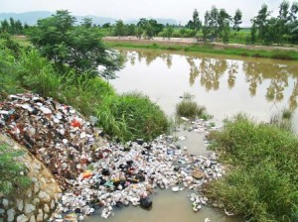
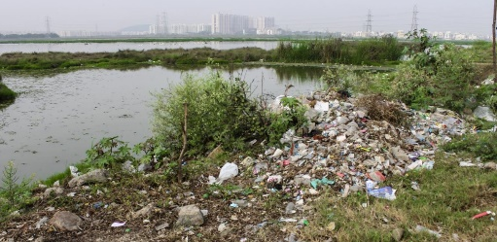
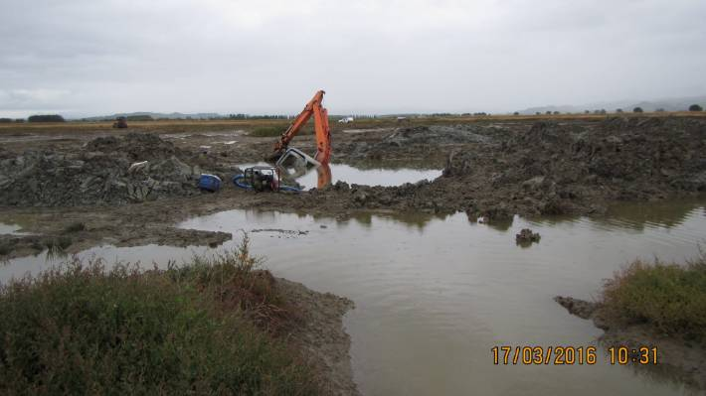
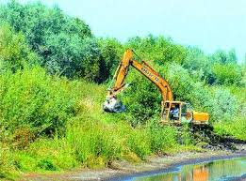
PROTECTION OF PUBLIC HEALTH
Water Sources endangered
Wetlands threatened

Slide 16
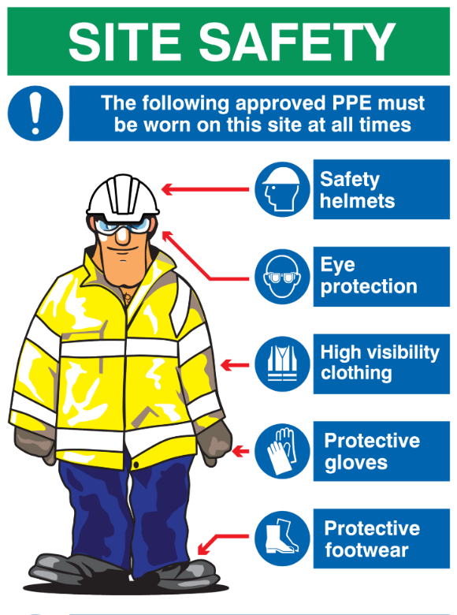
PROTECTION OF USERS AND OPERATORS
Protective equipment when handling wastewater for users & Operators
Appropriate training must be conducted
Health protection of the owners of the premises or workers providing emptying services must be accounted for

Slide 17
Meeting the needs & expectations of users
User needs& Expectations
Improvement of current living conditions:
Safety, privacy
Communication commitment & service delivery
Re-use
End- user needs & expectation
Research:
Number of users, cultural acceptance,
Economic costs

Slide 18
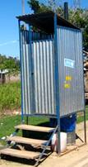
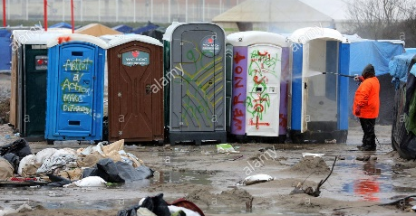
Provision of service under normal & emergency situations
Wastewater services should be available on a continuous basis
Where an emergency applies, emergency calls & response actions should be initiated
User interfaces intended for emergency situations should be portable/easy to assemble
Potential short term emergency solutions:

Slide 19
Sustainability of basic on-site domestic wastewater system
Demand for Re-use of sanitation system product
Need to consider health & safety requirements.
Nutrients Recovery
From faeces & urine and used at household level as fertilizer or soil improver.
Safety and hygiene requirements must be considered.
To ensure cost recovery od services.
To ensure financially stability.
(Assets)
Provide capacity to meet current & future needs.
Periodically desludging & preventative maintenance so that assets meet criterion for functional lifespan.
Sustainable on-site sanitation systems
Revenue Sources
Maintenance of onsite domestic system

Slide 20
Promotion of sustainable development of the community
According to ISO 24511: The Wastewater facilities must address:
Sustainable development
Ability for communities to grow & prosper within the environmental, infrastructural & economic resources available to it
Promoting efficient use of resources through recycling & reuse
Instituting pollution prevention techniques by eliminating/ separating pollutants at source

Slide 21
Promotion of sustainable development of the community
Strategic priorities for management of water resources
Attention to be given to overall management of water resources
Quantitative and qualitative aspects of management
Quantitative Aspect of water management
Efficient use of water
Retention & re-use
Discharge

Slide 22
Promotion of sustainable development of the community
According to ISO24521: The Wastewater facilities must address −
Integrated water resources management
Renewable energy
Utilization of treated wastewater residues: reuse of treated wastewater residues in agriculture for the provision of food, when applicable

Slide 23
COMPONENTS OF BASIC ON-SITE DOMESTIC WASTEWATER SYSTEMS

Slide 24
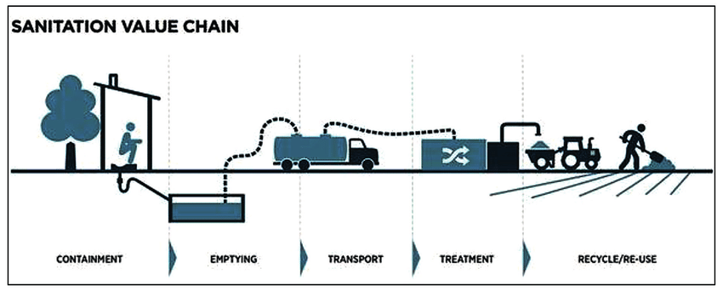
Components of basic on-site domestic wastewater systems
Basic on-site domestic wastewater systems generally comprise:
User interface> Collection and Transport > Treatment > Disposal/ Re-use

Slide 25
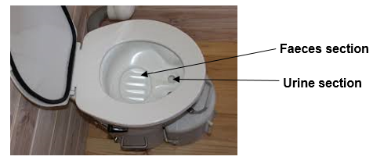
User-Interface (Containment)
Technologies with which the user comes into contact and access the sanitation system
Toilets and washing facilities are the user interfaces
Toilets may be designed to allow the separation of urine and faeces

Slide 26
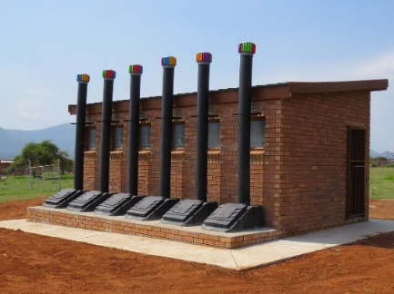
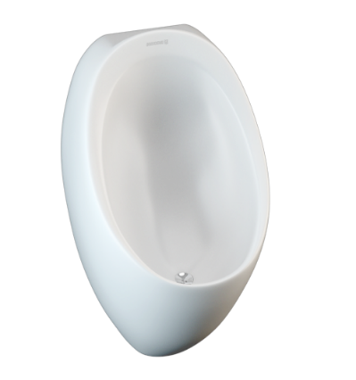
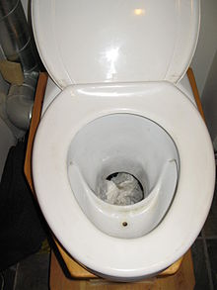
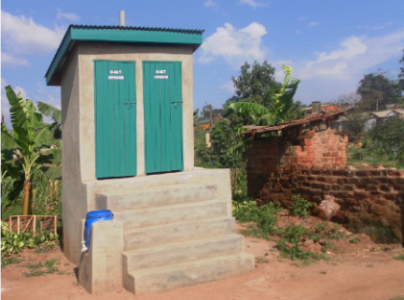
User-Interface (Containment)
User interfaces including but not limited to:
Simple ventilated/unventilated pit latrine;
Double ventilated improved pit latrine/fossa alterna;
Dry toilets, e.g. urine diverting dry toilet (UDT), composting toilet
Pour flush toilet;
Waterless urinal;
Cistern flush toilet;
Washing facilities, e.g. greywater sink
Ventilated pit latrines
Urinary diverting Toilet
Double ventilated improved pit latrines
Waterless urinal

Slide 27
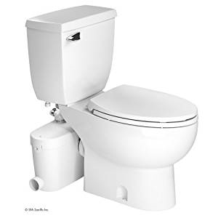
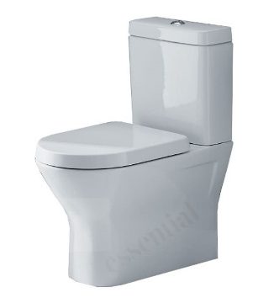
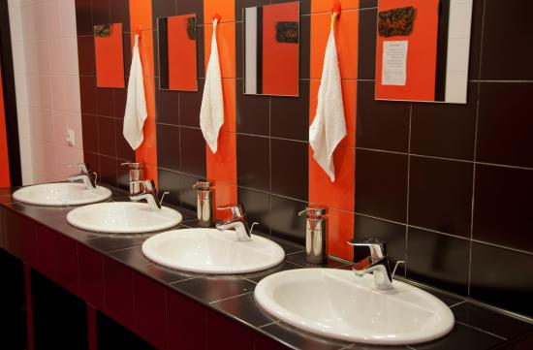
User-Interface (Containment)
Composting toilet
Cistern flush toilet
Washing facilities

Slide 28
Collection & Transport
Collection facilities contain human excreta awaiting transportation, including drums and containers, vaults and chambers, and double pit system

Slide 29
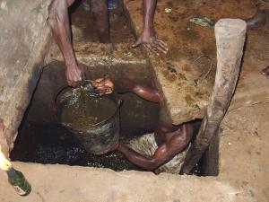
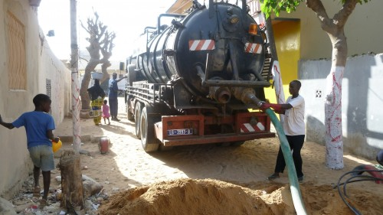
Collection & Transport
Collection facilities include:
above ground tank
human-powered emptying
motorized (pump or vacuum) emptying
Transportation:
Carts
Tricycles
any other human-powered multiple-wheeled vehicles
trucks
vacuum tankers

Slide 30
TREATMENT

Slide 31
TREATMENT
TWO GROUPS OF TREATMENT TECHNOLOGIES:
Technologies primarily for the treatment of wastewater may include
Septic tank with one or more compartments without discharge
Septic tank system with discharge and adequate filtration
Up flow anaerobic sludge blanket reactor (UASB)

Slide 32
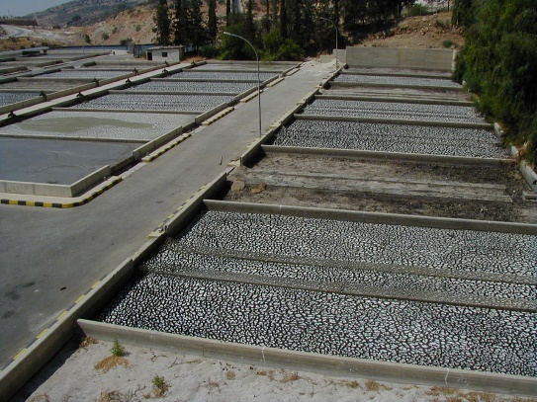
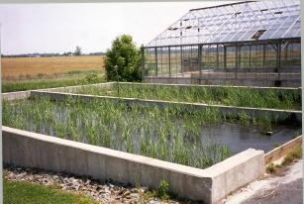
TREATMENT
Technologies primarily for the treatment of sludge may include:
Sedimentation/thickening ponds
Unplanted drying beds
Planted drying beds
Co-composting
Anaerobic biogas reactor

Slide 33
DISPOSAL / RE-USE

Slide 34
DISPOSAL / RE-USE
The recovery of resources for economic use by post treatment should be considered when designing basic on-site domestic wastewater systems.
Nutrients recovery from faeces & urine
Effluent use in irrigation
Land application of treated/stabilized sludge (biosolids) as fertilizer/soil conditioner
Energy recovery option of sludge treatment

Slide 35
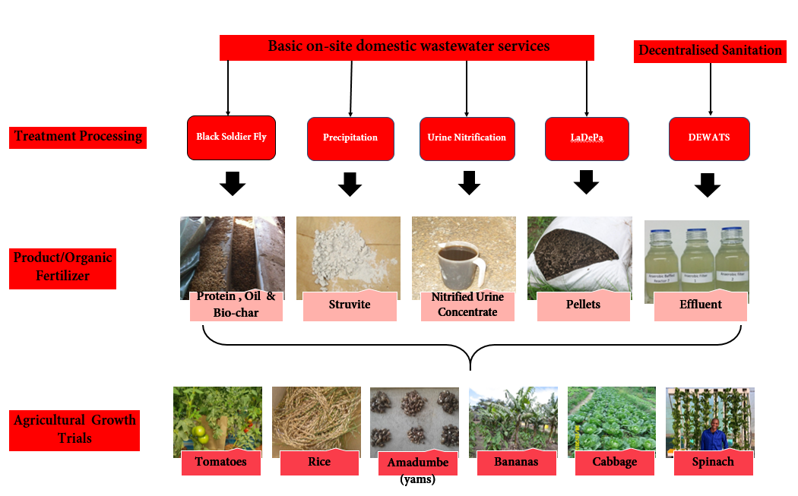
DISPOSAL / RE-USE
UKZN research team and their partners:
PRG, UKZN 2019

Slide 36
Management of basic on-site domestic wastewater systems

Slide 37
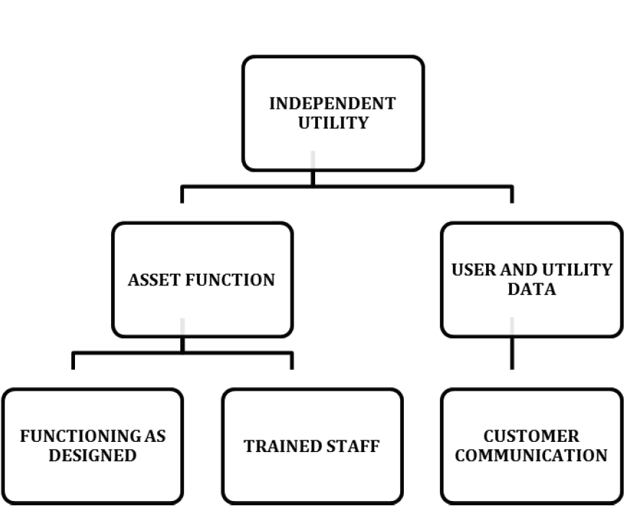
Management of basic on-site domestic wastewater systems
Independent management of system function and stakeholder communication:

Slide 38
Basic Management Activities
Developing objectives and establishing action plans
The objectives, strategies and processes of the system and users must be clear defined.
Financial sustainability of the system
The financial stability of all resources is important to ensure that the wastewater systems function as designed, are operated as intended and meet the objectives for sustainability and the criterion for lifespan.

Slide 39
Basic Management Activities
Sustainability of the assets
Must include monitoring and planning for continuous technical functioning and the continuing availability of financial resources so that the needs and requirements of the users are met with respect to treatment of the human waste/wastewater and lifespan criterion for the asset.
Customer relations
Where basic on-site domestic wastewater systems are managed by people other than the owners of the premises, managing the customer relationship requires that the customers (user/users) accept the human waste/wastewater treatment system and agree that their needs and concerns are known and resolved.

Slide 40
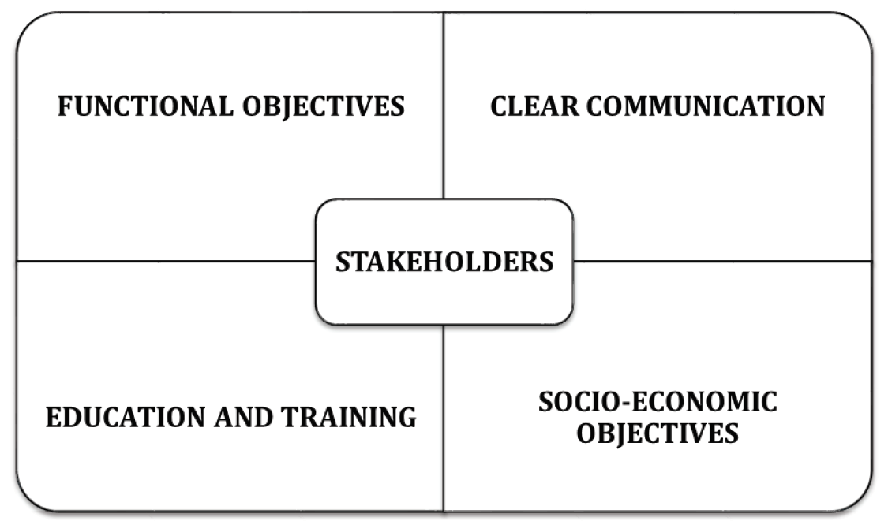
Stakeholder relations
Developing plans for support of stakeholders

Slide 41
Education and/or training of stakeholders
Education and/or training should be well planned and sustainable
The education and/or training should cover health and hygienic practices of using the basic on-site domestic wastewater system and could be provided as follows:
For key local authorities and field staff: proper training on principles and technical solutions
For field workers: practical training concerning the construction and management of the basic on-site system, as well as empowerment methods
For household and community members: acquisition of skills in building, operating and maintaining basic on-site domestic wastewater systems, including awareness raising on hygienic practices of the basic on-site domestic wastewater system

Slide 42
Education and/or training of stakeholders
Education could be conducted through:
Public awareness campaigns
One on one basis
School curriculum
Media
Community-based organization/community user groups
Community engagement/mobilization programs (government or donor), such as community-led total sanitation
School health clubs/youth groups

Slide 43
Environmental management
Environmental management of basic on-site domestic wastewater systems should:
Promote sustainability of the policy objectives for wastewater projects by protecting and
preserving water quality and water resources.
To assess the impact of basic on-site domestic wastewater collection, treatment and disposal, an environmental check list should be specifically developed in accordance with local conditions.

Slide 44
Environmental management
An environmental check list could include:
The number of persons whose waste will be treated
The expected monthly flow
The nature of the expected flow, i.e. whether it is just domestic (as it should be in the case of basic on-site systems) or mixed with institutional or industrial waste
The type of treatment unit: septic tank, alternative treatment system (e.g. aeration), wetlands
The nature of the soils surrounding the effluent bed
The proximity to natural water sources
The use of the natural water sources
Access to the area by livestock

Slide 45
Risk Assessment
Risk management should begin in the planning stage of the basic on-site domestic wastewater system and should include all aspects of :
Design
Construction
Implementation
Operation and Maintenance

Slide 46
Risk Assessment
The risk management should include the following steps:
Problem formulation: A planning process for generating and evaluating hypotheses about the effects that might occur and identify the risks
Analysis: Typically includes both the site-specific analysis and characterization of risk causation (occurrence or exposure) and the more general analysis or characterization of risk effects
Risk characterization: The process of combining the estimates of occurrence or exposure with the exposure-response relationships from the analysis of effects to estimate the magnitude and (if possible) probability of effects and resulting consequences
Development and implementation of a dynamic plan: The plan should include monitoring operation, preventative maintenance and corrective action to eliminate or control the risks

Slide 47
Risk Assessment
Categorization of risks:
Risks may be grouped in the following categories:
public health and safety
environmental impact
socio-economic
Operational risk of transportation of wastewater: Risks associated with the collection, treatment and transportation of wastewater and its constituents
Risk framework: The framework for evaluating risk of system performance should be flexible enough to accommodate various types of basic on-site domestic wastewater systems

Slide 48
Risk Assessment
The operational risk model for wastewater should account for:
Backup of the treatment system
Surface breakthrough from structural failure
Contamination of the land
Transport into drinking water wells and groundwater
Potentially exposed populations
Exposure of biota

Slide 49
Site assessment for risks
The site model for evaluating basic on-site system risks should account for:
location of the basic on-site domestic wastewater treatment system
location of residences and water wells
topography
groundwater sources to prevent adverse impacts from contamination on water sources like wells and boreholes
surface water sources to prevent adverse impacts or nutrient over enrichment from contamination
soils and slopes which may create effluent plumes
potentially exposed populations

Slide 50
Causes of failure
The failure mode can be divided into two categories, design deficiency or process variation, which can be described in terms of something that can be corrected or can be controlled.
The potential failure modes are identified through answers to the following questions:
In what way can this subsystem fail to perform its intended function?
What can go wrong although the subsystem is manufactured/assembled to specifications?
If the subsystem function was tested, how would its failure mode be recognized?
How will the environment contribute to or cause a failure?
In the application of the subsystem, how will it interact with other subsystems?

Slide 51
Planning & construction

Slide 52
Planning & construction
Planning & construction
Criteria
Economic Costs
Cultural Acceptance
Protection of public health
Protection of Environment
Risk & Assessment & Management
-Stakeholders Involvement
- Awareness raising methods

Slide 53
Criteria for selecting appropriate basic on-site domestic wastewater technologies
The criterion of acceptance by households and by local sanitation professionals
The criterion of lifespan of the infrastructure
The criterion of the efficiency of the technology
The criterion of investment, operating and maintenance cost
The criterion of design, construction, operation and maintenance
The criterion of accessibility
The criterion of range
The criterion of required surface area
The criterion of water requirements
The criterion of availability of energy

Slide 54
Operation & Maintenance

Slide 55
Operation & Maintenance
Basic On-site domestic wastewater services should have:
Written and visual instructions for operational and maintenance plans
Disposal plans
Education and training plans
Planning of operation and maintenance should take into consideration defined responsibilities

Slide 56
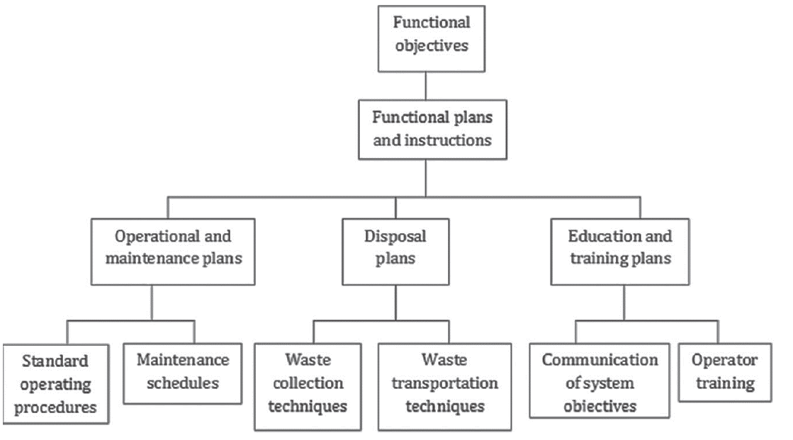
Operation & Maintenance
Developing instructions for operational and maintenance plans, disposal plans and/or education and training plans

Slide 57
Developing operational plans and instruction
Sequence of all essential operation must be:
defined for the treatment of domestic waste
define tasks required to maintain the process including residual disposal & effluent discharge
Documentation using visual representations or instructions
These documents should minimize problems due to language or education
More detailed working/ user instructions must be prepared whenever required

Slide 58
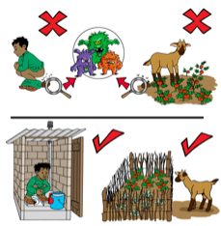
Developing operational plans and instruction

Slide 59
Developing maintenance plans and instructions
Maintenance Plan of the system should be both Preventative and Reactive
Preventative plan includes:
Maintenance performed at planned condition-oriented or scheduled intervals in order to prevent, minimize or delay failures or ineffective treatment of domestic wastewater

Slide 60
Developing maintenance plans and instructions
Benefits of Preventative Maintenance
Preventative maintenance eliminates many conditions that cause unplanned maintenance.
Reduces probability of failure
Improves safety
Cost effective
Minimize overhaul frequency
Energy savings
Flexibility
Decreases downtime

Slide 61
Developing maintenance plans and instructions
Reactive maintenance includes:
Maintenance performed following a failure of the equipment, treatment process or shutdown
It involves activities necessary to repair or restore the system to a satisfactory condition or level of performance.
Steady degration of equipment performance
Respond to emergency

Slide 62
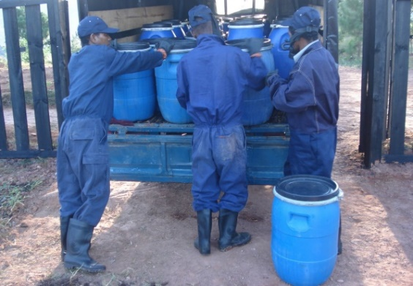
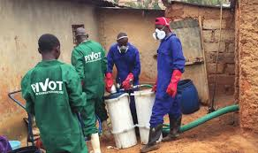
Developing plans and instructions for collection of waste
Domestic wastewater is collected from different types of toilets
Whenever possible faeces and urine should be separated to facilitate reuse
Tools to collect Faeces & Urine:
Double pit system
Plastic or metal containers or drum.
Excreta can also be collected in vaults and chambers.
Instructions:
The collection systems should be structurally resistant to cracks
Must be checked regularly for leakage.
The capacity should be monitored to prevent overflow of the excreta

Slide 63
Developing plans and instructions for collection of waste
Implementation, operation and collection techniques should:
Include regular removal of excreta
Safe handling of faeces and urine, as they may contain pathogens – develop SOP
The sustainability and continuity of the entire sanitation system depends on good organization and management of transportation systems
Transportation depends on :
Quantity (Volume) of wastewater and sludge
Characteristics of wastewater and sludge (both treated and untreated)

Slide 64
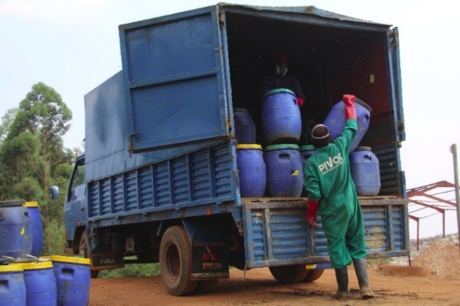
Developing plans and instructions for collection of waste
Different types of transportation techniques include:
Cartage techniques include cycles and pushcarts
mechanical emptying systems
sewer systems

Slide 65
Health and safety issues

Slide 66
Health & Safety
Regular medical check-ups: For users, service providers & operators who handle waste
Protective equipment: Must be provided for users & operators when handling waste
Monitor for any infectious or parasitic diseases: For stakeholders who come in contact with wastewater and/or sub-products of basic onsite domestic wastewater.

Slide 67
Health & Safety
Education/Training: Should be conducted to avoid any health risk.
Training is necessary for proper transport and handling of waste/wastewater to prevent or minimize operator risk and risk to the public (community) or environment
It should be confirmed that the operator is sufficiently well-trained before given permission to transport waste/wastewater
Discontinued use − In the event of outbreak of diseases, short term emergency solutions

Slide 68
Public health programmes
To mitigate any effects of sub-products of basic on-site domestic wastewater systems.
The health programs should include:
Medical surveillance of concerned stakeholders
Testing of sub-products for any pathogenic microorganisms or other hazardous materials
Review of the use of technologies of the system to establish any improper use or faults that could promote activity of pathogenic microorganisms and, where possible, the kind of routes of exposure as a result of using the system
Health and hygiene education, including promotion of washing hands with soap and/or an equivalent washing agent
Pre-evaluation of a particular technology for possible failure that could promote the activity of pathogenic microorganisms as well as other hazards, where feasible

Slide 69
Thank You!
SABS & WRC team
QUESTIONS
Content collated by Pollution Research Group, University of KwaZulu-Natal

