Slide 1
engaging the WASH sector before national review
Presenter name
Organization
Date
Location

Slide 2
National standards body role
Before proceeding with national review of ISO non-sewered sanitation (NSS) standards, think about:
What priorities does your national standards body (NSB) have:
Can you introduce new standards for review at this time?
Do you need to propose NSS review for inclusion in next year’s priorities?
Do you need relevant ministry or stakeholder support to review?

Slide 3
technical committees
Does your NSB have a sanitation or WASH related technical committee (TC)?
Do you have non-sewered sanitation experts in this TC?
Do you need to recruit experts?

Slide 4
importance of WASH experts in your TC
WASH experts for rural and urban areas have in depth understanding of the situations and realities on the ground.
WASH experts can demonstrate the need for NSS standards to relevant ministries and NSB leadership to support national review.
Notes:
Consider recruiting both rural and urban WASH experts. Some technologies in NSS standards may be appropriate for different contexts.
WASH experts will have an understanding of the end users of NSS: reinvented toilets (ISO 30500) or waste water treatment plants operational guidelines (ISO 24521, ISO 24510, ISO 24511)

Slide 5
identify stakeholders
Identify stakeholders across different sectors
Encourage technical committee members to reach out to their networks
Stakeholders may be:
NGOs
Ministries
Local government
Academics
Private sector
Engineering firms
Consultant organizations
Regulators
Manufacturers, suppliers and downstream value chain support
Estate developers, eco-estates and green buildings owners and developers
Notes:
Take the time to identify stakeholders that you will be engaged with from review to adoption to implementation.
Keep track of your stakeholders in an excel sheet and inform them of updates to review/adoption and encourage them to participate when possible.
The next section will give you the opportunity to brainstorm stakeholders.

Slide 6
Identifying stakeholders

Slide 7
Your role when identifying stakeholders: visual stakeholder mapping
Tertiary stakeholders
Secondary stakeholders
Primary stakeholders
ISO 30500 /
ISO 24521
Notes:
Visualize your stakeholders.
This exercise is best conducted in a group.
Think of who is at the center of nationally adopting and implementing ISO 30500 and/or ISO 24521.
Draw three circles insides of each other and begin to map your stakeholders
Primary stakeholders: Who is the closest to national review? Who needs to be directly engaged?
Secondary stakeholders: When national review/adoption is complete, who needs to learn and implement these standards
Tertiary Stakeholders: Is there anyone else that is involved in the process of national review, adoption/publication, and implementation of the standards?
Consider:
Question yourselves as to why tertiary stakeholders are the furthest away? Should they be included in the beginning? Why or why not?
Some examples from previous exercise include:
Primary stakeholders: Government entities: health, environmental, water and sanitation, local authorities, and NSB
Secondary stakeholders: research institutions, estate developers, NGOS, conformity assessment bodies, manufacturers, industry, traders, importers
Tertiary stakeholders: social workers, academia, hospitals, schools, households, manufacturers, consumers, associations, construction companies

Slide 8
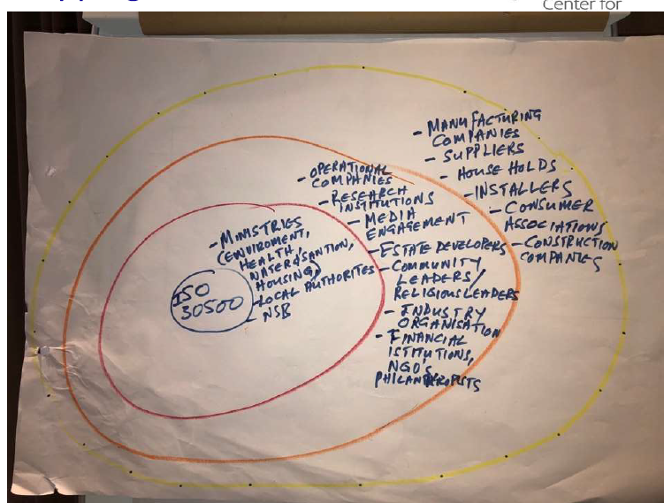
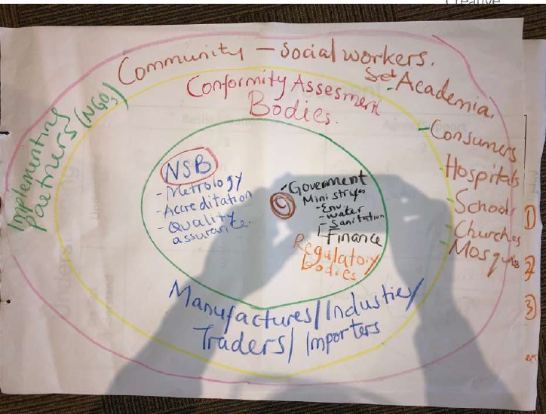
Your role when identifying stakeholders: visual stakeholder mapping an example
An example of visual stakeholder mapping from the NSB Peer to Peer Workshop at the African Organization for Standardisation Technical Harmonization Committee to review non-sewered sanitation standards (ISO 30500, ISO 24510, ISO 24511, ISO 24521)
Notes:
Review this example to give you some ideas.
Can you improve on this?
You can see how different groups have identified similar stakeholders in different groups.
Think about:
What if adoption strategies focused on end users (/target communities and their local authorities)
What would be the impact of reframing NSS standards as a means to an end, not as an end in itself?
There are no right answers!

Slide 9
Your role when identifying stakeholders: structured stakeholder mapping
Now that you have visualized stakeholders, identify why each of them are interested in NSS standards.
Make a table
What are each of their interests and motives?
What would be their “win” and vested interest in successful adoption/implementation?
Identify the current strategies that can be used to engage these stakeholders for technical committees, information sessions, and training opportunities
Stakeholder | What are their interests and concerns in ISO 30500/ISO 24521? | What would they consider “wins” with adoption and impact? | What are strategies to influence their decisions?
Example 1
Example 2
Notes:
Now that you have visualized stakeholders, identify why each of them are interested in NSS standards.
What are each of their interests and motives?
What would be their “win” and vested interest in successful adoption/implementation?
Identify the current strategies that can be used to engage these stakeholders for technical committees, information sessions, and training opportunities
Make a table like the one in the slide for each stakeholder group.

Slide 10
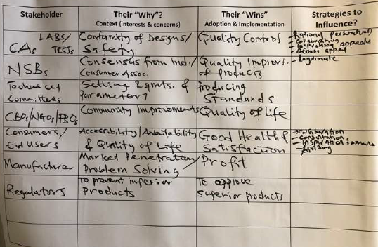
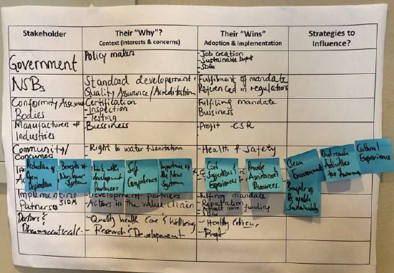
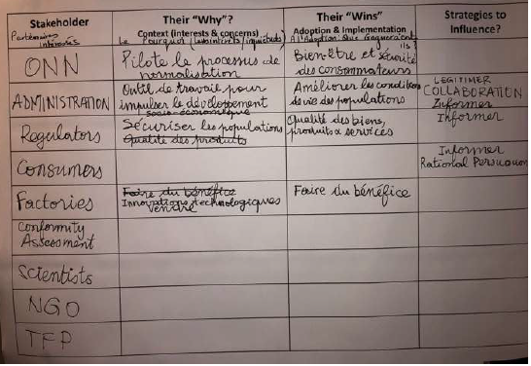
Your role when identifying stakeholders: structured stakeholder mapping examples
An example of structured stakeholder mapping from the NSB Peer to Peer Workshop at the African Organization for Standardisation Technical Harmonization Committee to review non-sewered sanitation standards (ISO 30500, ISO 24510, ISO 24511, ISO 24521)
Notes:
Review this example to give you some ideas.
Expand each image to see each clearly.
There are no right answers!

Slide 11
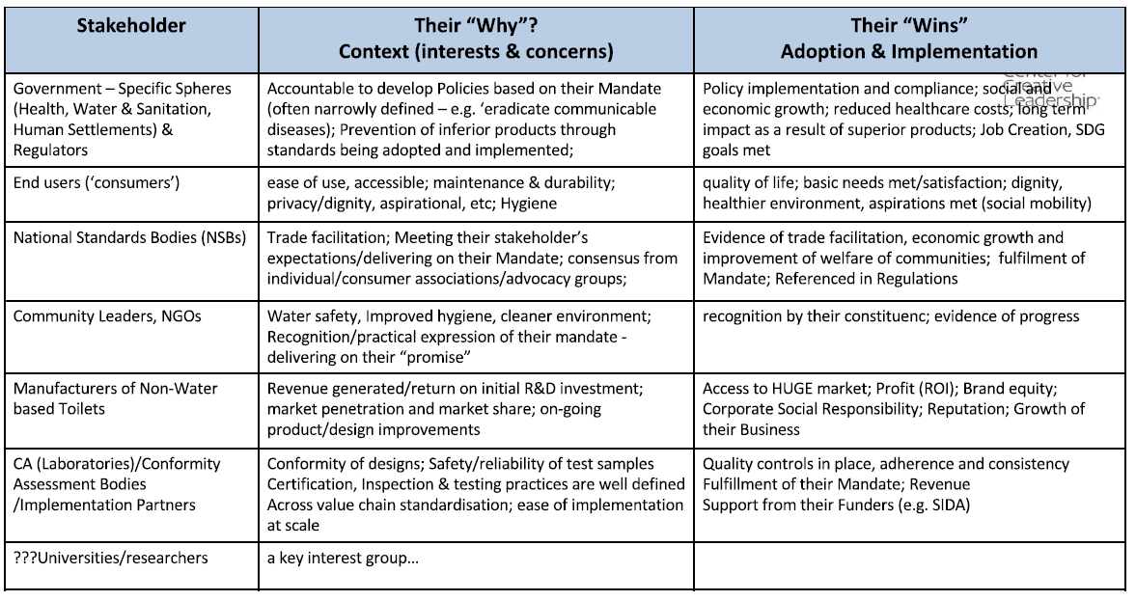
Your role when identifying stakeholders: structured stakeholder mapping compiled example
Notes:
See this compilation of stakeholders, their whys and their wins from the NSB Peer to Peer Workshop at the African Organization for Standardisation Technical Harmonization Committee to review non-sewered sanitation standards (ISO 30500, ISO 24510, ISO 24511, ISO 24521).
Use the example in this slide and above to identify your own stakeholders for national review of NSS standards.

Slide 12
Communicating with stakeholders

Slide 13
effective participation
When engaging with NSS stakeholders:
Demonstrate interconnectedness between UN SDG 6, standards, and national priorities
Determine if stakeholders are best suited for:
Technical committees
Information or technical sessions
Training sessions
Follow up with stakeholders after first contact:
Share your contact information and resources, and plan to reconnect within two weeks.
Track your stakeholders and engagement in a word or excel document

Slide 14
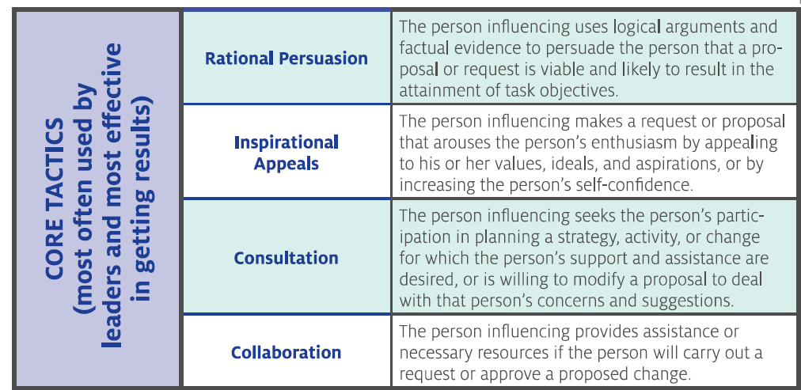
Influencing strategies
How to get commitment from identified stakeholders:
Notes:
There are several core strategies used by leaders to get effective results. Those most often used are shown on this slide.

Slide 15
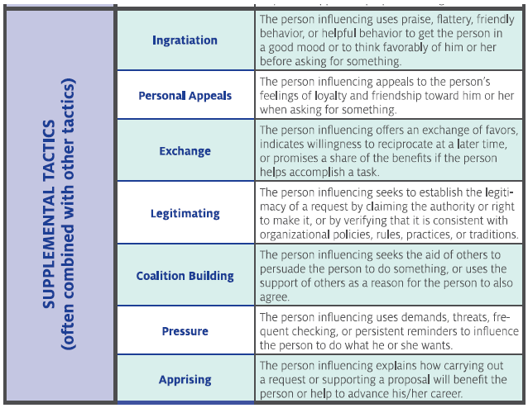
Influencing strategies
Explore additional strategies to engage with stakeholders
Notes:
Think about which tactics you use and which you think may be most effective when dealing with different stakeholders at different stages of the adoption and implementation.

Slide 16
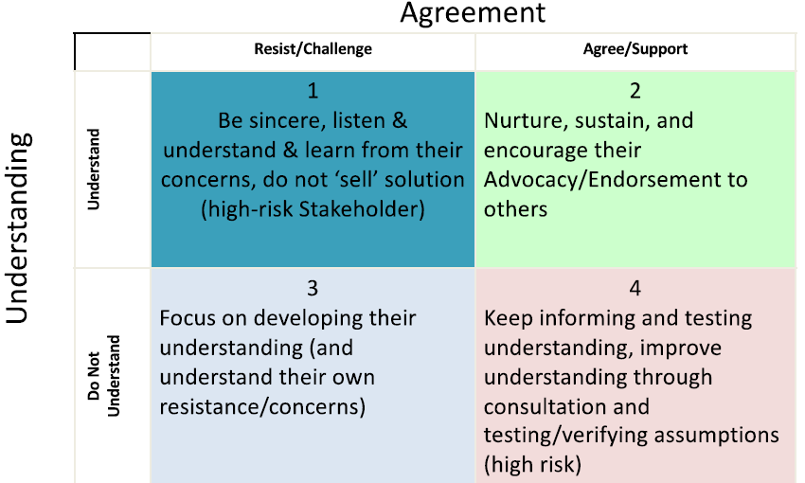
How to achieve commitment from stakeholders
Think of how you engage with stakeholders and consider ways to keep them involved throughout the NSS standards review and adoption process so they feel committed to the outcome
Consider each stakeholder and identify their level of understanding and agreement on the importance of NSS standards. Use the table on the right to understand how to best interact with the stakeholder to develop their understanding.
Notes:
Thank about what strategies and specific tactics would be important to become committed to review, adoption, and implementation on NSS standards.
This strategy can be used for any standard– not just NSS standards.

Slide 17
the finish line
There is no finish line!
Building strong stakeholder connections before national review will strengthen the value and reach of NSS standards review, adoption, and implementation.
Publication and adoption is not the end of your commitment:
Ensure that you are connected to the right people to see these standards implemented in your country.
Follow through with your stakeholder groups to support them in their implementation.
Continue knowledge sharing by hosting informational and technical sessions.
Notes:
Visit ANSI’s English Toolbox to download more powerpoints to guide you on steps to take after national adoption: https://sanitation.ansi.org/EnglishToolbox

Slide 18
https://sanitation.ansi.org/
sanitation@ansi.org

