Slide 1
Case studies of international standards supporting public policy
Jeffrey G. Weiss Tyler G. Welti
Partner Counsel
Venable LLP Venable LLP

Slide 2

Case Studies of International Standards Supporting Public Policy

Slide 3
Case Studies of International Standards Supporting Public Policy
We will evaluate several examples of international standards that have advanced public policy
(1) Earthen Building Materials
(2) Denatured Ethanol as a Cooking Fuel
(3) Cement Production
(4) LED Standards
(5) Environmental Technology Verification for Emerging Technologies

Slide 4


Case Studies
(1) Earthen Building Materials
  Earthen Walls (ASTM E2392)
  Earthen Floors (ASTM WK 64123) (RS 311:2016)

Slide 5
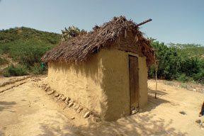
Case Studies
Earthen Building Materials: Earthen Walls
The policy issue:
  More than a billion people live in earthen homes, many of which are at risk from earthquakes.
  Some developing countries in the 1990s outlawed earthen buildings but did not provide economically feasible alternatives.
  Haiti earthquake highlighted pressing
  need for guidelines that local builders
  could follow using traditional, affordable
  materials available locally.

Slide 6
Case Studies
Earthen Building Materials: Earthen Walls
Engineers and other stakeholders set out to determine how to build seismically safe earthen buildings that:
  Use locally available materials and techniques
  Are affordable, climate-appropriate, and aesthetically pleasing
Determined that the best way to get that knowledge out was to develop and publish a recognized standard
  Target markets: (1) areas where earthen buildings are preferred for economic or cultural reasons; and (2) areas with new/reviving interest in earthen architecture

Slide 7
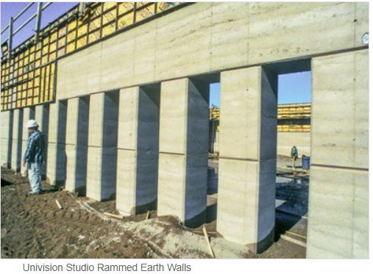
Case Studies
Earthen Building Materials: Earthen Walls
ASTM 2392:
  Contains both design and performance elements.
  Addresses sustainability issues related to the use of earthen wall building systems (e.g., materials, manufacturing process, operational performance, indoor
  environmental quality)

Slide 8
Case Studies
Earthen Building Materials: Earthen Walls
ASTM 2392 is an example of a standard that:
  Takes local practices/ traditions into account while improving safety
  Disseminates knowledge of best practices to local people
  Provides validation to government officials and decision makers of an alternative material
  Demonstrates the value of a leading standards body’s approval of a new technology in a developing country
  Improves government procurement and private funding—relief funds in Haiti could go further
  Benefits local economies by improving skills in providing an improved product and safe, desirable housing
  Addresses a pressing problem in developing countries that is also used in developed countries

Slide 9

Case Studies
(1) Earthen Building Materials: Earthen floors
The policy issue:
  Over 1 billion people in the world currently are living on dirt floors
  Living in a home with dirt floors increases exposure to bacterial infections, parasites, and other pathogens
  Commercial flooring options are not an affordable option
EarthEnable in Rwanda developed methods to improve earthen floors using local materials and a sealant
  Costs 75% less than cheapest concrete solution
  Improves public health outcomes caused by dirt floors

Slide 10
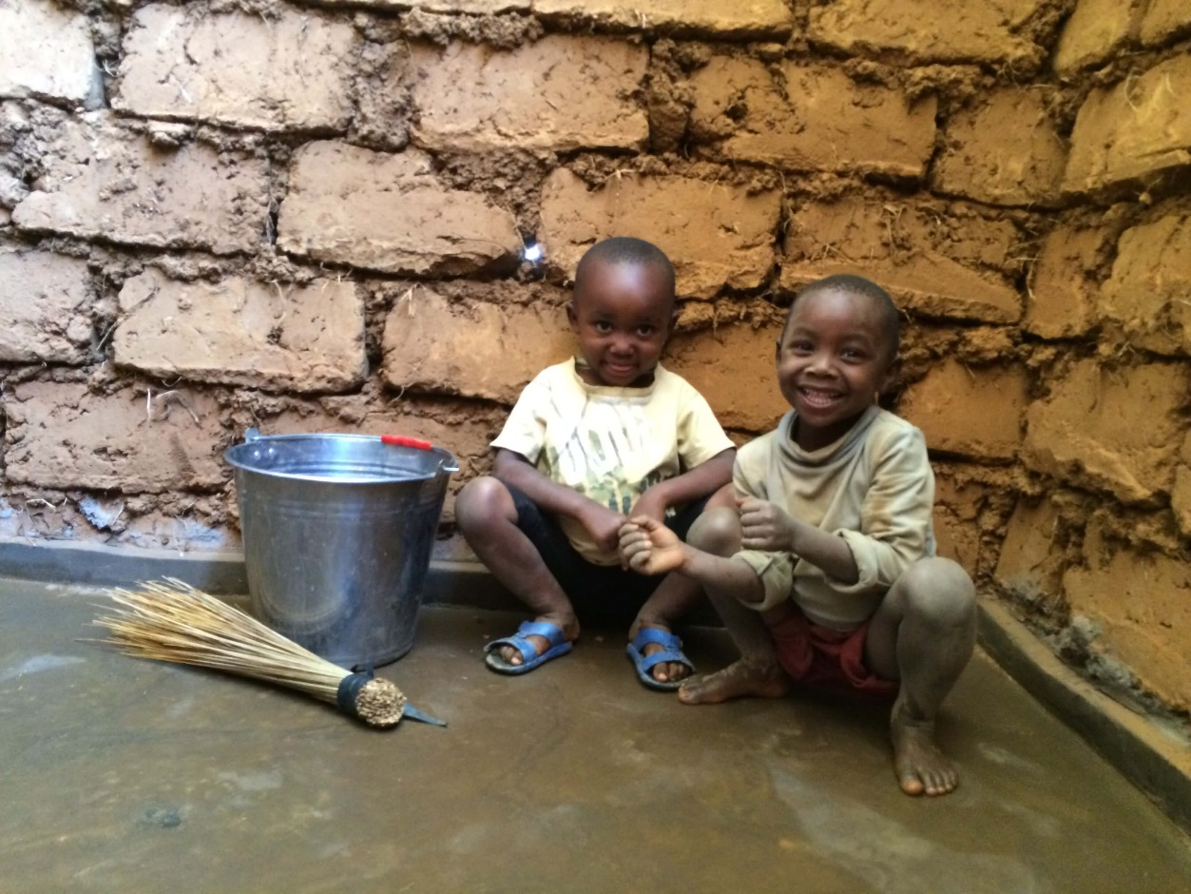
Case Studies
(1) Earthen Building Materials: Earthen floors
Before After

Slide 11


Case Studies
(1) Earthen Building Materials: Earthen floors
EarthEnable sought the development of standards to help spread use of improved earthen floor technologies and create related businesses
RS 311:2016: Rwanda developed a performance standard for earthen floors
  Advantage is that it was developed with the participation of local engineers, written in a language that they can understand and test to
  But EarthEnable found that the recognition associated with an international standards organization was needed to bring the technology to other African nations
ASTM WK 64123: ASTM began developing an international standard in June 2018
  Performance tests written to be
  applied as simple tests that do not
  require expert training

Slide 12
Case Studies
(1) Earthen Building Materials: Earthen floors
Lessons from ASTM WK 64123 / RS 311:2016:
  Name recognition and trust associated with a sophisticated international standards body is important in the developing world
  Standards can create markets, helping businesses grow and technology spread, by helping gain the approval and trust of national governments and build confidence of consumers
    EarthEnable has installed over 3,000 earthen floors in Rwanda thus far
  Where local labor will be used to make a product and ensure performance standards are met, local input in developing a standard is especially important

Slide 13
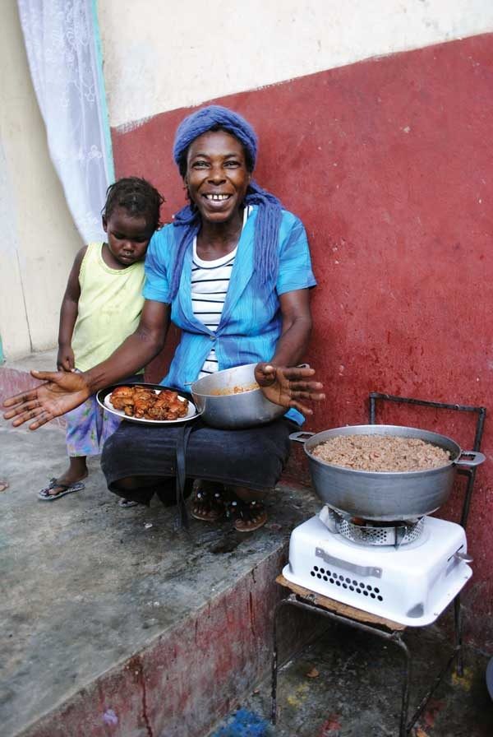
Case Studies
(2) Denatured Ethanol as a Cooking Fuel
Policy issue:
  Cooking with traditional fuels like wood and coal causes indoor air pollution and significant health risks
  Using ethanol cooking fuels reduces these risks
  Also creates other public benefits:
    Reduces deforestation
    Saves time and increases personal safety (eliminates
    fuel gathering)
    Promotes agriculture and a self-sustaining local
    business where local farmers may grow fuel sources
    that factories distill into ethanol

Slide 14
Case Studies
(2) Denatured Ethanol as a Cooking Fuel
ASTM E3050
  Performance standard designed to realize benefits of ethanol cooking fuels while avoiding problems with previous attempts to market it in the developing world
  For example, it establishes requirements to:
    Protect consumers from purchasing low-quality fuel that can damage stoves
    Prevent human ingestion
    Lower business costs by reducing confusion regarding the proper customs classification of the product for import purposes
    Include an additive that has bitter taste and colored die to distinguish cooking ethanol from other types of ethanol

Slide 15


Case Studies
(2) Denatured Ethanol as a Cooking Fuel
Following successful pilot projects and a workshop, ASTM E3050 adopted and implemented at national level in Uganda
So far an economic success, too
  Uganda’s leading sugar producer, Kakira Sugar (a participant in the workshop), recently opened East Africa’s largest ethanol distillery in Uganda

Slide 16
Case Studies
(2) Denatured Ethanol as a Cooking Fuel
ASTM E3050 is an example of a standard that:
  Reduces a product’s cost by helping eliminate market inefficiencies/failures
  Eliminates confusion about a product
  Helps customs and regulatory authorities enforce the law
  Improves the safety of a product for consumers
  Increases consumer awareness and acceptance of a product
  Furthers multiple public policy goals, including those related to public health and safety, environmental conservation, and economic development

Slide 17

Case Studies
(3) Cement Production
Policy issue
  Reducing the amount of “clinker” in cement reduces production costs for cement and improves environmental performance
Holcim used a Lebanese national cement standard – NL 53:1999 (based on a European standard) – to bring an alternative to traditional Portland cement to the market
  Having a standard transformed the cement market in Lebanon, providing Holcim’s customers with trust/confidence that the product, even though it was lower in clinker, would perform well. It would have been a very tough sell to customers without having a standard in place.
Holcim also used ISO management standards to improve its business performance:
  ISO 9001:2008 for quality management
  ISO 14001:2004 for environmental management

Slide 18
Case Studies
(3) Cement Production
NL 53 is an example of a standard:
  Helping to de-risk investment in an emerging technology
  Improving consumer confidence in a new product (enabling market acceptance)
  Providing cost savings to businesses
  Driving private investment in a particular technology
  Furthering multiple public policy goals, including those related to environmental conservation and economic development

Slide 19
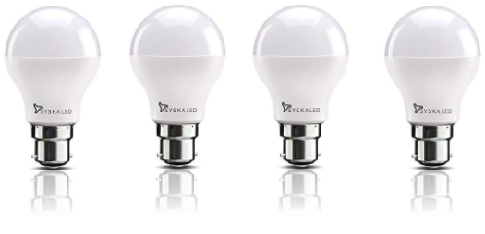
Case Studies
(4) LED Standards
Public policy issue
  New LED technology promotes public benefits of energy savings and cost savings
Shenzhen LED Standards Alliance used standards to:
  Assure customers of the quality of a new technology (product certification and marketing)
  Promote interchangeability of component parts
  Establish testing procedures for installations of LED public street lights
  Establish energy efficiency requirements for LED products
Standards allowed greater availability of the product to meet market demand and drive down costs

Slide 20
Case Studies
(4) LED Standards
The LED standards example illustrates that standards can:
  Increase consumer confidence in a new technology and thereby help new products take hold
  Reduce costs to businesses by promoting consistency and best practices along the supply chain
  Improve public procurement decisions (e.g., by converting street lights of older technology to LED, Shenzhen’s government achieved significant energy savings)
  Further public policy goals of environmental conservation and economic development

Slide 21
Case Studies
(5) Environmental Technology Verification for Emerging Technologies
Policy issue:
  New environmental technologies can face difficulty obtaining market acceptance because they lack a track record.
International standards for Environmental Technology Verification (ETV) provide a way to evaluate new products by:
  Verifying manufacturing claims (e.g., claims that a new product is made from sustainable materials)
  Verifying performance claims (e.g., claims about a new product’s environmental impact)
  Providing independent and credible assessments that promote public acceptance of new market entrants
  Differentiating among competing solutions

Slide 22
Case Studies
(5) Environmental Technology Verification for Emerging Technologies
International standards for ETV identify consensus-based verification principles, testing practices, and reporting requirements that can be used to assess the environmental performance claims of new products
  ISO 14304:2016, Environmental Management – Environmental Technology Verification
  ASTM D6866, Standard Test Methods for Determining the Biobased Content of Solid, Liquid, and Gaseous Samples Using Radiocarbon Analysis
A standardized verification process assures consumers of the credibility of claims verified in accordance with the standard

Slide 23

Case Studies
(5) Environmental Technology Verification for Emerging Technologies
USDA BioPreferred Program (federal procurement program) promotes the purchase of goods that incorporate bio-based product materials as an alternative to petroleum-based product materials
ASTM D6866 is used to verify claims made by producers of goods that are part of the BioPreferred Program

Slide 24
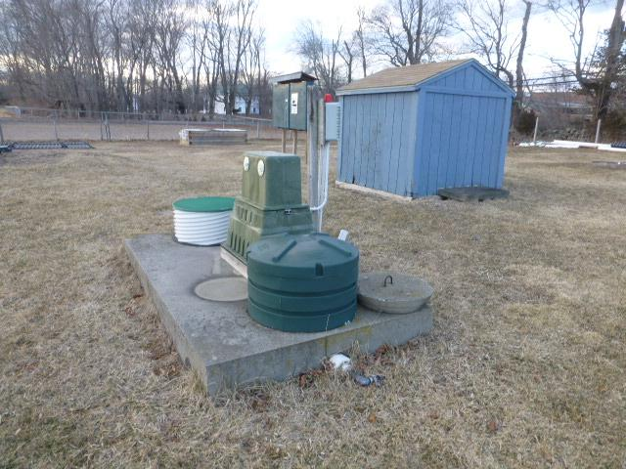

Case Studies
(5) Environmental Technology Verification for Emerging Technologies
EPA Advanced Septic System Nitrogen Sensor Challenge
ISO 14034 used to verify prototypes submitted to the Challenge
Participation in the Challenge incentivized by the potential prize of possible future business
  Funding to purchase up to 200 units of the best performing sensor(s) is being sought by The Nature Conservancy and others
The Challenge is meant to spur innovators to develop new technologies

Slide 25
Case Studies
(5) Environmental Technology Verification for Emerging Technologies
ASTM D6866 and ISO 14304 are examples of standards:
  Providing the tools to assure consumers and regulators that emerging technologies perform as advertised
  Increasing consumer trust in a new technology by providing confidence that product claims can be verified and thus helping the technology take hold
  Enabling informed consumer choice
  Leveling the playing field between competing businesses
  Improving competition in new technologies and spurring new innovations
  Driving commercialization in conjunction with government incentives such as labels and challenges, which may present cash prizes or privately-funded market stimulation opportunities

